Slide 1
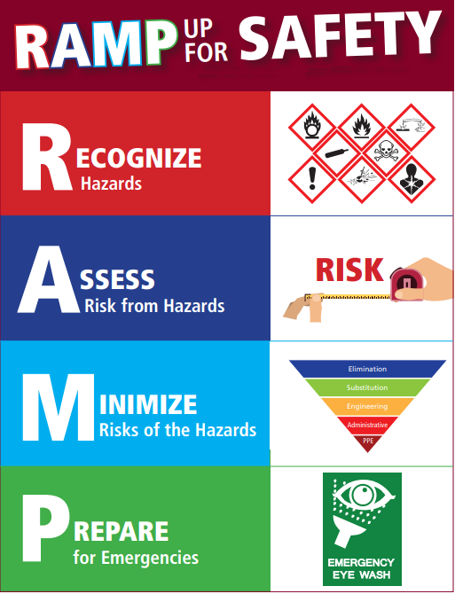
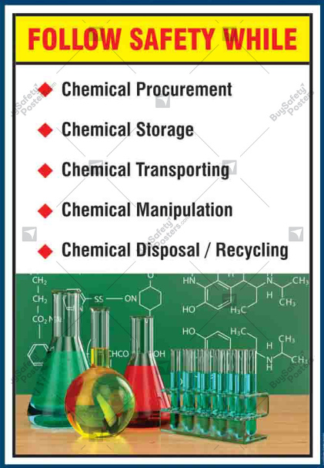
HAZCHEM Safety

Slide 2
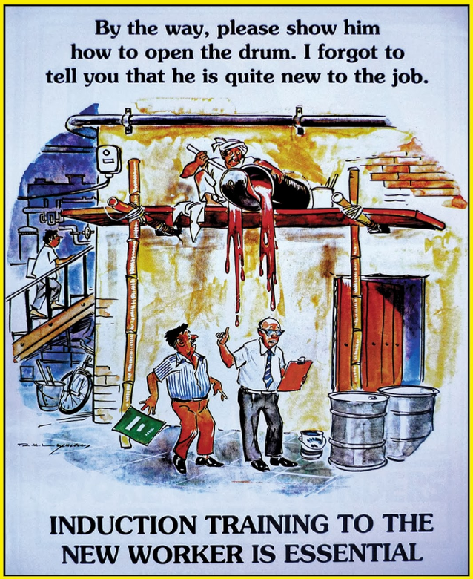
Induction and Training
Not inducted and trained ? – Say No to START work!!
Ask for training

Slide 3
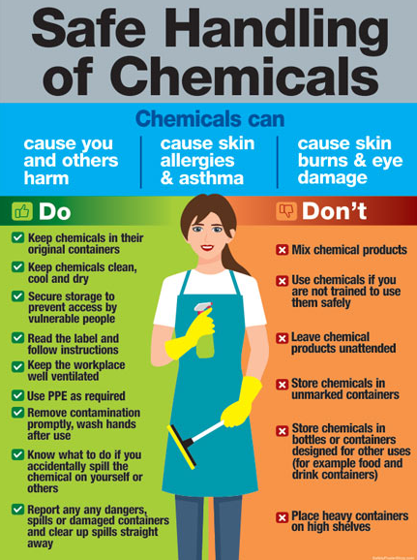
Do’s and Don’t s

Slide 4

Pre-purchase Requirements- Permits, Licences
Verify if the chemical falls into the following categories:
Scheduled Poison
Scheduled Carcinogens
Chemicals of Security Concern (SSDS)
Industrial chemicals (Imported from overseas)
Ensure Permits/Licences are aquired, and WHS & Wellbeing notified before Procurement..

Slide 5
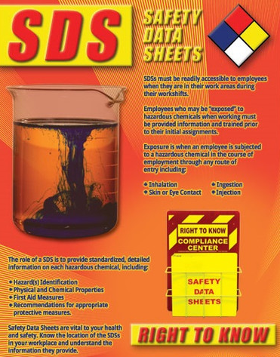
Right to Know & Access SDS..

Slide 6
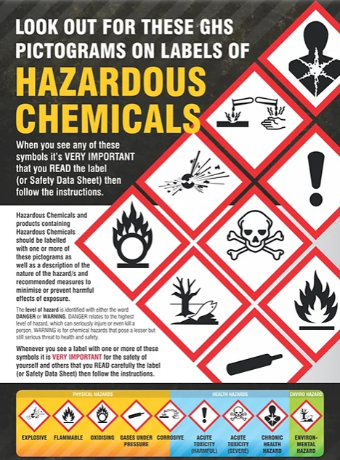
Check for GHS compliant labelling!
GHS is Mandatory in Australia.
All containers with chemicals must have minimum GHS complaint label.

Slide 7
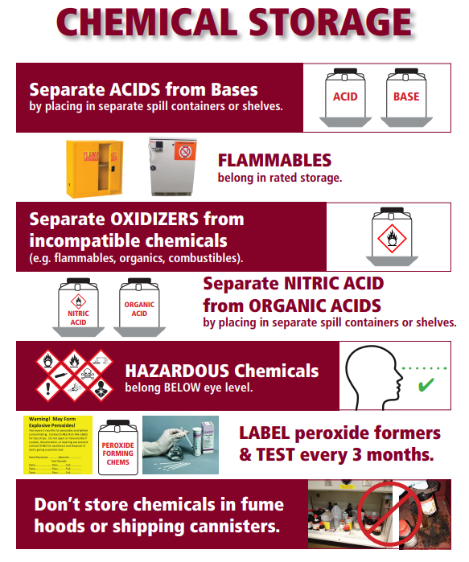
Ensure appropriate Chemical storage
Know the right storage location
Refer to incompatibility Guide for segregation

Slide 8
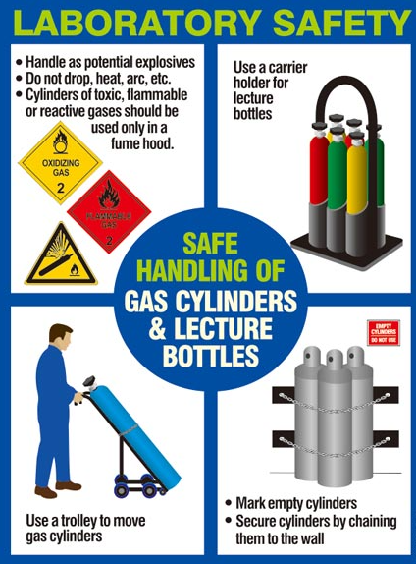
Gas Cylinder Safety

Slide 9
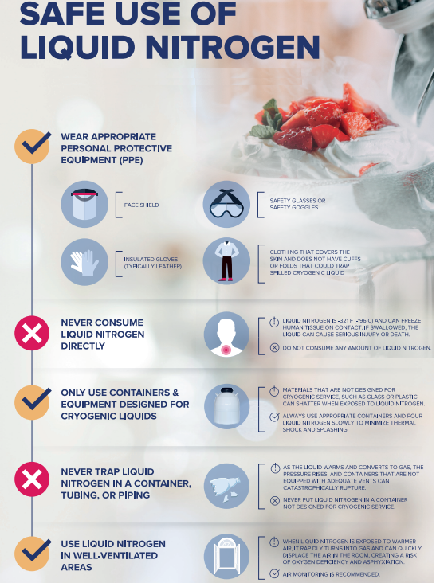
Liquid Nitrogen Safety

Slide 10
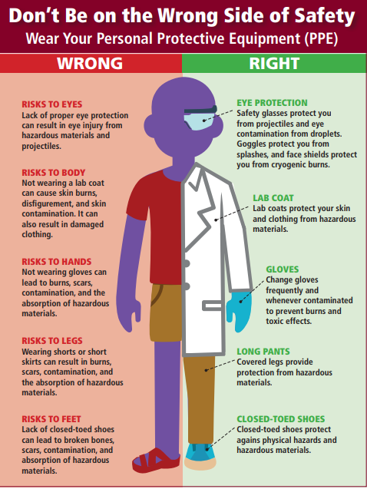
Use the right PPEs
The Right Way!!!!

Slide 11
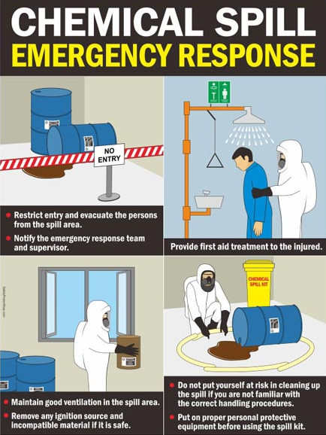
Emergency Response to Chemical Spills…
Do you know the location of Chemical Spill Kits?
Are you trained and confident to use Chemical Spill kits?

Slide 12
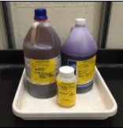

Appropriate containers and vented caps in use?
Maximum 75% capacity of the container followed ?
Are Hazardous Waste labels available?
Checked SDS for incompatibility before mixing?
Are the containers placed in secondary containers until disposal?
No hazardous chemical substances should be disposed down drains.
Chemical Waste Storage and
Disposal appropriate?

Slide 13

Thank You!
Contact WHS & Wellbeing –whs@westernsydney.edu.au

