Slide 1
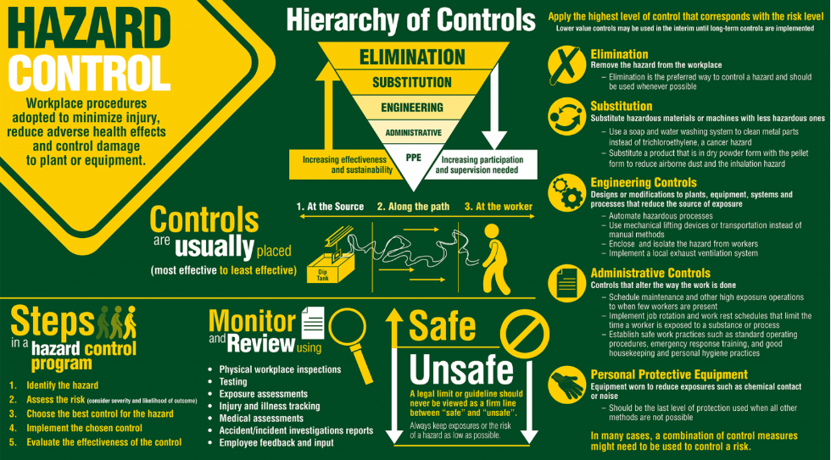
Hazard/Risk Assessment Factsheet

Slide 2
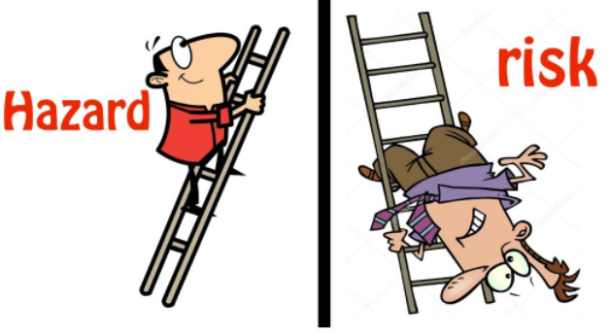
Hazard vs Risk
Hazard
Risk
Likelihood or chance that a person or people being harmed when exposed to the hazard/s
Risk = Hazard x Occurrence (likelihood)
A source, situation or an act that has the potential to cause harm (injury, illness, psychological) to a person or people.

Slide 3
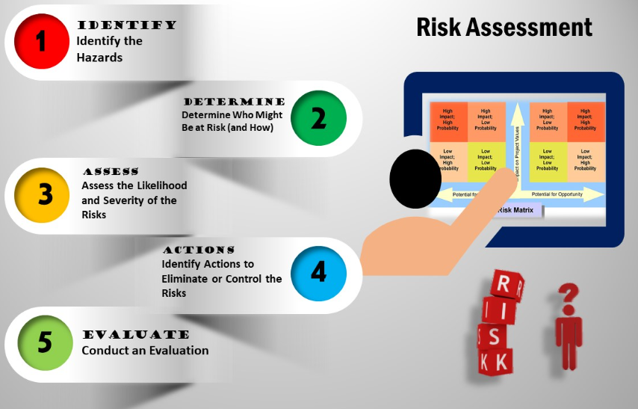
What is a Risk
Assessment?
Risk assessment is a systemic process or method to:

Slide 4
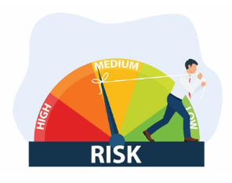
Why is it important to do the RA?
Protection: Key prevention of accidents in workplace, during activities or work process
Awareness: It help raise awareness on any hazards or risks with the potential to cause harm and introduce the appropriate control to eliminate, mitigate or substitute it.
Legal requirement: RA is mandatory for high-risk activities under WHS Regulation 2017.
RA is a step in the risk management process under Code of practice for how to manage work health and safety risks
.

Slide 5
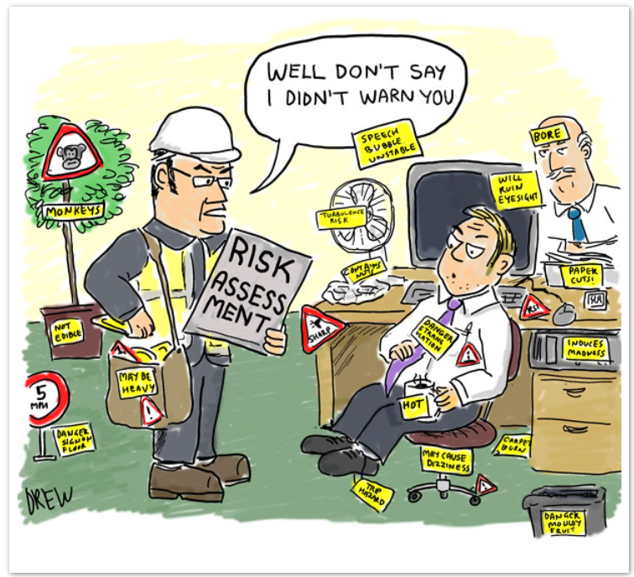
When should you do the Risk Assessment ?
Every time there are new machines, substances or procedures (Irrespective of the type of the task), which could lead to new hazards.

Slide 6

Who should do the Risk Assessment ?
Consult with those directly involved or affected or exposed (eg:- staff and students) as they are the most familiar with the activities and environment.
Consult with health and safety representative (HSR)/WHS & Wellbeing to check if the current control are adequate or if more needs to be implemented.
Communication between all related individual help us better in understanding the situations, activities and environment.

Slide 7
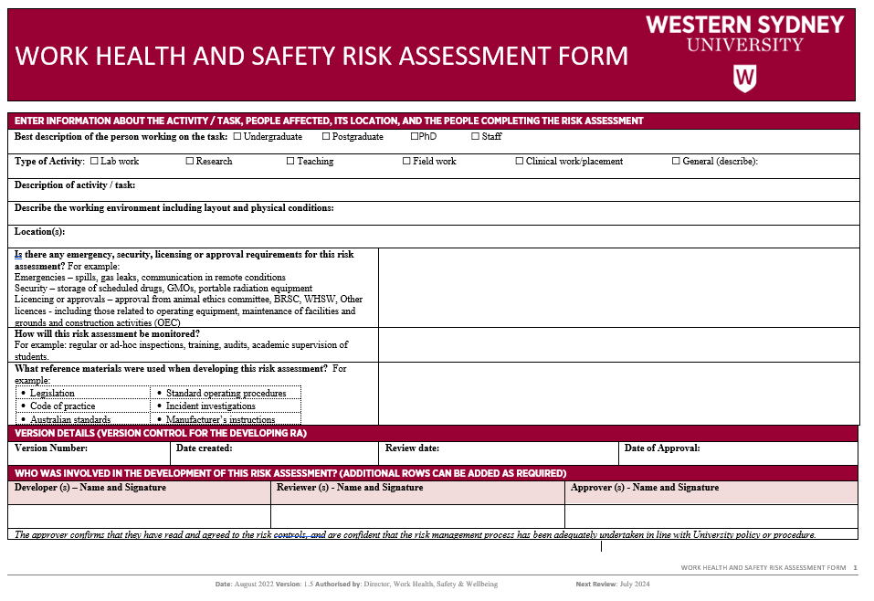
A Risk Assessment Form is available!!!

Slide 8
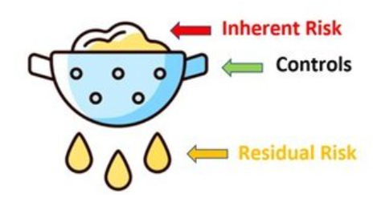
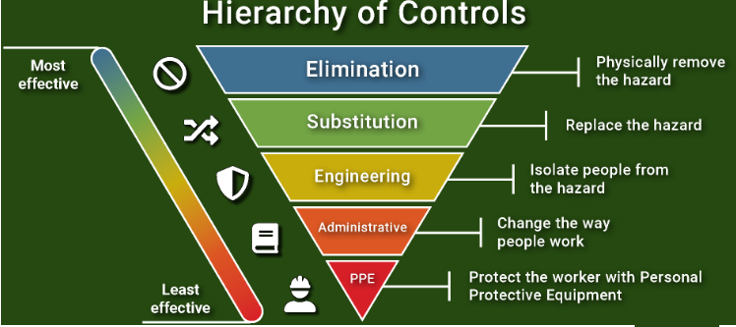
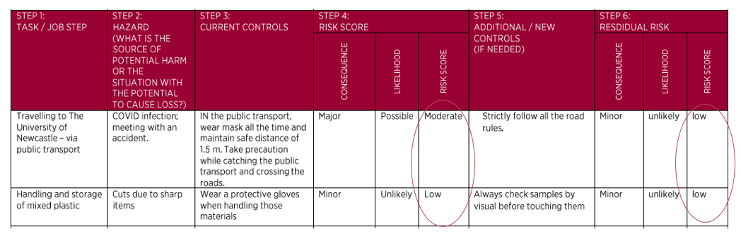
What are the controls in place?
What additional controls you can think of?
Current Controls are already existing controls to keep the risks As Low As Reasonably Practicable (ALARP)
Additional controls must be listed for any risks with initial score equal to or greater than Moderate.
The Residual risk score must be equal to or less than the initial score.

Slide 9
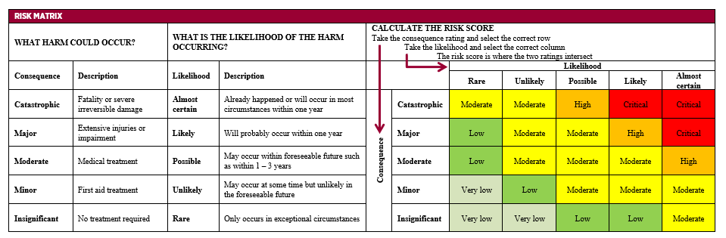
What is the Risk Score for your activity ?
E.g., slips & trips at the construction site
Likelihood = likely (due to terrain); Consequence = Major
Risk score = High

Slide 10

Thank You!
Contact WHS & Wellbeing –whs@westernsydney.edu.au

