Slide 1


Slide 2
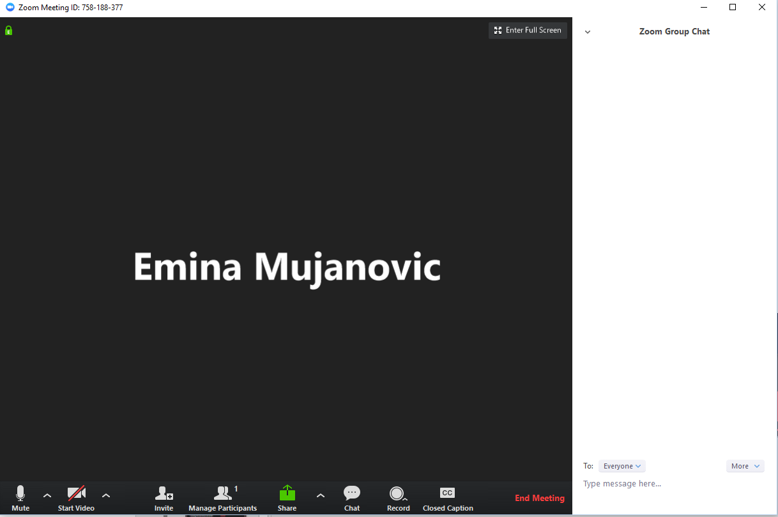
Zoom Chat – Attendance
Before we begin:
Enter your Full name, School and email into the Zoom chat

Slide 3


Zoom into Zoom and Blackboard Collaborate
Presenter: Emina
LEARNING FUTURES

Slide 4



SESSION PLAN
2 PARTS
Blackboard Collaborate and Zoom

Slide 5

SESSION PLAN
Blackboard Collaborate
How do I access Collaborate
A deep look at the interface
Whiteboard and Annotation
Polling
Sharing Screen, Application and Files
Recording and reporting attendance

Slide 6

SESSION PLAN
Zoom
Using chat
Basic navigation and tools within Zoom
Managing participants and sharing of screens/whiteboard
Scheduling and setting up repeat sessions
Polling
Using breakout rooms

Slide 7

SIMILARITIES BETWEEEN ZOOM AND BB COLAB

Slide 8
DIFFERENCES BETWEEEN ZOOM AND BB COLAB

Slide 9
BLACKBOARD COLLOBRATE

Slide 10
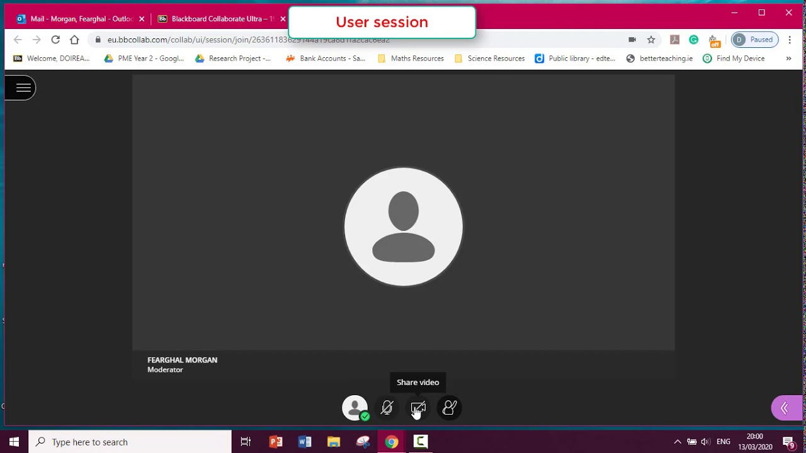
HOW DO I ACCESS
Make sure that the tool link is enabled
Students having access to it – Adding the tool link

Slide 11


DEEP LOOK INTO THE INTERFACE

Slide 12
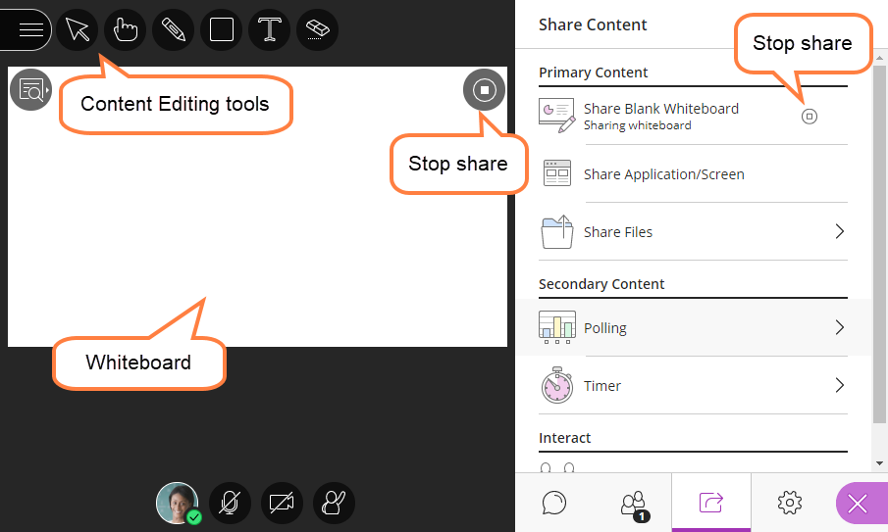
WHITEBOARD AND ANNOTATION
Share whiteboard - https://help.blackboard.com/Collaborate/Ultra/Moderator/Moderate_Sessions/Share_Content#share-whiteboard_OTP-5
Annotation tools - https://help.blackboard.com/Collaborate/Ultra/Moderator/Moderate_Sessions/Share_Content#annotation-tools_OTP-6

Slide 13
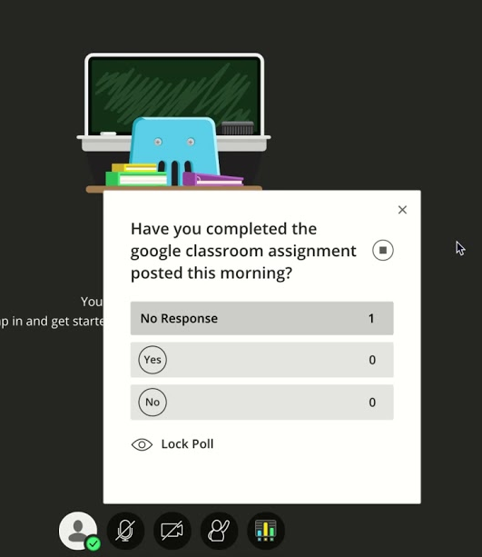

POLLING
Create polls
Monitor your poll
Show responses to attendees
What do attendees see
How do I stop a poll
Download poll results
For more detailed instructions
https://help.blackboard.com/Collaborate/Ultra/Moderator/Moderate_Sessions/Polling
You must create these polls while you are in the session.

Slide 14
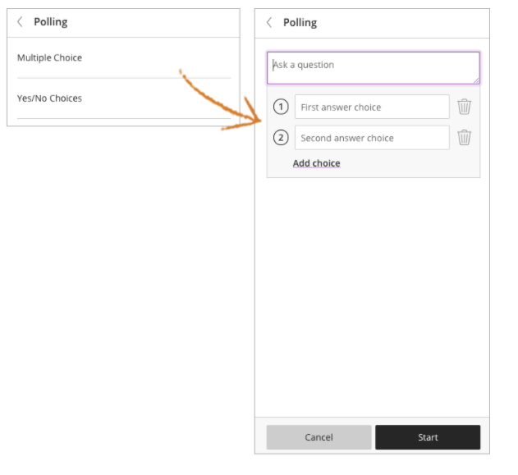

Create polls

Slide 15
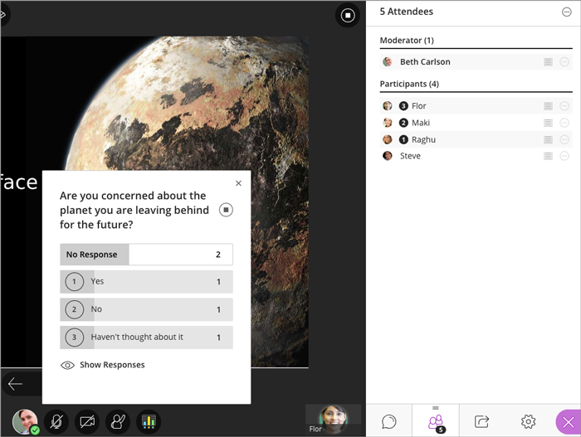
Monitor your poll

Slide 16
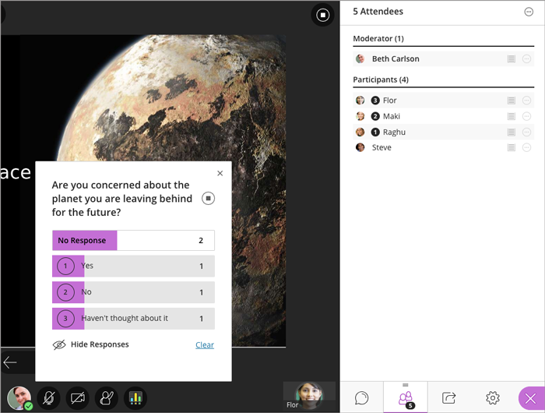

Show responses to attendees – Moderator view

Slide 17
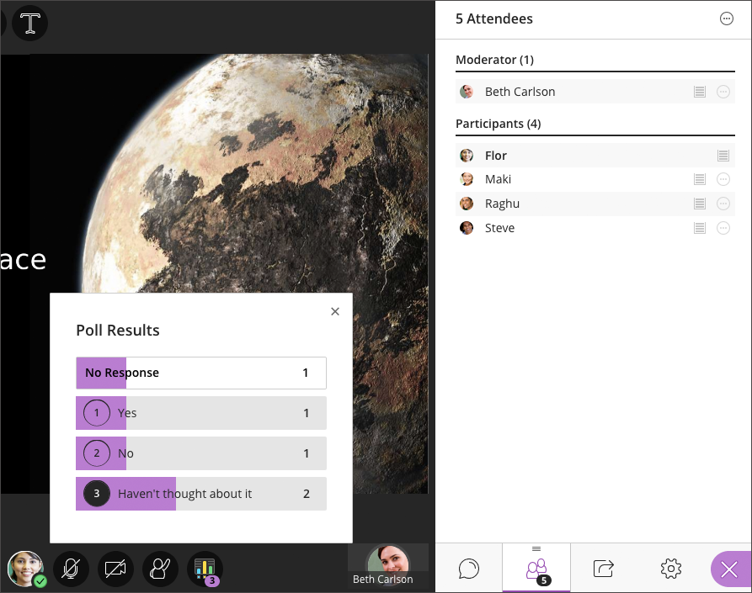
Show responses to attendees – Attendee view

Slide 18
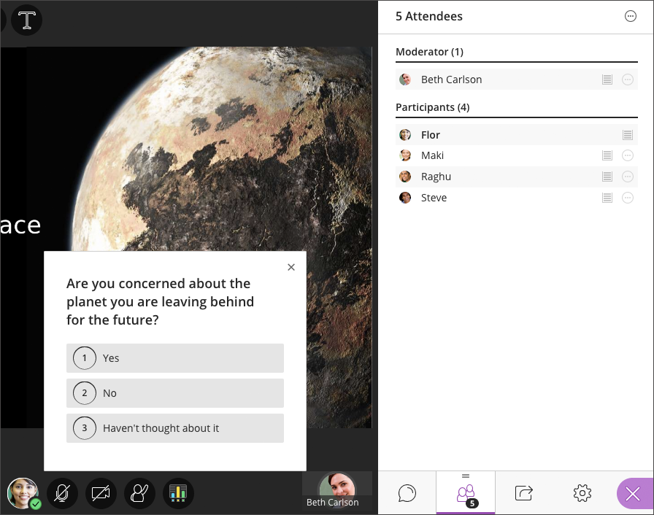

What do attendees see

Slide 19
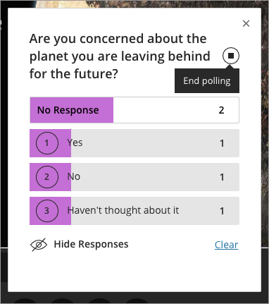
How do I stop a poll

Slide 20

How do I stop a poll

Slide 21
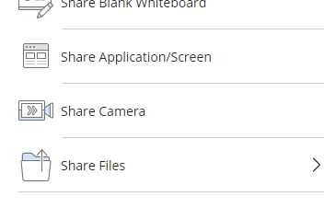

SHARING SCREEN, APPLICATION AND FILES
You can share in 3 different ways
Show you using a demo
https://help.blackboard.com/Collaborate/Ultra/Moderator/Moderate_Sessions/Share_Content

Slide 22
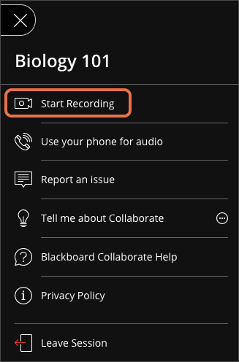
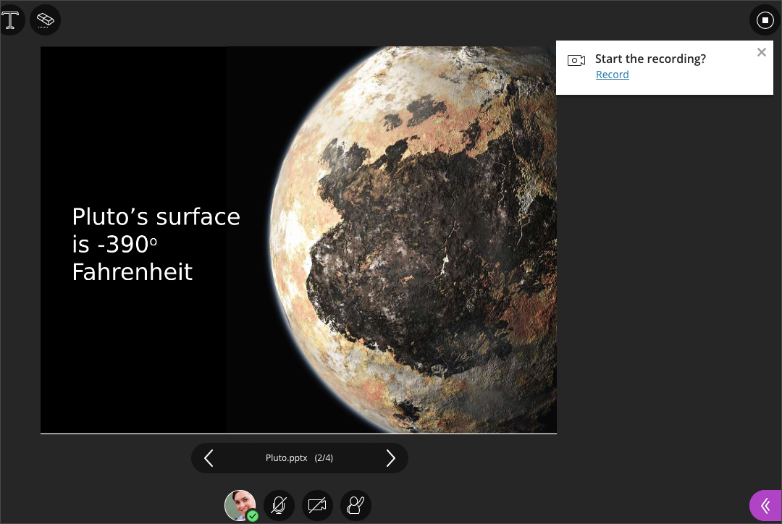
RECORDING AND REPORTING ATTENDANCE
Recording the session - https://help.blackboard.com/Collaborate/Ultra/Moderator/Moderate_Sessions/Recordings
Recording reminder

Slide 23
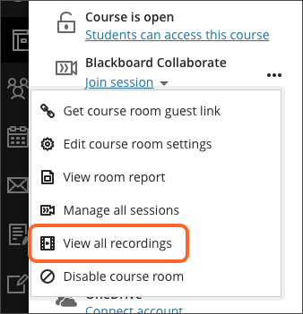
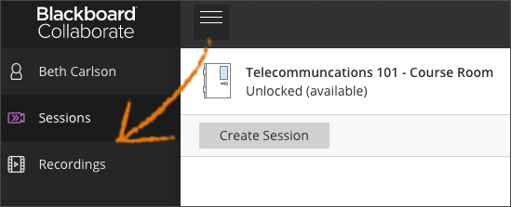
RECORDING AND REPORTING ATTENDANCE
Where to find your sessions after they have been recorded

Slide 24
ZOOM

Slide 25
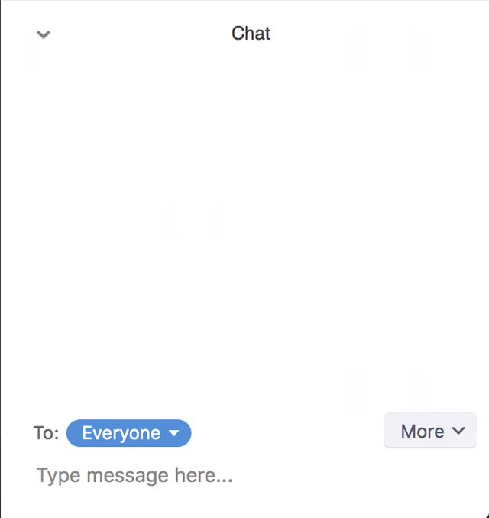
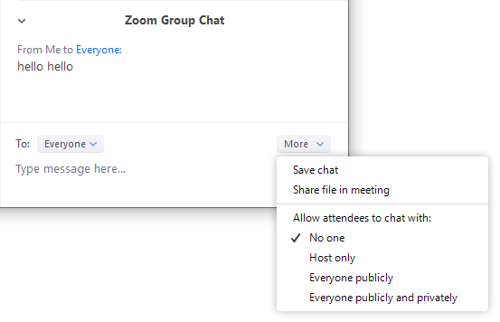

USING CHAT
Using in-meeting chat - https://support.zoom.us/hc/en-us/articles/203650445-In-Meeting-Chat

Slide 26
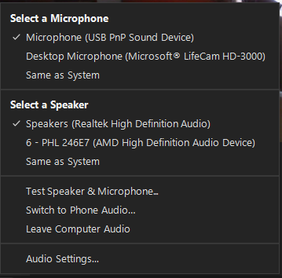
BASIC NAVIGATION AND TOOLS WITHIN ZOOM

Slide 27
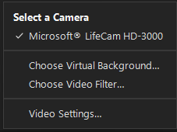
BASIC NAVIGATION AND TOOLS WITHIN ZOOM

Slide 28
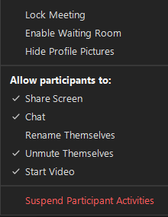
BASIC NAVIGATION AND TOOLS WITHIN ZOOM

Slide 29
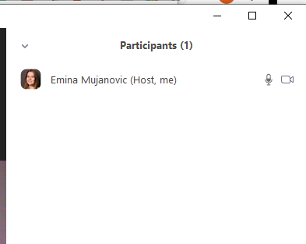
BASIC NAVIGATION AND TOOLS WITHIN ZOOM

Slide 30
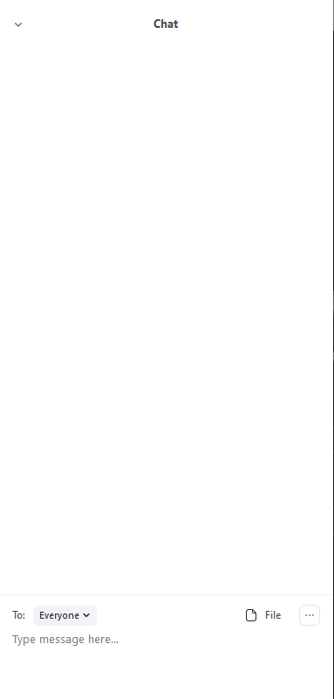
BASIC NAVIGATION AND TOOLS WITHIN ZOOM

Slide 31
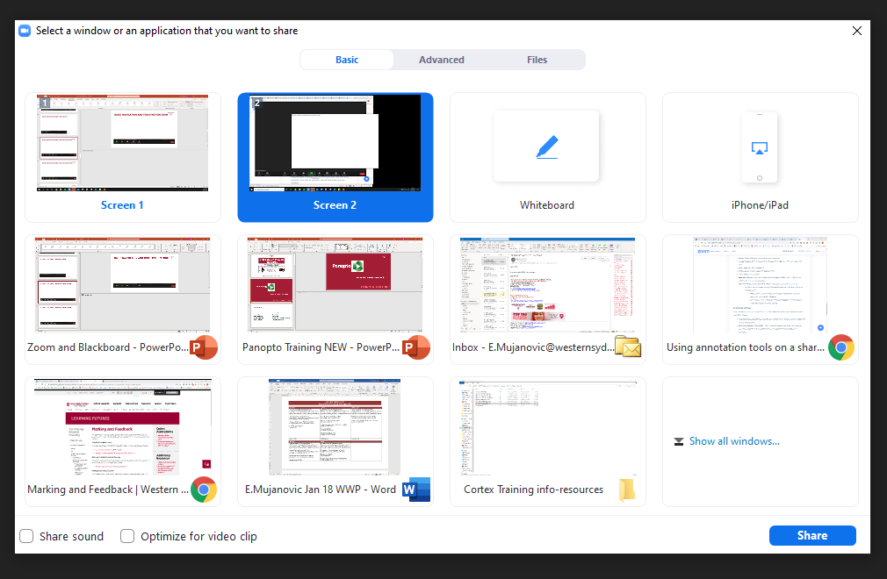
BASIC NAVIGATION AND TOOLS WITHIN ZOOM

Slide 32

BASIC NAVIGATION AND TOOLS WITHIN ZOOM

Slide 33
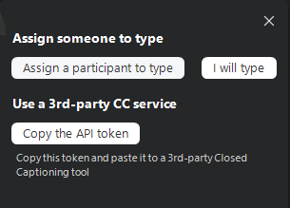
BASIC NAVIGATION AND TOOLS WITHIN ZOOM

Slide 34
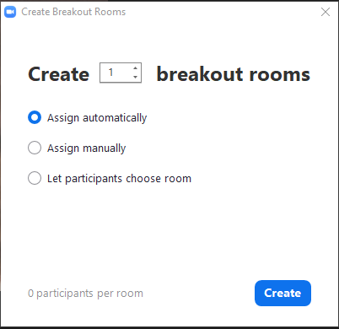
BASIC NAVIGATION AND TOOLS WITHIN ZOOM

Slide 35
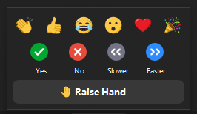
BASIC NAVIGATION AND TOOLS WITHIN ZOOM

Slide 36
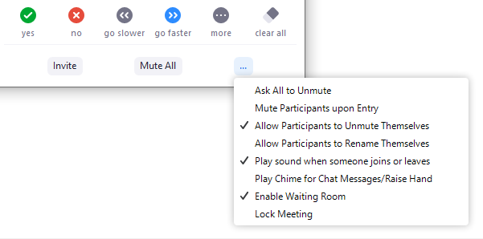

MANAGING PARTICIPANTS AND SHARING OF SCREENS/WHITEBOARD
Managing participants - https://support.zoom.us/hc/en-us/articles/115005759423-Managing-participants-in-a-meeting

Slide 37

MANAGING PARTICIPANTS AND SHARING OF SCREENS/WHITEBOARD
Annotation tools - https://support.zoom.us/hc/en-us/articles/115005706806-Using-annotation-tools-on-a-shared-screen-or-whiteboard

Slide 38
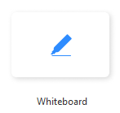
MANAGING PARTICIPANTS AND SHARING OF SCREENS/WHITEBOARD
Whiteboard- https://support.zoom.us/hc/en-us/articles/115005759423-Managing-participants-in-a-meeting

Slide 39

SCEDULING AND SETTING UP REPEAT SESSIONS
Scheduling meetings - https://support.zoom.us/hc/en-us/articles/201362413-Scheduling-meetings
Scheduling recurring meetings - https://support.zoom.us/hc/en-us/articles/214973206-Scheduling-recurring-meetings

Slide 40
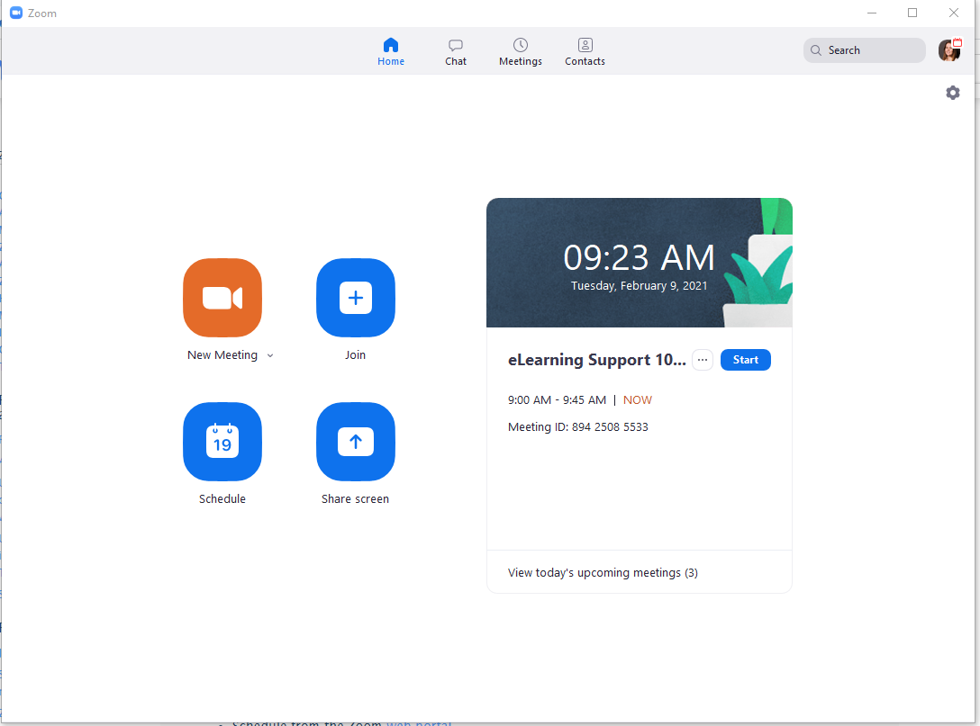

Slide 41
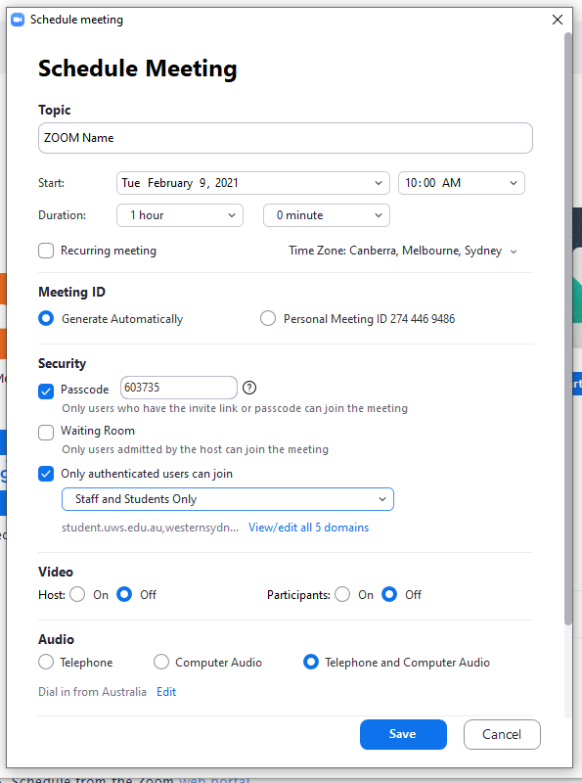


Slide 42
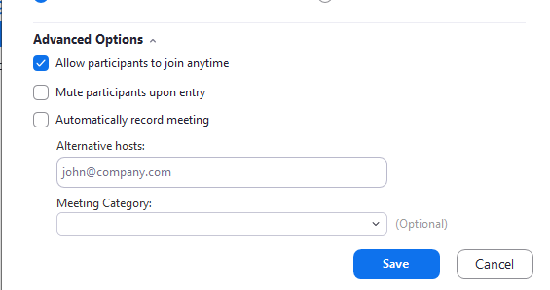

Slide 43
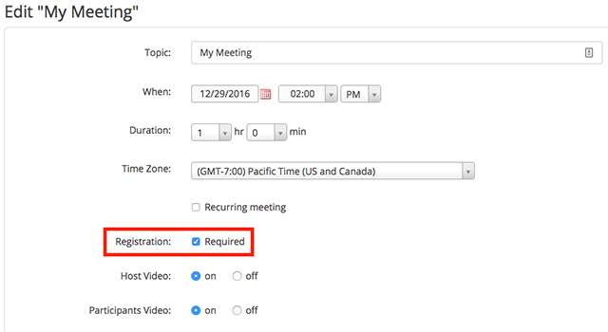

TAKING ATTENDANCE OF A ZOOM SESSION
Taking attendance of a zoom session - https://support.zoom.us/hc/en-us/articles/211579443-Setting-up-registration-for-a-meeting

Slide 44

POLLING
Polling - https://support.zoom.us/hc/en-us/articles/213756303-Polling-for-meetings
Log into Zoom using this link via the web - https://zoom.us/signin

Slide 45
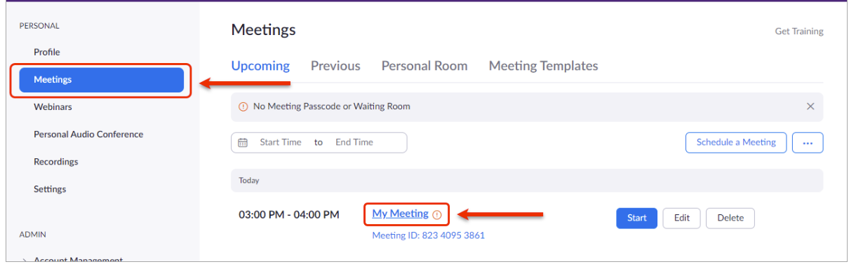
POLLING

Slide 46
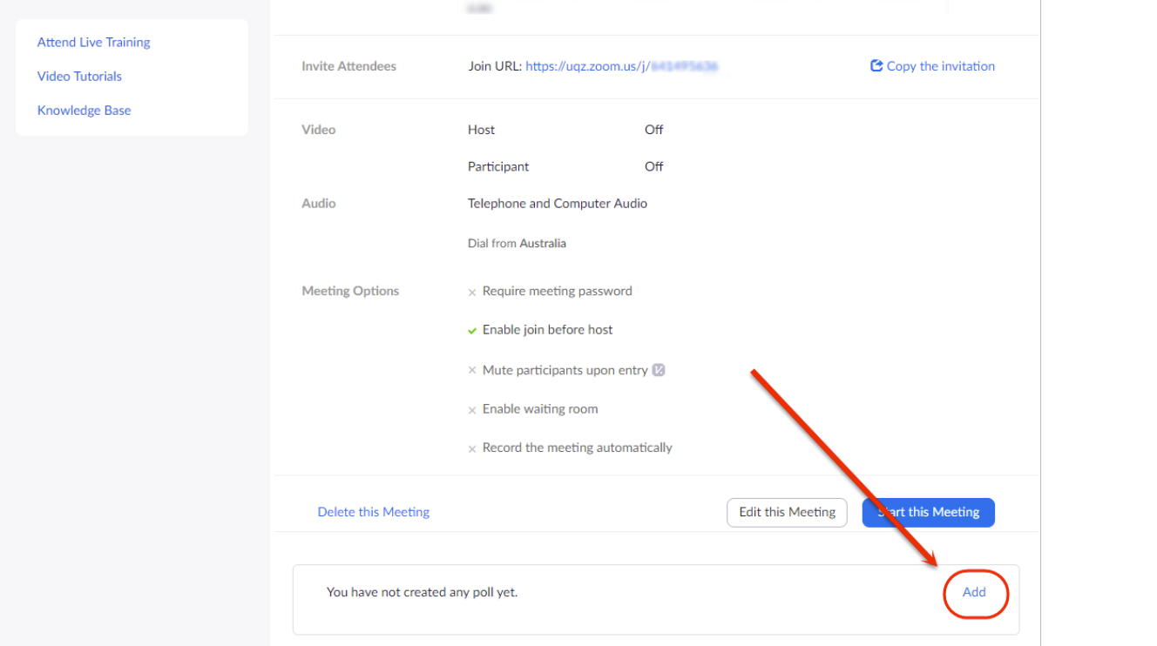
POLLING

Slide 47
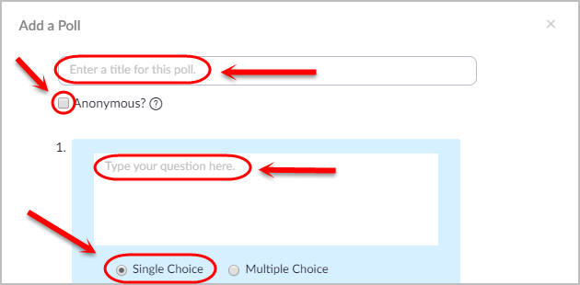
POLLING

Slide 48
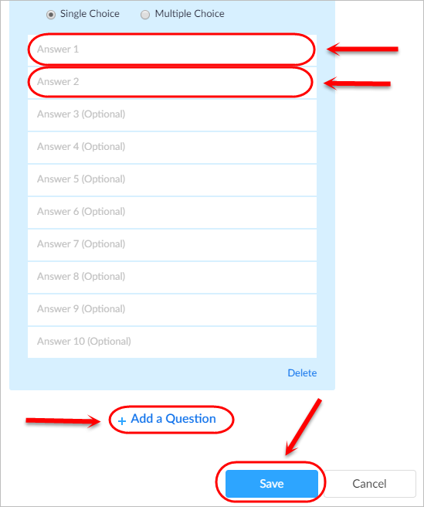
POLLING

Slide 49
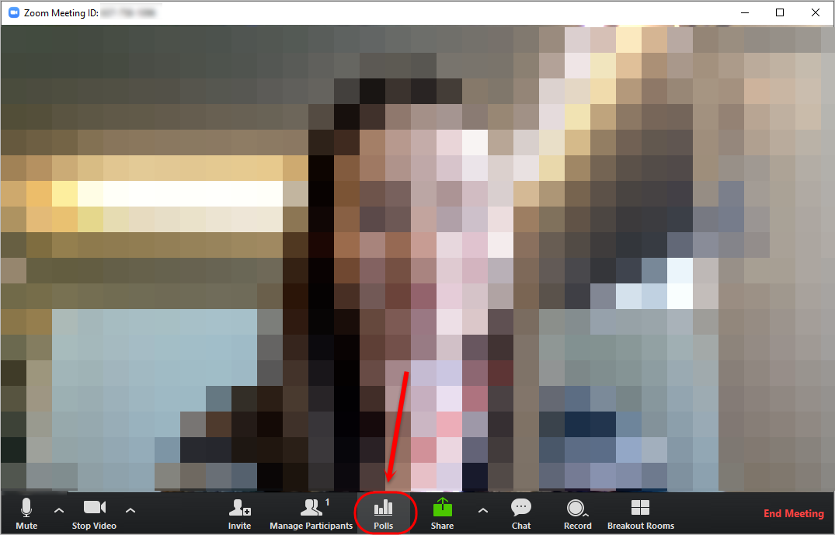
POLLING

Slide 50
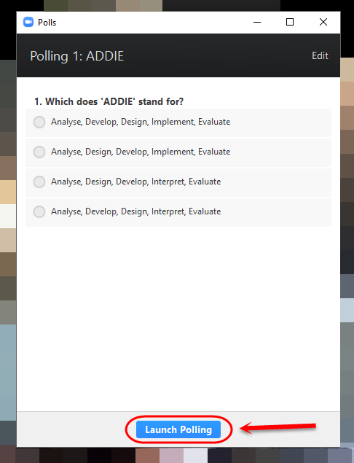
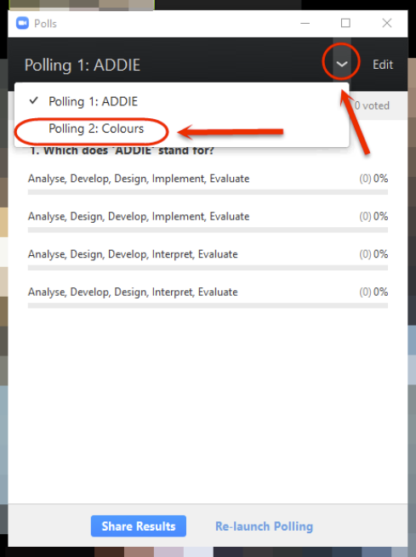
POLLING

Slide 51
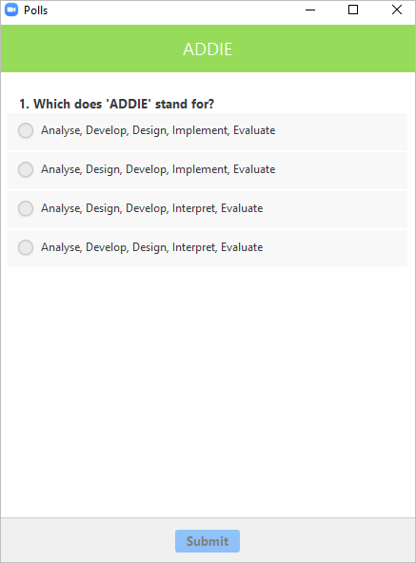
POLLING
Student view

Slide 52
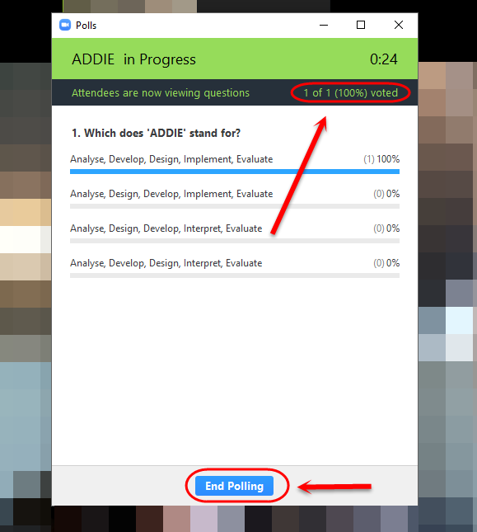
POLLING
Academic view

Slide 53
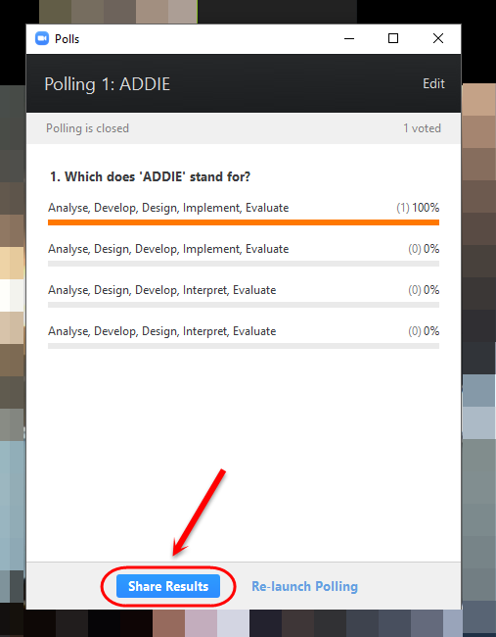
POLLING

Slide 54
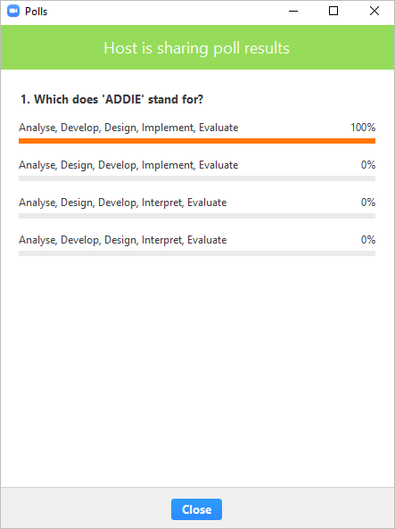
POLLING
Student view

Slide 55
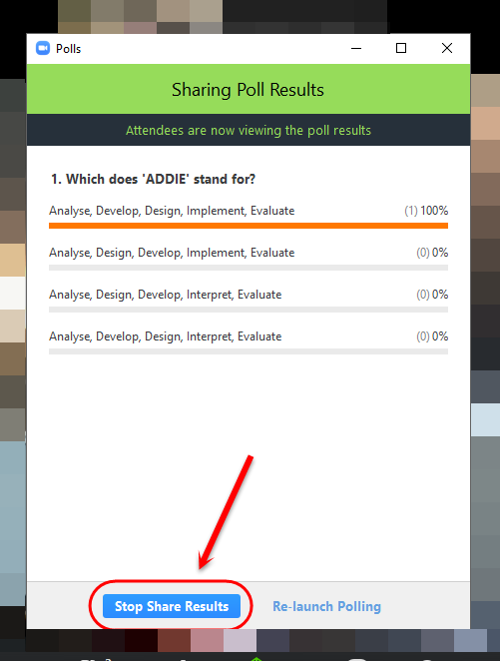
POLLING
Academic view

Slide 56
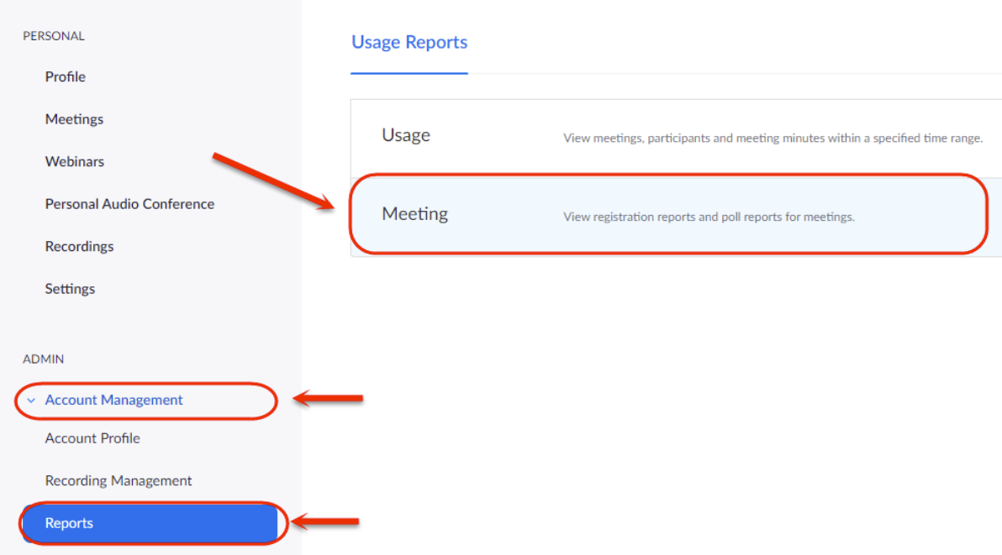
POLLING
Reports for polling or registrations

Slide 57
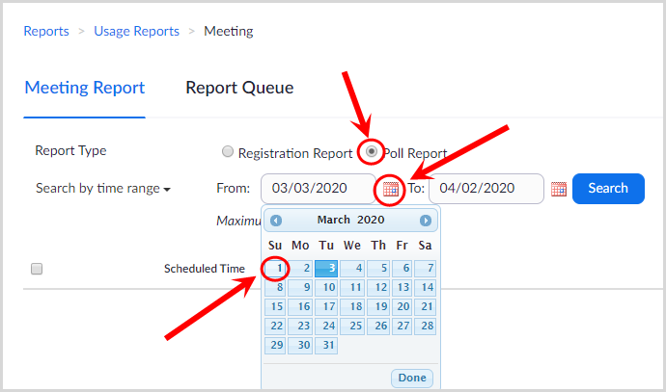
POLLING
Reports for polling

Slide 58
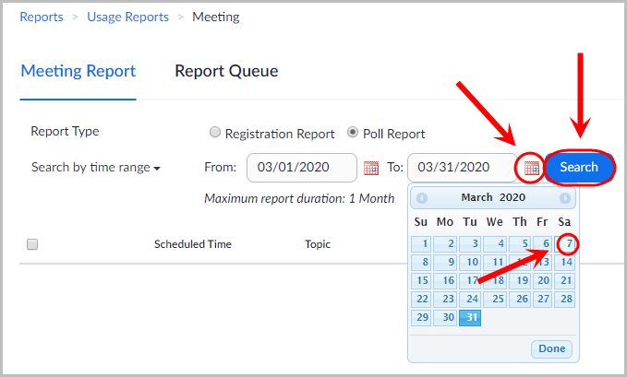
POLLING
Reports for polling

Slide 59
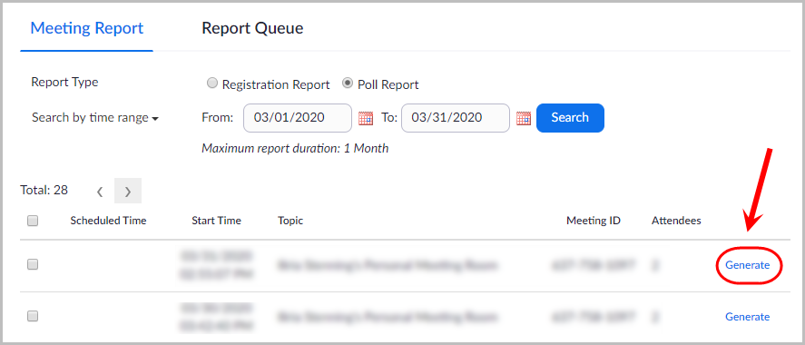
POLLING
Reports for polling

Slide 60
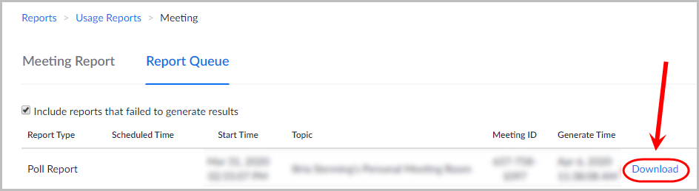
POLLING
Reports for polling

Slide 61

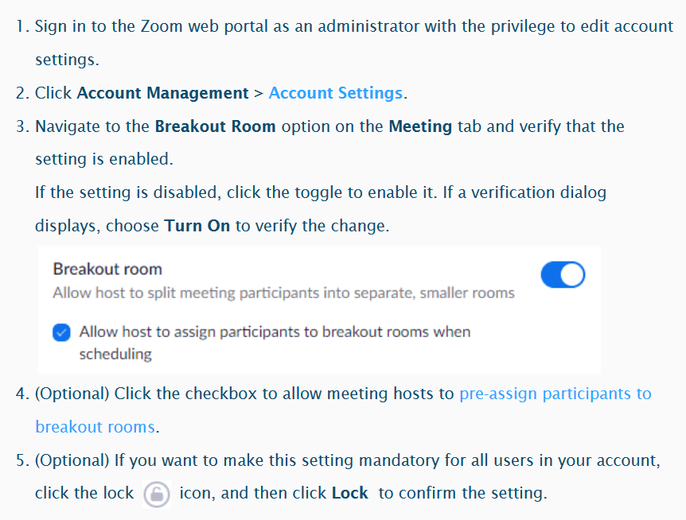
USING BREAKOUT ROOMS
Enabling breakout rooms

Slide 62

USING BREAKOUT ROOMS
Creating Breakout Rooms

Slide 63

USING BREAKOUT ROOMS
Options for Breakout Rooms

Slide 64



USING BREAKOUT ROOMS
Assigning participants to rooms

Slide 65

USING BREAKOUT ROOMS
Preparing Breakout Rooms - Move to (participant): Select a room to move the participant to.

Slide 66

USING BREAKOUT ROOMS
Preparing Breakout Rooms - Exchange (participant): Select a participant in another room to swap the selected participant with.

Slide 67


USING BREAKOUT ROOMS
Preparing Breakout Rooms – Add a room: add another breakout room

Slide 68

USING BREAKOUT ROOMS
Preparing Breakout Rooms – Rename/Delete Room: Rename/Delete the selected room.

Slide 69

USING BREAKOUT ROOMS
What students will see

Slide 70

USING BREAKOUT ROOMS
Broadcasting a message to all the rooms

Slide 71
Support and Resources

Slide 72

eLearning Support One to One (101)
Would you like to learn more about vUWS Blackboard tools and functionalities to enhance teaching and learning experience?
Learning Futures team is now able to offer personalised one-on-one eLearning support session via a zoom appointment. If you have any vUWS related queries, a member of our eLearning support team will support you through a tailored session specific to your needs.
Book a session today using our online form https://forms.gle/23UoDvsvSoybqHgZ6
If you have any additional queries, our contact email is elearning@westernsydney.edu.au
Notes:
Would you like to learn more about vUWS Blackboard tools and functionalities to enhance teaching and learning experience?
Learning Futures team is now able to offer personalised one-on-one eLearning support session via a zoom appointment. If you have any vUWS related queries, a member of our eLearning support team will support you through a tailored session specific to your needs.
Links for Chat:
One on one Consultation link:
https://forms.gle/23UoDvsvSoybqHgZ6

Slide 73


Additional Resources
    Training
Upcoming Sessions
Recorded Sessions
eLearnathon page – Where you will find the PowerPoint slides
Support
Contact eLearning@westernsydney.edu.au
Notes:
Links for Chat:
Upcoming Sessions : https://www.westernsydney.edu.au/digital_futures/dft/services_and_resources/Learning_Futures_Online_Workshops/LF_Workshop_Schedule
Recorded Sessions: https://www.westernsydney.edu.au/digital_futures/dft/services_and_resources/Learning_Futures_Online_Workshops/recorded_sessions
eLearnathon page: https://www.westernsydney.edu.au/digital_futures/dft/services_and_resources/Learning_Futures_Online_Workshops/elearnathon

Slide 74
Feedback
Notes:
NEED LINK???

Slide 75

Tell us what you think!
Quick feedback form :
The URL in the chat. It should only take 2-3min (we promise!)
We actually use your feedback to fine-tune, create and schedule future workshops
Notes:
URL: https://forms.gle/JrUyGf3szvuLTJZc8

Slide 76

Thank you for attending

Slide 77

Notes:
Thank you for your time

