Slide 2
Zoom Chat – Attendance
Before we begin:
Enter your Full name, School and email into the Zoom chat

Slide 3
Panopto Capture
Presenter: Diane Camilleri
Wing: Emina Mujanovic
LEARNING FUTURES

Slide 4
SESSION PLAN
What is Panopto?
What is Panopto Capture?
How to access Panopto Capture
Using Panopto Capture
Options After Recording
Recording Scenarios and Examples
Panopto Video Editing
Questions & Further Resources

Slide 5
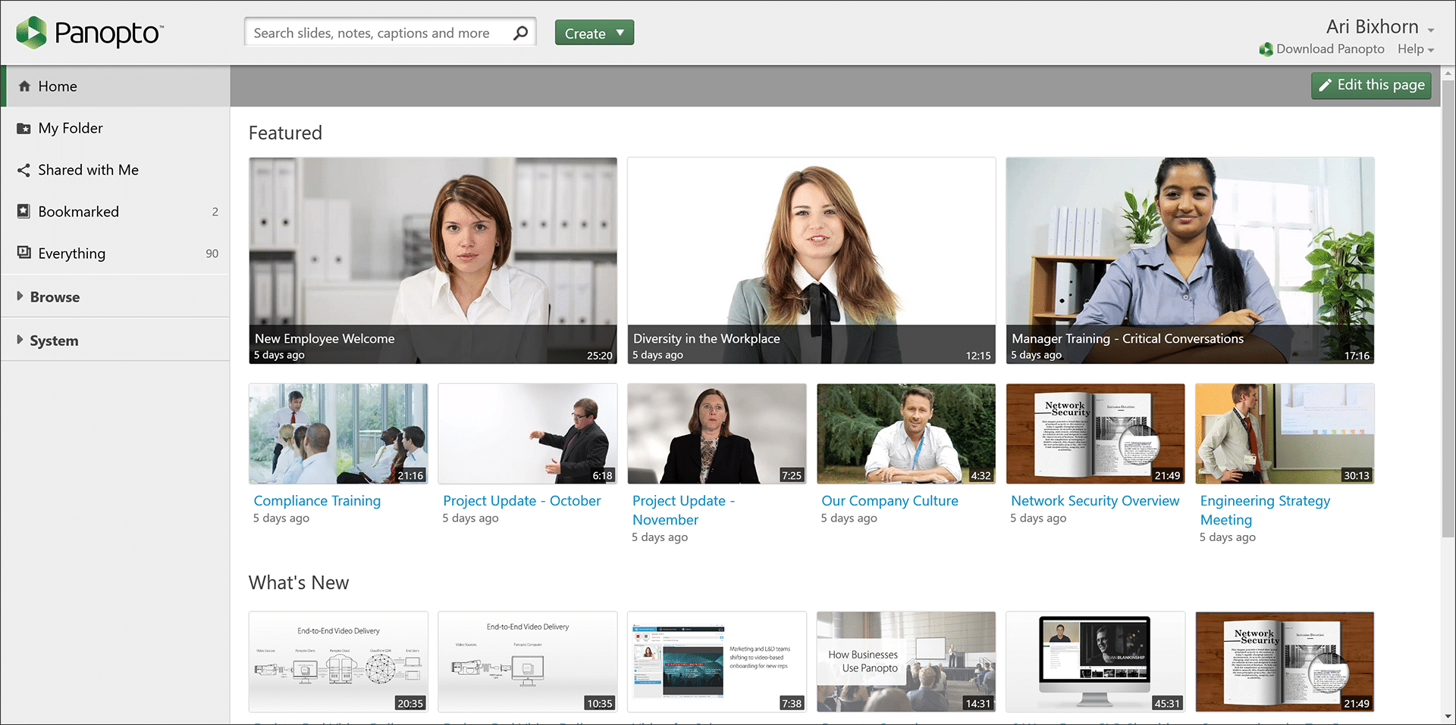
WHAT IS PANOPTO?
The University's video management system and online repository of lecture recordings
Consider using this for your videos as YouTube and Vimeo videos cannot be viewed in all countries
For copyright advice – you can contact Frank Hill

Slide 6
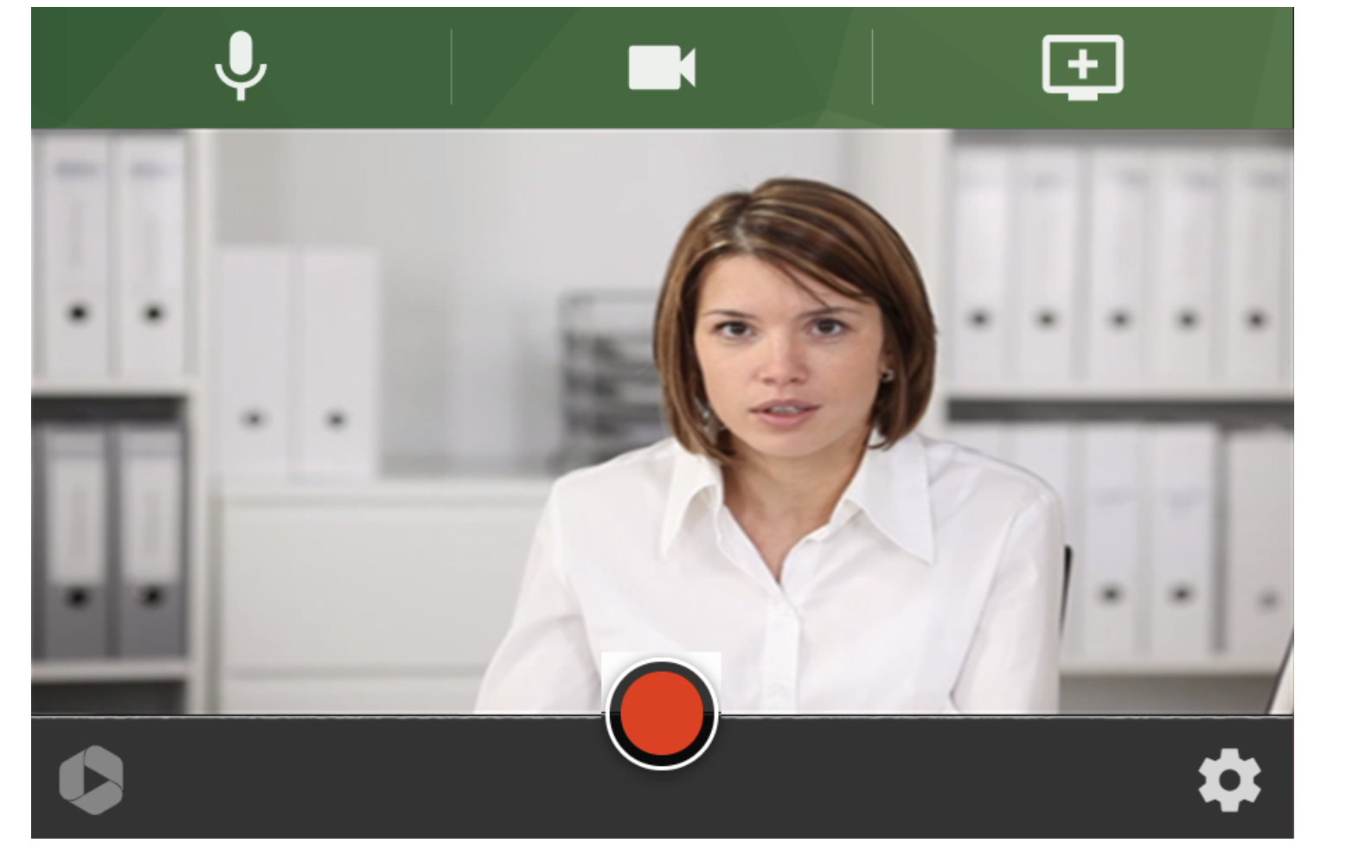
WHAT IS PANOPTO CAPTURE?
Panopto Capture allows a user to easily record audio, video, and entire screens or application windows.
A user can access Panopto Capture from directly within their browser, and no download is required.
Prerequisites:
Creator access to Panopto
Latest version of: Chrome, Edge (Chromium-based), or Firefox browsers on Windows 10, MacOS 10.15 or higher, or the latest ChromeOS.
Trusty internet connection
Notes:
Capture is also in beta for mobile devices. Panopto also plans to add support for Safari on desktop soon.
Note: Please make sure anti-virus exceptions are made for audio (microphone), video (web camera), and screen in your preferred browser.
If it says ‘Beta’ it means it is not full version and you can experience issues.
We refer to streams in this workshop – however this is not a streaming tool for live viewing online, this is a capture tool where audiences can view your video, only after you have finished recording. Stream refers to what you share from your computer.

Slide 7
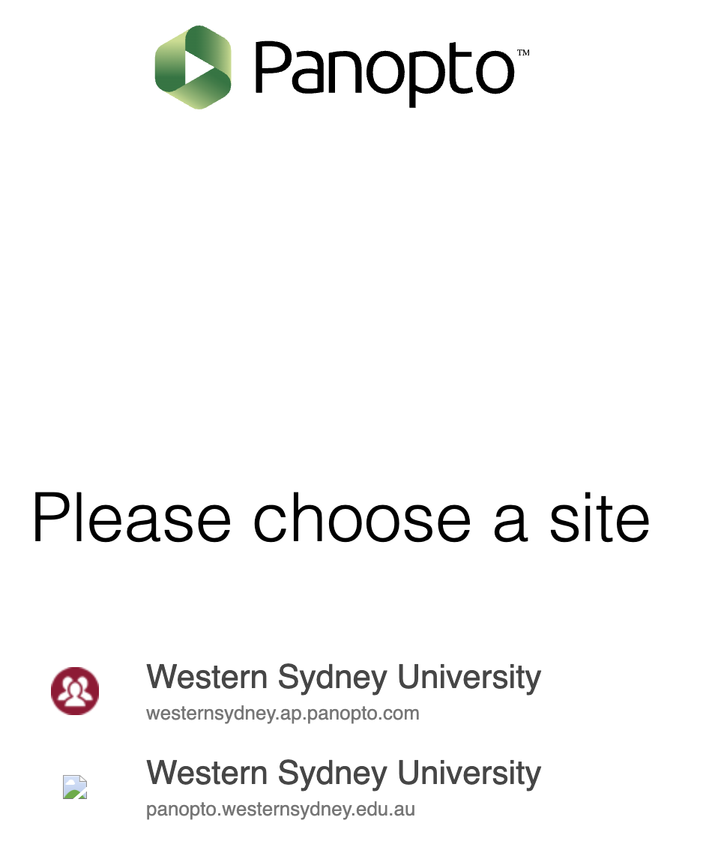
WHERE TO LOG IN & ACCESS PANOPTO CAPTURE
The link to log in is - www.panopto.com
Via your vUWS Site
Notes:
Show Live

Slide 8
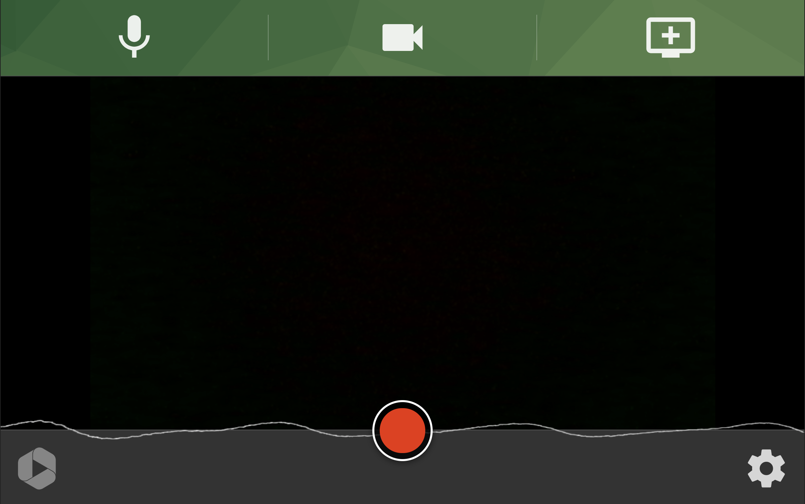
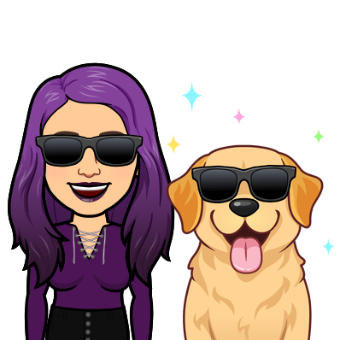
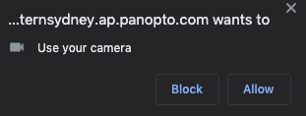
USING PANOPTO CAPTURE
Panopto Capture online recorder: https://www.panopto.com/record/
How to Create a Video using Panopto Capture: https://support.panopto.com/s/article/How-to-Create-a-Video-Using-Panopto-Capture
Notes:
The first time you enter this page you will have pop ups from your browser, asking for permissions to use your video etc, press allow
Now I want to show you through the interface and the different settings.
Automatically uses your default camera – to change this however, click the video icon.
To change your microphone click the audio icon and to check your audio levels
To record only audio, you can click the camera and click your primary video twice and it will turn off video. You cannot turn off audio.
To add a secondary camera (hypothetically you want a second camera recording a demonstration, you can select that in here).
The settings cog provides you with a few options.
Count down
If you do not select HD it will automatically record in SD, which will be more internet friendly (i.e. uploading/downloading).
However if you want to record in HD make sure to turn this on.
Smart Camera – this is a personal preference. What is does is adjust the camera if you move side to side and try to re-centre you in view.
The little person icon will appear.
If you click the person icon that appears it will then add smart camera for multiple people
Go through other icons that appear
‘Stream Output’ - This is where you select how you would like your shared screen/s or program etc to be recorded.
We’ll go through the different scenarios shortly.
Now Streams – This is where it gets complicated
Streams refers to the different programs, Chrome tabs, desktops etc, you have selected to share.
You can share up to 16 streams and potentially more, but you have to remember how complicated it getswith sharing so many streams at once.
Also my computer started to really struggle at 12, so remember keep it manageable.
How to start sharing a stream?
Click the monitor icon to also show a browser or program, PowerPoint etc, as you are recording.
If you would like to share your computer sounds, make sure to tick on ‘share audio’
You can share:
Screen – is everything you can see on your screen/s
Application – program etc
Browser tabs
When you hit share, it will take you to the program or tab etc, that you have shared, but if you navigate back to Panopto Capture, it will show you a preview of your shared screens and video.
If you hover over tiles, it will show you options for each. X stops sharing, the expand button shows you an expanded version of the stream.
On your video, if you hit the pop out button, it will pop out your video, which will still be recorded, it just allows you to move around the preview so you can ssee yourself as you record.
If you are recording your entire desktop/screen please note the video preview will also be recorded.
Place it strategically when sharing.

Slide 9
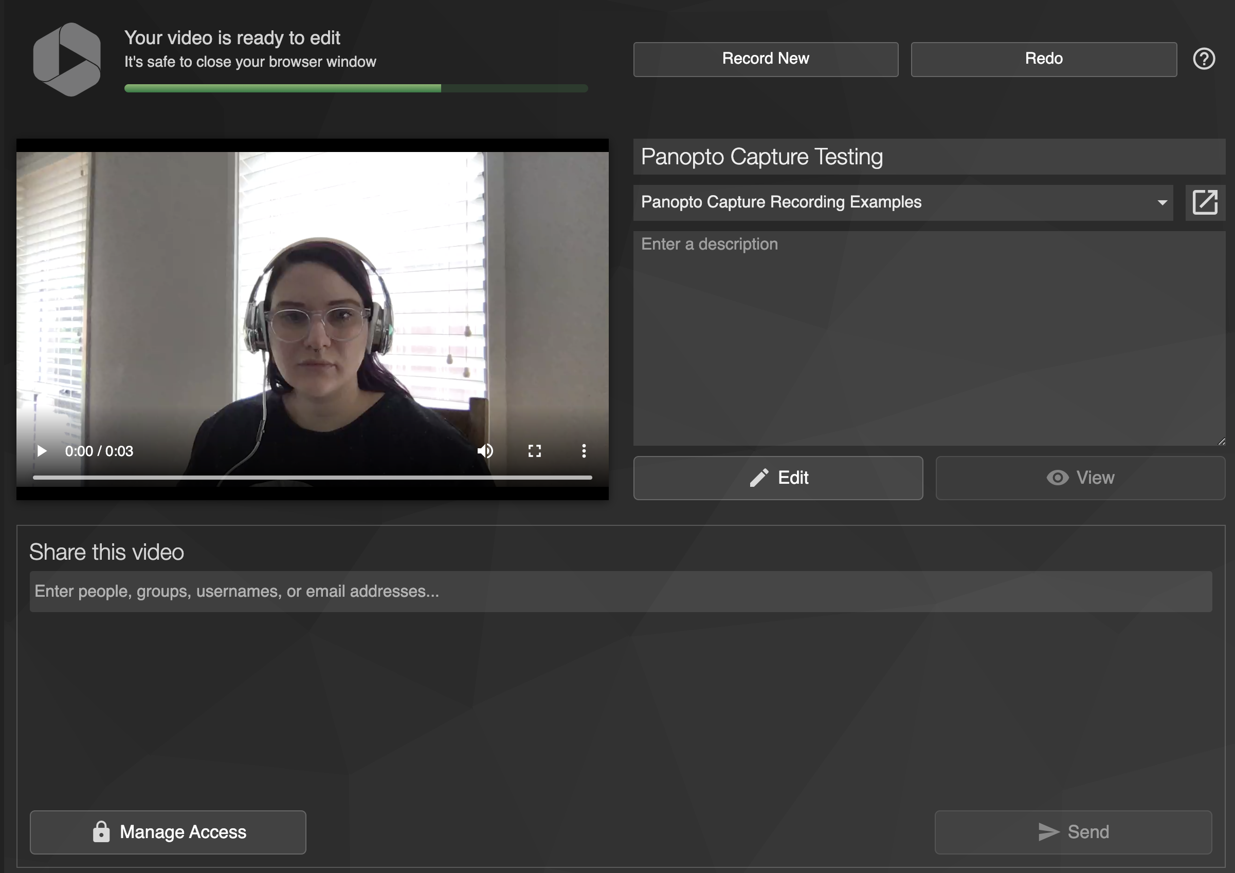
OPTIONS AFTER RECORDING
Notes:
Options after recording
Once you stop recording by re-clicking the red record button Panopto will start uploading and processing your video right away – see green bar.
Only close this tab or browser window when Panopto says it’s safe to do so.
You can rename the video
You can add a short description
If you click view, it will take you to view the video on Panopto
If you click ‘edit’ it will take you into the Panopto edit space
At the bottom you can also add people to share the video with if it’s for specific people to view
And you can manage the share or edit access by clicking ‘Manage Access’.
Redo – will delete the video and take you back to the recording interface
Record New – will take you back to record new video and save the video in the selected folder.
Where does the video save?
You can select which folder the video is saved into – if you are logged into Panopto via a web browser, it will automatically select your ‘My Folder’ or the folder you were in when you opened up Panopto Capture.
If you are recording through the Panopto link in vUWS it will automatically upload into the specific vUWS unit folder.

Slide 10
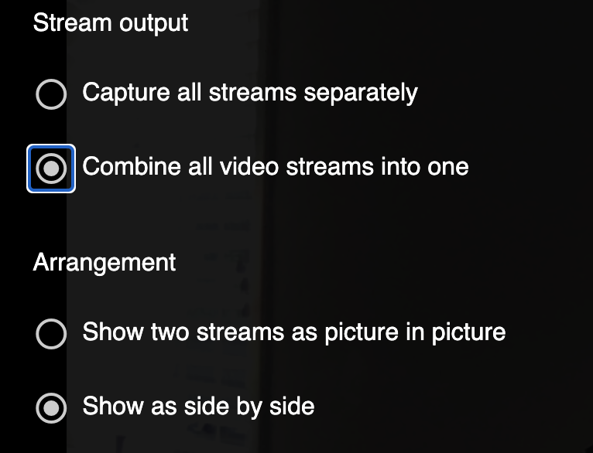
RECORDING SCENARIOS AND EXAMPLES
Scenario 1: Capture All Video Streams Separately
Scenario 2: Combine All video streams into one – Side by Side
Scenario 3: Combine All video streams into one – Picture in Picture
Scenario 4: Combine All video streams into one – Multiple Streams
Notes:
Now we’re going to go through 4 different scenarios and examples of different stream sharing.
This really impacts the way your final video output will look.
In the settings cog in Panopto Capture, it gives you the option to record streams as separate videos, or together as one video.
If you share multiple streams, recorded separately this brings an interactive element to your viewer which we will show shortly.
Otherwise to keep it simple, you can record streams to create 1 video.
If you record your streams ’into one’ video in the settings it gives you two options:
Show two streams as picture in picture.
Or show as side by side.
I will show what the difference is.

Slide 11
SCENARIO 1: SEPERATE VIDEO STREAMS
Video Example – 2 Streams
https://westernsydney.ap.panopto.com/Panopto/Pages/Viewer.aspx?id=383ce40d-ed0e-4610-a9fc-ac7e0014cb1a
Video Example – 1 Stream
https://westernsydney.ap.panopto.com/Panopto/Pages/Viewer.aspx?id=6b5eeb7a-17f8-4542-b979-ac7e0017caec
Notes:
We’re going to start with the most complicated way and then we’ll go through some easier options.
Recording each video stream separately, allows your viewer to select any video stream at any time during video playback, whilst you present.
This gives a bit of an interactive element to your videos.
DISCLAIMER: this interactive element does not work if you embed this into vUWS – if you are recording in this way, you will need to add a Panopto tool link or a link to the video to view it on Panopto. Embedding will not work for this recording style.
So for example, if you share your whole desktop/screen, and also share the specific program, the viewer will be able to click the specific stream to get a close up look, and can then navigate back to the wider desktop or other programs as they please, whilst the video is still playing.
You can even begin sharing a new video stream once recording has begun.
If you record multiple streams separately, keep in mind the last stream that you selected or shared when recording, will automatically focus on that.
Panopto Capture DOES recognise when you click in and out of a program or PowerPoint presentation, although it will also continuously record the stream/program from beginning to end, the video will focus on the program you click into.
In Panopto editor, you can also adjust the stream you want to the viewer to focus on, by using the cut or focus tool, which I will show you briefly soon.
How? In settings cog, under ‘Stream Output’ select Capture all streams separately.
Then click the monitor tool in Panopto capture to share the different streams.
And record.
Example of recording and playback – viewer point of view.
2 Stream video example: https://westernsydney.ap.panopto.com/Panopto/Pages/Viewer.aspx?id=383ce40d-ed0e-4610-a9fc-ac7e0014cb1a
1 Stream Video example: https://westernsydney.ap.panopto.com/Panopto/Pages/Viewer.aspx?id=6b5eeb7a-17f8-4542-b979-ac7e0017caec

Slide 12
SCENARIO 2: SIDE BY SIDE
Video Example – 1 Stream
https://westernsydney.ap.panopto.com/Panopto/Pages/Viewer.aspx?id=129368e2-518b-469d-abed-ac7e0018a900
Notes:
If you select ‘Show as side by side’ it will record your stream into 1 video, sitting side by side with the camera recording.
How? In settings cog, under ‘Stream Output’ select ‘Combine all video streams into one’.
Then select ‘Show as Side by Side’.
Then click the monitor tool in Panopto capture to share a stream (i.e. program, tab, desktop etc).
And record.
Text appears small – so please keep this mind.
Example of recording and playback – viewer point of view.
https://westernsydney.ap.panopto.com/Panopto/Pages/Viewer.aspx?id=129368e2-518b-469d-abed-ac7e0018a900

Slide 13
SCENARIO 3: PICTURE IN PICTURE
Video Example – 1 Stream
https://westernsydney.ap.panopto.com/Panopto/Pages/Viewer.aspx?id=4e44c9e4-f1ac-4cb3-bd15-ac7e001af0ce
Notes:
If you select ‘Show two streams as picture in picture’ it will record your stream into 1 video, with your camera recording inside the frame.
How? In settings cog, under ‘Stream Output’ select ‘Combine all video streams into one’.
Then select ‘Show two streams as picture in picture’
Then click the monitor tool in Panopto capture to share a stream (i.e. program, tab, desktop etc).
And record.
Example of recording and playback – viewer point of view.
https://westernsydney.ap.panopto.com/Panopto/Pages/Viewer.aspx?id=4e44c9e4-f1ac-4cb3-bd15-ac7e001af0ce

Slide 14
SCENARIO 4: ONE VIDEO, MULTIPLE STREAMS
Video Example – 3 Streams
https://westernsydney.ap.panopto.com/Panopto/Pages/Viewer.aspx?id=676c10e2-84ba-4bf0-8df3-ac7e001d8202
Notes:
One Video with multiple streams – excluding your camera recording.
If you select ‘ Combine all video streams into one’ and share multiple streams (i.e. program, tab, desktop etc) it will tile each stream next to each other.
So no matter what you have selected in the settings either ‘Side by side’ or ‘picture in picture’, if you share more than one stream they will automatically tile each of the streams into one video.
How? In settings cog, under ‘Stream Output’ select ‘Combine all video streams into one’ (doesn’t matter what further option you choose from here in settings).
Then click the monitor tool in Panopto capture to share a stream (i.e. program, tab, desktop etc).
And record.
Example of recording and playback – viewer point of view.
https://westernsydney.ap.panopto.com/Panopto/Pages/Viewer.aspx?id=676c10e2-84ba-4bf0-8df3-ac7e001d8202

Slide 15
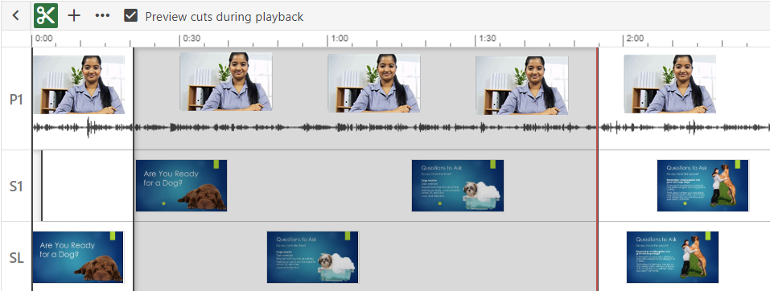
PANOPTO VIDEO EDITING
https://support.panopto.com/s/article/Edit-a-Video
Notes:
Editing a Panopto Capture video recording where the streams are recorded separately is a little more complicated than the usual Panopto edit tool or if you record the streams into 1 video, i.e. there is just one visual and one audio track.
When you record multiple streams they appear in the timeline on their own separate tracks, allowing you to isolate the stream to either focus on or cut from the final recording.
Live example using the scissors tool.
Or you can make sure the focus is on a particular stream for the audience, at certain times, by using the focus tool.
If you do not use the focus tool on a stream, the video and it’s focus will automatically run as it was recorded.
Live example using the focus tool.
If you click ‘Streams’ you can rename each stream based on what you have shared – make things are little more clear for the viewer also.
Show what it looks like for the viewer when you give each stream a label.
MAKE SURE YOU HIT APPLY ONCE EDITING IS COMPLETE. Panopto will then begin processing your changes.
Show Live example of how editing the 1 video vs multiple videos look.
Then you have all of the other Panopto editing tools that you would usually have (inserting a YouTube video, presentation, quiz etc)
We cover all of this in our other workshop on Panopto.
Link for chat: https://westernsydney.ap.panopto.com/Panopto/Pages/Viewer.aspx?id=df1a78ab-c231-4907-be19-ac0d00280834

Slide 16
Support and Resources

Slide 17
(WOS)
Western One Stop Studio is a custom-built lecture pod capture system designed to assist you to make short and simple, high quality lecture pods. It’s been designed in-house, here at Western Sydney by our Learning Futures team.
All you’ll need is your PowerPoint presentation and yourself, ready to record!
For additional information and resources to assist you prepare for your WOS Recording please check out our website: https://www.westernsydney.edu.au/digital_futures/dft/western_one_stop_studio Or Google ‘WOS Studio’
Notes:
Link for chat:
https://lf.westernsydney.edu.au/wos/index.php (Booking form/Calendar for WOS)
Information on WOS:
https://www.westernsydney.edu.au/digital_futures/dft/western_one_stop_studio
Western One Stop Studio is a custom-built lecture pod capture system designed to assist you to make short and simple, high quality lecture pods. It’s been designed in-house, here at Western Sydney by our Learning Futures team.
All you’ll need is your PowerPoint presentation and yourself, ready to record!

Slide 18
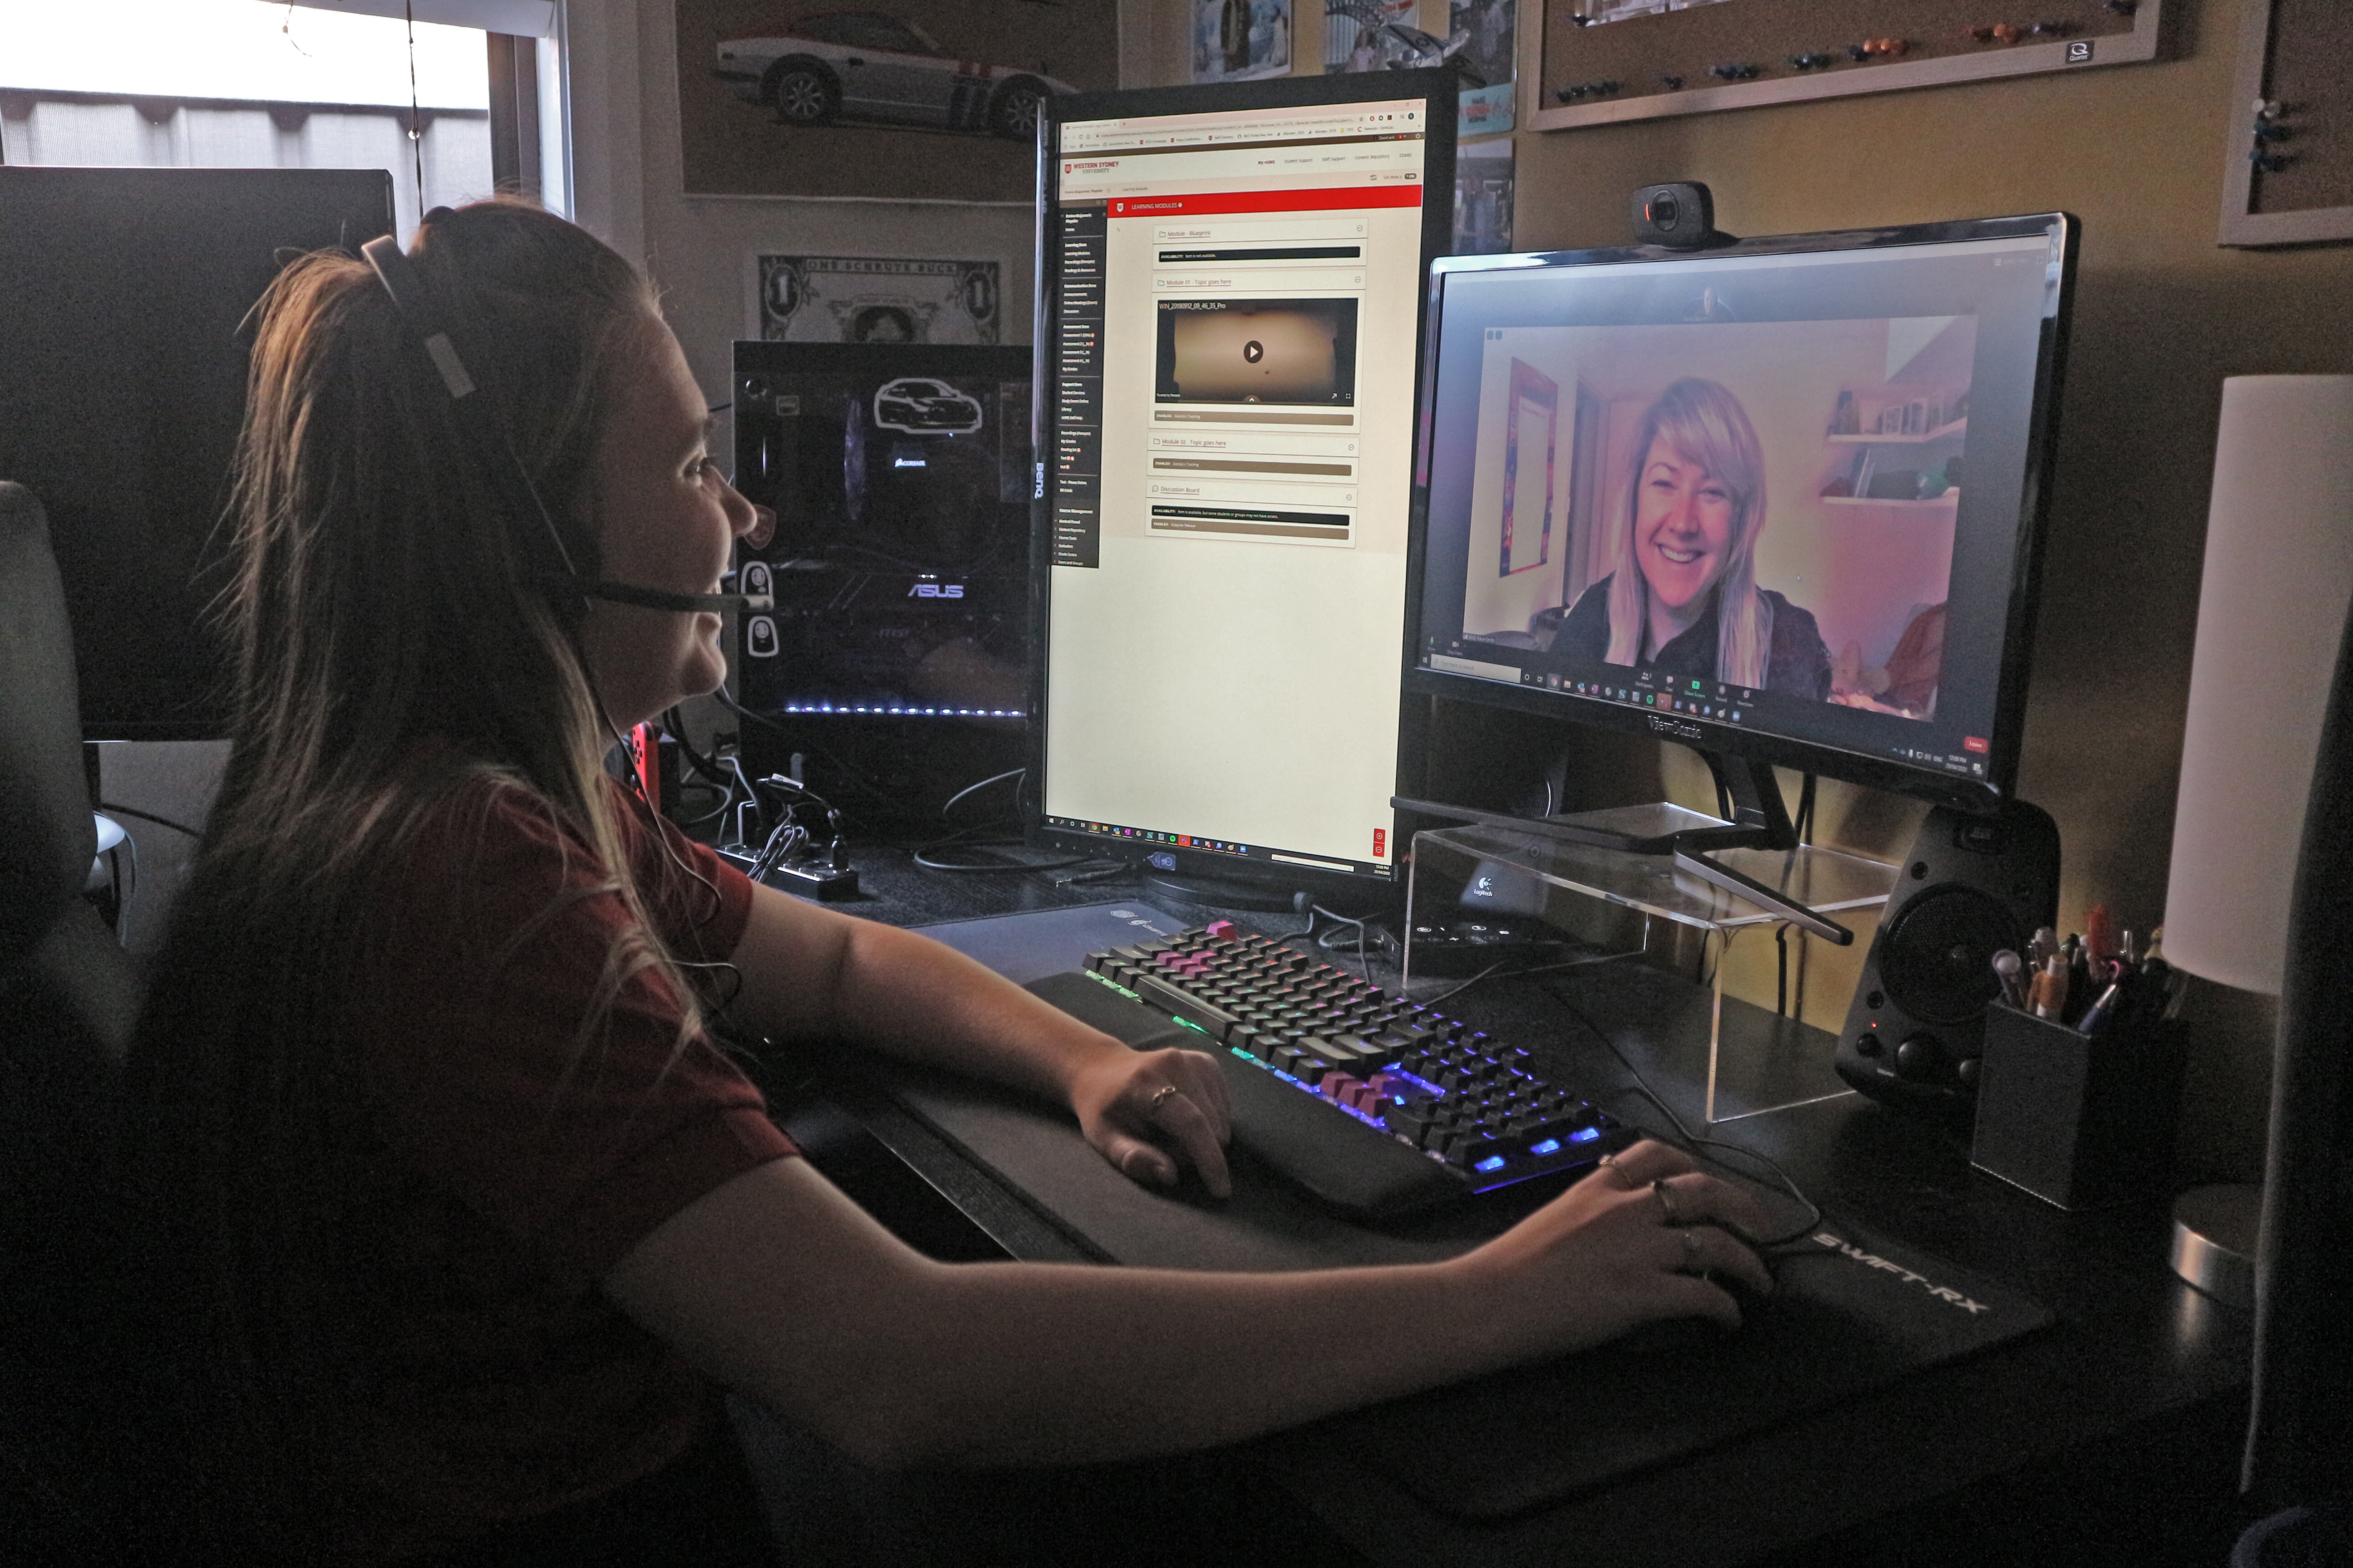
eLearning Support One to One (101)
Would you like to learn more about vUWS Blackboard tools and functionalities to enhance teaching and learning experience?
Learning Futures team is now able to offer personalised one-on-one eLearning support session via a zoom appointment. If you have any vUWS related queries, a member of our eLearning support team will support you through a tailored session specific to your needs.
Book a session today using our online form https://forms.gle/23UoDvsvSoybqHgZ6
If you have any additional queries, our contact email is elearning@westernsydney.edu.au
Notes:
Would you like to learn more about vUWS Blackboard tools and functionalities to enhance teaching and learning experience?
Learning Futures team is now able to offer personalised one-on-one eLearning support session via a zoom appointment. If you have any vUWS related queries, a member of our eLearning support team will support you through a tailored session specific to your needs.
Links for Chat:
One on one Consultation link:
https://forms.gle/23UoDvsvSoybqHgZ6

Slide 19
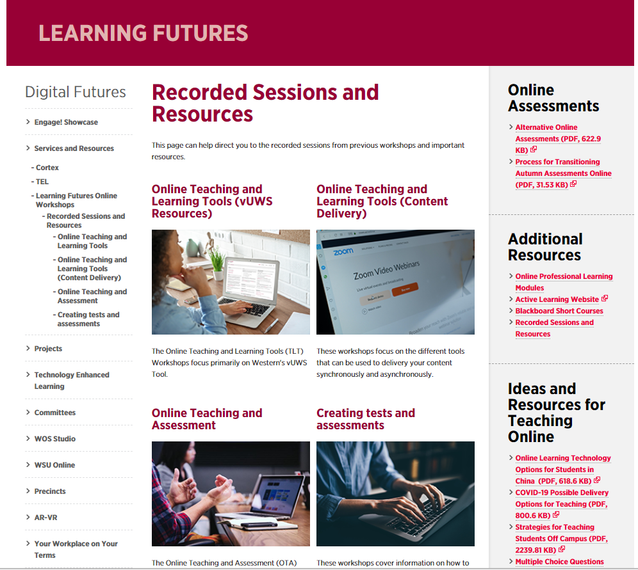
Additional Resources
Training
Upcoming Sessions
Recorded Sessions
eLearnathon page – Where you will find the PowerPoint slides
Support
Contact elearning@westernsydney.edu.au
Notes:
Links for Chat:
Upcoming Sessions :
https://www.westernsydney.edu.au/digital_futures/dft/services_and_resources/Learning_Futures_Online_Workshops/LF_Workshop_Schedule
Recorded Sessions:
https://www.westernsydney.edu.au/digital_futures/dft/services_and_resources/Learning_Futures_Online_Workshops/recorded_sessions
eLearnathon page:
https://www.westernsydney.edu.au/digital_futures/dft/services_and_resources/Learning_Futures_Online_Workshops/elearnathon
elearning@westernsydney.edu.au

Slide 20
Questions

Slide 21
Feedback
Notes:
Feedback link:
https://bit.ly/2YlU2Q1

Slide 22
Tell us what you think!
Quick feedback form :
The URL in the chat. It should only take 2-3min (we promise!)
We actually use your feedback to fine-tune, create and schedule future workshops
Notes:
Links for Chat:
URL: https://forms.gle/JrUyGf3szvuLTJZc8

Slide 23
Thank you for attending
Notes:
Links for Chat:
Workshop Schedule
https://bit.ly/2Sk7Pmh
Recorded Sessions and Recourses
https://bit.ly/3cZNGcO

Slide 24
Notes:
Thank you for your time

