Slide 1
Youth co-research toolkit: training slide deck template

Slide 2
Welcome to co-research training

Slide 3
Aims for today
Get to know one another
Introduction to research methods used in youth research
Learn about the research projects
Develop foundational research skills in research methods and ethics
Tips on project management
Notes:
Today you can expect to do a bit of listening and a lot of small group discussion which we’ll then bring into a full group discussion.

Slide 4
Agenda
10.00 - 10.25: Welcome and introductions
10.25 - 10.40: Introduction to Research Project / Partnerships
10.40 - 11.40: Research Approaches & Methods
11.40 - 12.00: Morning tea
12.00 - 1.00: Introduction to Research Ethics
1.00 - 1.45: Lunch
2.00 - 3.00: Power and Privilege in Research
3.00 - 3.15: Afternoon tea
3.15 - 3.45: Managing a Research Project
3.45 - 4.00: Wrap up and next steps

Slide 5
Acknowledgement of Country

Slide 6
Housekeeping

Slide 7
Introduction to research project and those involved
Notes:
Provide a brief introduction to research project / context: what, who, why. Why are you seeking to co-research with young people?
Explain any partnerships involved – how did they come to work together?

Slide 8
Icebreaker

Slide 9
Research Methods in Youth Research
Aim of this session:
Share your experience & knowledge of research methods
Introduction to methods used in youth research
Explore methods

Slide 10
What has your research journey been so far? Why are you interested in being a youth researcher?
Chat with the person next to you

Slide 11
What does research mean to you?
Notes:
Consider using a Slido poll to ask participants ‘What does research mean to you’?
Facilitate group discussion.

Slide 12
What research methods do you know of?
Notes:
Consider using a Slido poll to ask participants ‘What research methods do you know of?’
Facilitate group discussion on limitations and benefits of these methods.

Slide 13
Research: A definition
“Research is defined as the creation of new knowledge and/or the use of existing knowledge in a new and creative way so as to generate new concepts, methodologies and understandings. This could include synthesis and analysis of previous research to the extent that it leads to new and creative outcomes.”
(Department of Education and Training)

Slide 14
Digital
Research using digital technology such as computers, smartphones and the Internet
Quantitative
Numerical data or data that can be transformed into usable statistics
Participatory Action Research (PAR)
An approach to research in communities that emphasises participation and action. It seeks to understand the world by trying to change it, collaboratively and following reflection
Qualitative
Scientific method of inquiry and observation
TYPES OF SOCIAL RESEARCH
And much, much more!

Slide 15
Activity: Exploring research methods
Split into three groups
Join one of three stations
You will hear about a research project and learn about the proposed methodology
We’ll discuss together how these methods could work, benefits and limitations, and what could be improved (10 mins)
You’ll then rotate to the next station!
Group shareback
Notes:
Choose 3 research projects suitable for your context for 3 stations.
Have a facilitator at each station.

Slide 16
Station 1: [Insert research project title]
Research Problem: [Insert brief summary].
Research Questions:
[Insert key questions].
Proposed Approach: [Insert].
Methods: [Insert].
Participants: [Insert].
Notes:
Include these as print –outs at each station.
Group discussion (capture on butcher’s paper):
How could these methods work?
What could be improved?
How are these methods in the best interests of young people?
How can these be inclusive to diverse or marginalised groups?
How would they work in offline/online research?
Pros/cons of proposed methods?

Slide 17
Station 2: [Insert research project title]
Research Problem: [Insert brief summary].
Research Questions:
[Insert key questions].
Proposed Approach: [Insert].
Methods: [Insert].
Participants: [Insert].
Notes:
Include these as print –outs at each station.
Group discussion (capture on butcher’s paper):
How could these methods work?
What could be improved?
How are these methods in the best interests of young people?
How can these be inclusive to diverse or marginalised groups?
How would they work in offline/online research?
Pros/cons of proposed methods?

Slide 18
Station 3: [Insert research project title]
Research Problem: [Insert brief summary].
Research Questions:
[Insert key questions].
Proposed Approach: [Insert].
Methods: [Insert].
Participants: [Insert].
Notes:
Include these as print –outs at each station.
Group discussion (capture on butcher’s paper):
How could these methods work?
What could be improved?
How are these methods in the best interests of young people?
How can these be inclusive to diverse or marginalised groups?
How would they work in offline/online research?
Pros/cons of proposed methods?

Slide 19
Debrief
Notes:
Who would like to share one method they found particularly interesting? How could it be improved to be inclusive of young people from migrant and refugee backgrounds?

Slide 20
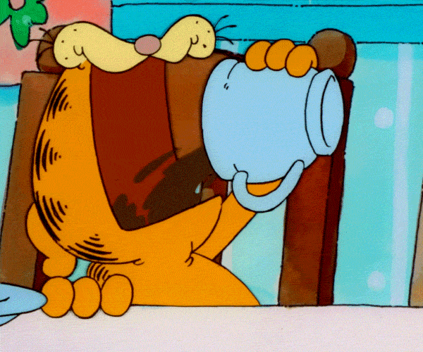
Break

Slide 21
Introduction to Research Ethics
Aim of this session:
Overview of research ethics
Consider challenges for ethical research with young people
Discuss practical ethics in relation to research projects

Slide 22
Why Research Ethics?
Notes:
Has anyone seen the 1989 Spike Lee movie ‘do the right thing’. Apart from being an awesome, landmark film about race relations you might be wondering what it has to do with the topic of this workshop - thoughts?
Research ethics is basically about ensuring researchers ‘do the right thing’.
But also, the Public Enemy track ‘fight the power’ is on the soundtrack - and even though research ethics is about redressing power imbalance between researchers and those who are researched, they are not neutral, but rather, reflect power relations in society… Something for us to keep in mind!

Slide 23
Ethics: A definition
“Ethics refers to well-founded standards of right and wrong that prescribe what humans ought to do, usually in terms of rights, obligations, benefits to society, fairness, or specific virtues. Ethics also involves the study and development of our own ethical standards via continual examination of our moral beliefs and conduct.”
(Graham et al. 2013, ‘Ethical Research Involving Children’)
Notes:
In relation to research ethics, this means that we must conduct research in a way that affords participants the protection and respect they deserve, and safeguards their welfare, dignity and safety.
Importance of ethics in research with young people (under 18): vulnerable population, limited capacity to consent.

Slide 24
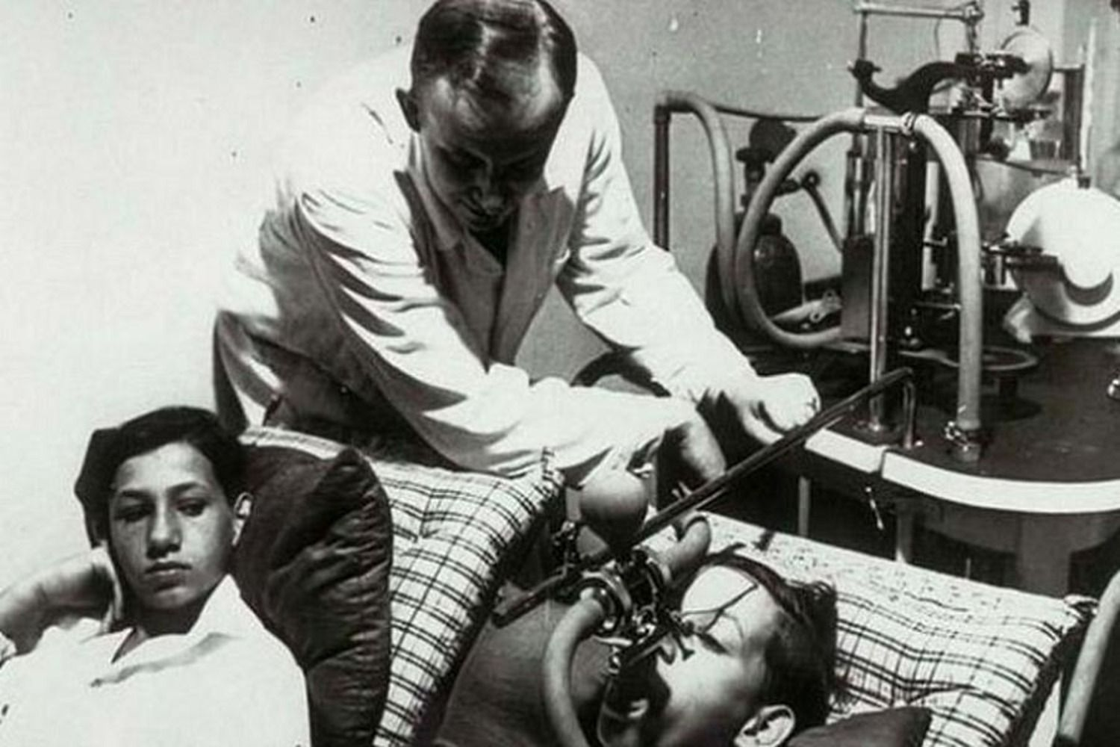
Notes:
Sounds straightforward. Right?
Wrong. Historically, research involving human subjects was highly unethical - disregarding human rights and often highly racists, ageist and classist.
Research ethics frameworks and codes have been shaped by the need to protect people from exploitation and harm: for example: “institutionalised children being subjected to vaccine experiments” (Institutional Review Board); human research experimentation in WW2 (Nuremburg Code); and, recognition that the safeguards in the Nuremburg Code were insufficient and not being observed (Helsinki Code).
Research Ethics is a live area of debate.

Slide 25
National Research Guidelines
The NHRMC National Statement
Guides Researchers
Guides Human Research Ethics Committees
“Acting in the right spirit, out of an abiding respect and concern for one’s fellow creatures”.
Notes:
In Australia…
Human research is conducted with or about people, or their data or tissue. E.g.
taking part in surveys, interviews or focus groups;
undergoing psychological, physiological or medical testing or treatment;
being observed by researchers;
researchers having access to their personal documents or other materials;
the collection and use of their body organs, tissues or fluids;
access to their information (in individually identifiable, re-identifiable or nonidentifiable form) as part of an existing published or unpublished source or database.

Slide 26
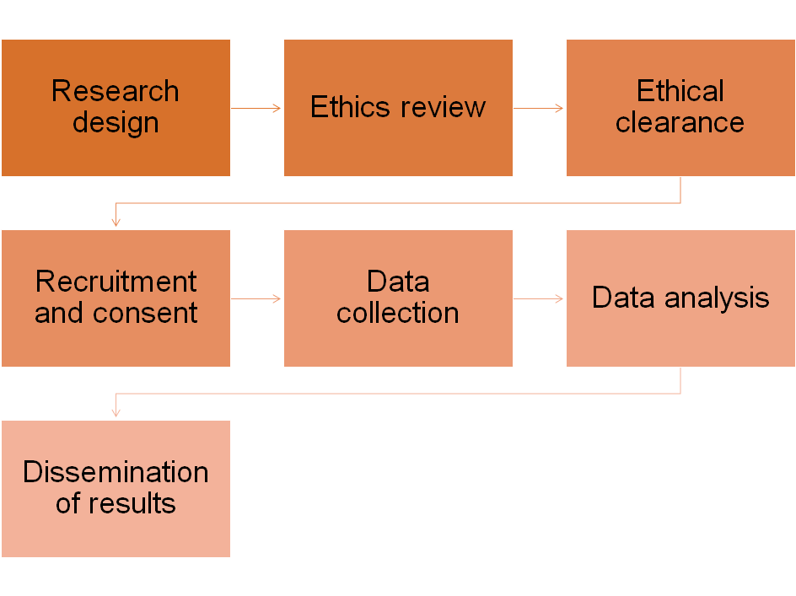
University Ethics Process
Human Research Ethics Committee (HREC)
Review proposals
Monitor conduct
Process complaints

Slide 27
Ethical Principles in Research
Integrity
Respect
Benefit
Justice

Slide 28
Key considerations for research with young people
Harms and benefits
Informed consent
Privacy and confidentiality
Payment and compensation
(Graham et al 2013, ‘Ethical Research Involving Children’)

Slide 29
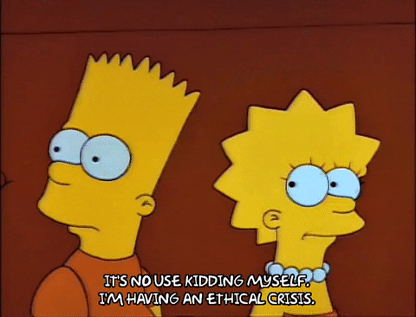
Ethical challenges
Consent
Online research
Cross-cultural research
Regulatory ethics processes
What ethical challenges have you experienced?

Slide 30
Activity: Exploring ethical dilemmas in research projects
Choose one of the research projects and head to that station
Discuss in your group
What are the potential ethical challenges or questions?
How could these be addressed/mitigated?
One person in the group to shareback to the whole group
Notes:
Use print-out ethical principle cards as prompts to discuss in groups.
Accessibility/inclusion
Harms and benefits
Informed consent
Privacy and confidentiality
Payment and compensation

Slide 31
Debrief
Notes:
What are ethical challenges or dilemmas did your group identify?
What were some of the ways you thought they could be addressed/mitigated by the research design or team?

Slide 32
Break

Slide 33
Energiser!

Slide 34
Introduction to Power and Privilege
Aims of this session:
Define power and privilege
Where do/don’t you hold power/privilege?
Exploring power and privilege through photo-analysis
Think about power dynamics in relation to different stages of research
Consider how to work productively with power dynamics in research

Slide 35
A definition
Power is “the ability or capacity to do or act in a certain way.”
(Oxford Dictionary)
Privilege is “a special right or advantage that a particular person or group of people has.”
What would you add to these definitions?
What comes to mind when you think of power and privilege?

Slide 36
Privilege Walk Activity
Notes:
See activity instructions here: What Is Privilege? (buzzfeed.com)

Slide 37
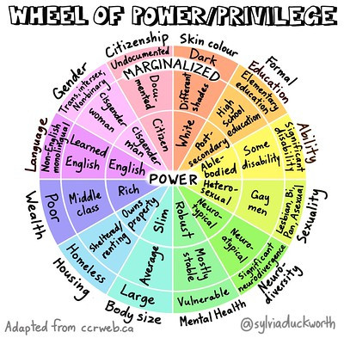
What is one context in which you hold power?
What is one context in which you hold privilege?
Where would you not?
Notes:
Sylvia Duckworth's illustration of Wheel of Power/Privilege can help us get a more intricate visualization of the term “marginalization;" the further you are from power, the more ignored and unimportant you feel. However, as you try to place yourself in the different categories, notice how your level of power/marginalization shifts between categories. A different way to interpret this illustration is through an intersectionality lens.
Intersectionality is when different aspects of an individual's identity interconnects overlaps with each other to expose and create unique experiences of marginalisation and discrimination.

Slide 38
Activity: Exploring power and privilege through photo analysis
Split into pairs and consider these questions…
How is power expressed in your image?
Thinking about the different people in your image, what does power and privilege look like from their perspective?
What symbols of power are at play in your image?
How does the composition/framing of your image help to construct ideas about power?

Slide 39
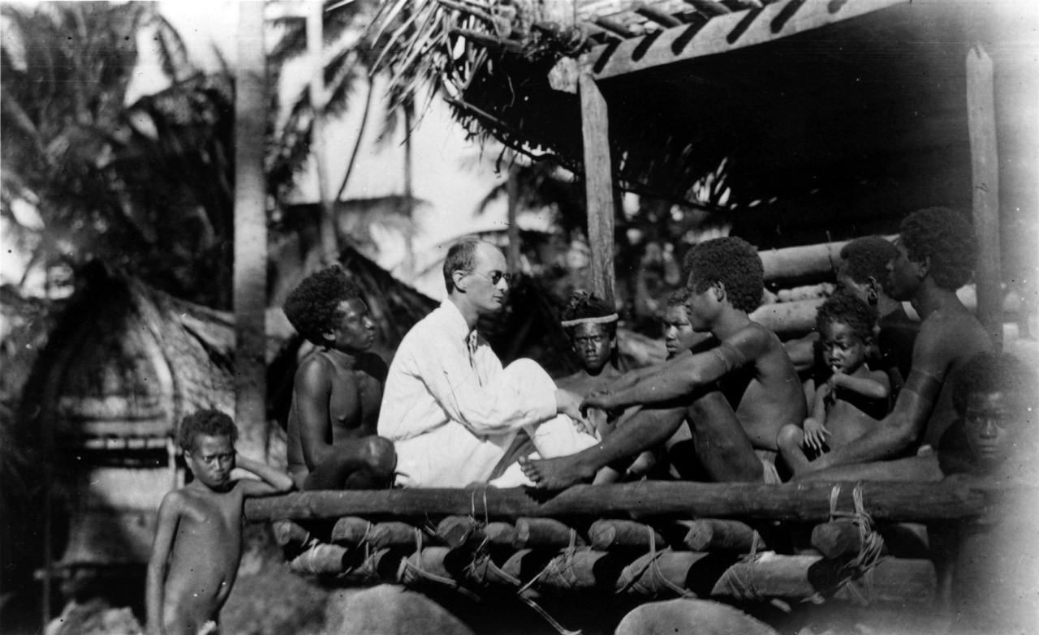

Slide 40
Activity: Power dynamics in research
Establishing research priorities: Who decides what issues or questions are important? What is the role of researchers/communities/partners/young people/funders in defining research questions/priorities?
Allocation of tasks: Who decides how tasks are allocated? Are task allocations realistic/do decisions suit everyone on the team?
Data collection: Are inclusive research methods used? Do they genuinely enable participants to have a say? Have issues of anonymity, confidentiality and community safety been considered?
Data analysis and dissemination: Who makes decisions about how data will be analysed? Are data analysis methods transparent and comprehensible to whole team? Does the researched community have a say in how data about them is disseminated and used? Will findings be open access/freely available, age appropriate and language/culturally inclusive?
Notes:
Break into 2 groups, discuss two stages each group.
For this activity we would like you to consider how power and privilege might play out during different stages of the research process. We have included some considerations for each of these stages. What else would you add in relation to how power and privilege might play out? Can you think of any examples of any research projects (perhaps from your own experience) where power and privilege have been negotiated skilfully in relation to these stages of research?

Slide 41
Debrief: Working productively with power dynamics in research
Thinking about the research settings above, can you think of any ways you would work creatively with power dynamics to navigate challenges?
Is power necessarily oppressive? Could people with power and privilege use it in positive ways?
Can the experience of being ‘othered’ or marginalised help researchers design and conduct better research?
Should existing power dynamics always be challenged? In what circumstances would/wouldn’t you challenge power dynamics in research?
What’s your one takeaway from this session?
Notes:
There are many things to consider in relation to power dynamics in research, including the responsibilities of employees in different organisations, university ethics committees, the time and resources available for different individuals/organisations to commit & be inclusive of others, and grant funding rules.
At the same time, power is not fixed, and you likely will have had experiences in your own lives navigating tricky power dynamics, whether this is in the workplace, at home, or within friendship groups.
Thinking about the research stages above, can you think of any ways you would work creatively with power dynamics to navigate potential challenges?

Slide 42
Activity: Power dynamics in research
Activity: Power dynamics in research
Takeaways from this session
Understand how you can work creatively with power dynamics
Power is a relationship (you can't have power without someone to exercise it on)
Power is fluid, it shifts and changes
Power can be contested in explicit ways (conflict), and subtle ways (manipulation)
Power can be navigated and thought of as an opportunity
We need to find the balance to both respect and contest power
We all have forms of power, but they are expressed differently (for some it is easier, for others it is not)

Slide 43
Break

Slide 44
Research Project Management 101

Slide 45
“If we knew what we were doing, it wouldn’t be called research, would it?”
Albert Einstein
Notes:
Research projects are often very complex, the exact outcome is difficult to plan, and the process towards the outcome may sometimes be rather disordered.
Research projects are often influenced by factors that are beyond the control of the project manager.
Things often go wrong, nearly as often as they go right! Continuous adjustment and adaptation is important.
At uni/school - what are some of the challenges you’ve experienced when working on a project/assignment? Did anything help with these challenges?
Anna’s example?

Slide 46
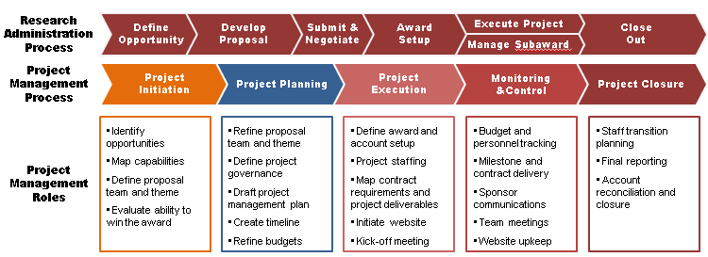
Notes:
But, there are ways to deal with uncertainty (and stress).
Project phases - initiation (reach agreement on goals), planning (refining research aims and questions, list of milestones and outputs, planning activities and timelines), execution (kicking off project), monitoring and control, and closure.

Slide 47
Project management principles and skills
Plan carefully and have clear objectives
Problem-solving and creative thinking (How do we get to the end-goal? What are the alternatives?)
Team-work
Clear communication (setting expectations)
Effective decision-making
Embrace change and uncertainty (expect the unexpected, flexibility, pivots)
Continuously improve (review successes and failures, capture lessons-learned)

Slide 48
Getting Started: Project planning
Questions to consider when planning research…
What are the major milestones you need to complete in your project? E.g. ethics approval, data collection complete, report drafted, publication submitted. Break these down into the activities needed to complete them
How much time will you need to reach each milestone and complete each activity? Make realistic estimates of how long each activity will take. Are there resources you need to complete the activities?
How are the different aspects of your project interrelated? Helps to adjust time-frames and identify any roadblocks. E.g. you will need to complete fieldwork before analysis.
What are some of the time constraints?
Notes:
Planning can help you to reach your milestones and complete your project within your expected time-frame.

Slide 49
Tool: Gantt Chart
Notes:
A Gantt Chart is a popular project management tool; it is a type of bar chart that illustrates a project’s schedule. The chart allows for organizing and viewing project activities and tasks against pre-established timeframes.
Useful for tracking progress and a living document that can be tweaked along the way.

Slide 50
Activity: Developing a project plan
Split into pairs
Read case study of a research project
Map out a Gantt Chart
Identify project milestones and end date
List all activities needed to reach milestones
Plan out the sequence of these activities (when would they occur?)
Estimate time required for each activity
Identify relationship of steps, i.e. does one step depend upon another?

Slide 51
Wrap-up and Next Steps

Slide 52
Reflections
One answer per post-it…
What was the most interesting thing?
What is something you learned?
What are you energised to do next?

