Slide 1
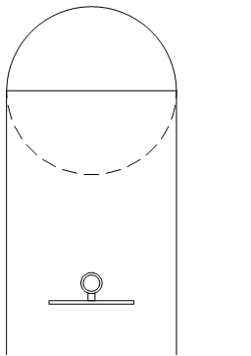
The Key to Setting up Turnitin and marking with Feedback Studio

Slide 2
Zoom Chat – Attendance
Before we begin:
Enter your Full name, School and email into the Zoom chat

Slide 4
Session Outline
Create a Turnitin submission for scratch
Create and attaching a rubric
Access the Turnitin Feedback Studio
Access the marking tools and rubric

Slide 5
Learning Outcomes
Able to create a Turnitin submission from scratch
Know where to create and attach a rubric
How to access the Turnitin Feedback Studio
How to access the marking tools and rubric

Slide 6
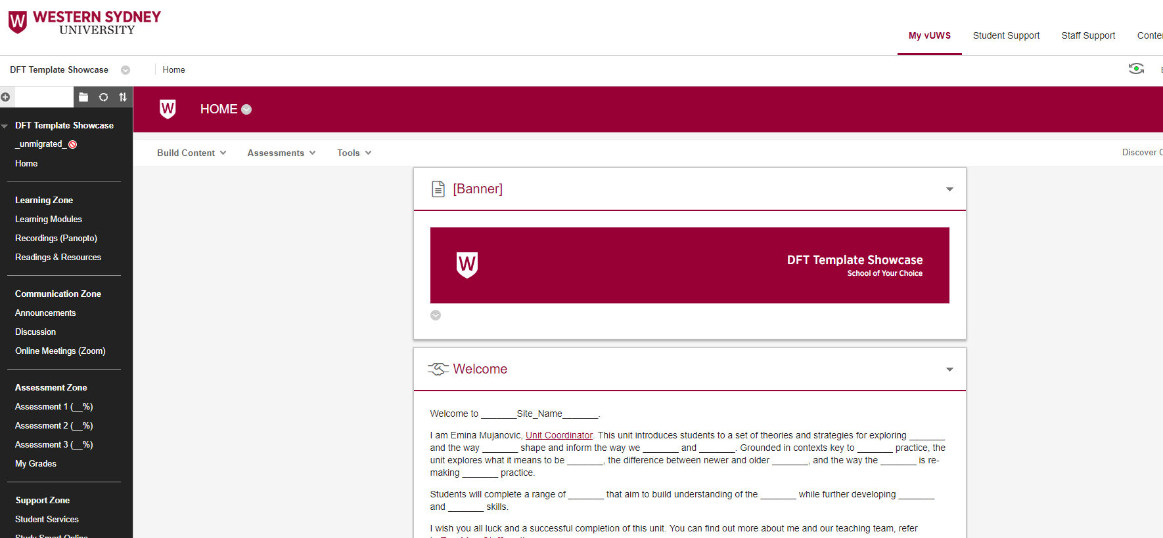
Live Demo

Slide 7
Support and Resources

Slide 8
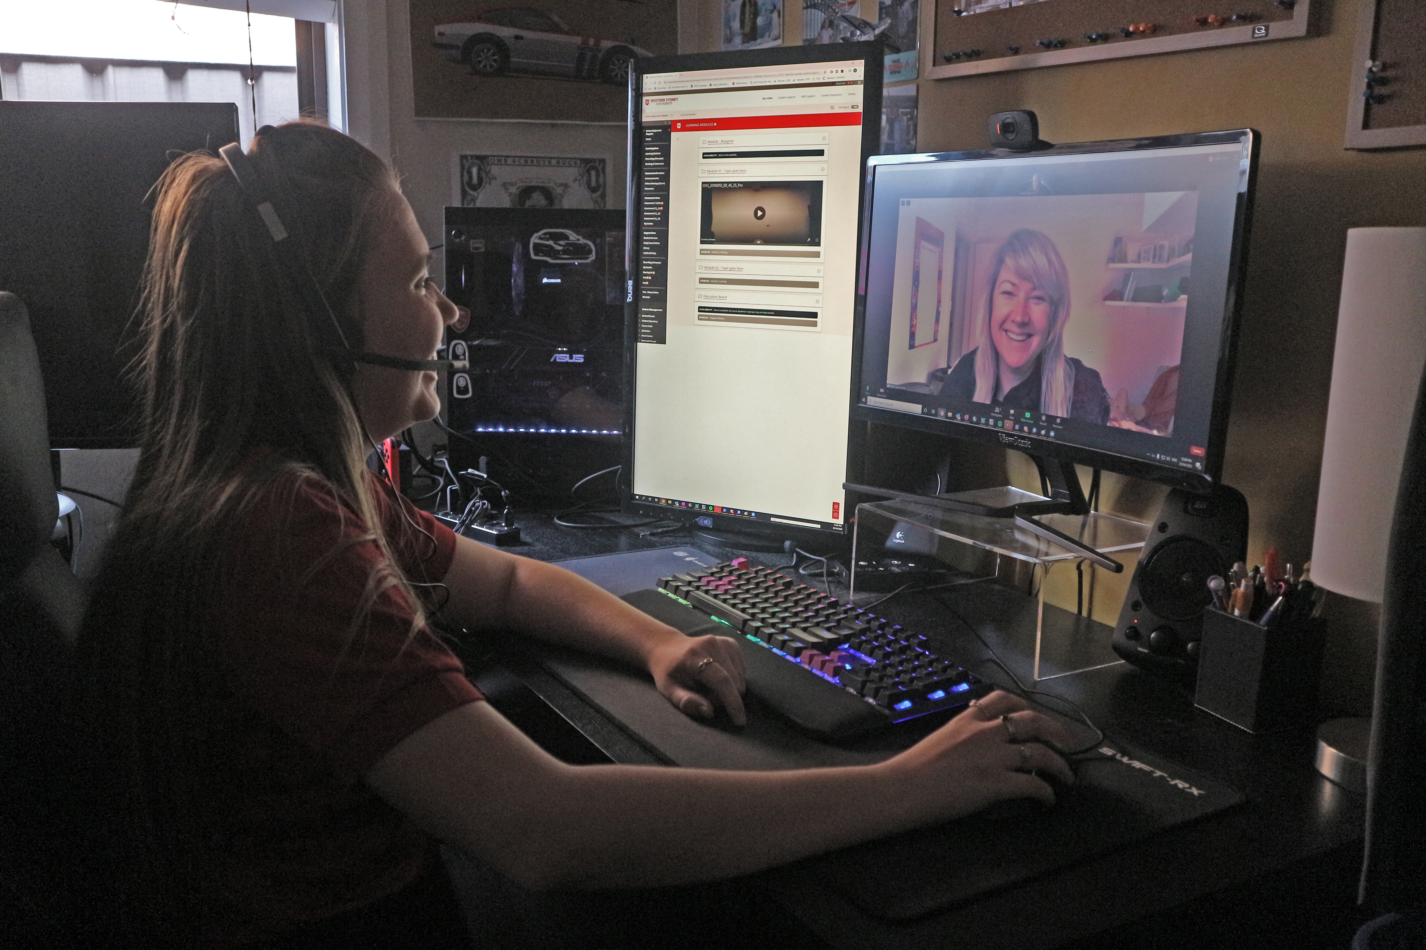
eLearning Support One to One (101)
Would you like to learn more about vUWS Blackboard tools and functionalities to enhance teaching and learning experience?
Learning Futures team is now able to offer personalised one-on-one eLearning support session via a zoom appointment. If you have any vUWS related queries, a member of our eLearning support team will support you through a tailored session specific to your needs.
Book a session today using our online form https://forms.gle/23UoDvsvSoybqHgZ6
If you have any additional queries, our contact email is elearning@westernsydney.edu.au
Notes:
Would you like to learn more about vUWS Blackboard tools and functionalities to enhance teaching and learning experience?
Learning Futures team is now able to offer personalised one-on-one eLearning support session via a zoom appointment. If you have any vUWS related queries, a member of our eLearning support team will support you through a tailored session specific to your needs.
Links for Chat:
One on one Consultation link:
https://forms.gle/23UoDvsvSoybqHgZ6

Slide 9
Additional Resources
Training
Upcoming Sessions
Recorded Sessions
eLearnathon page – Where you will find the PowerPoint slides
Support
Contact eLearning@westernsydney.edu.au
Notes:
Links for Chat:
Upcoming Sessions : https://www.westernsydney.edu.au/digital_futures/dft/services_and_resources/Learning_Futures_Online_Workshops/LF_Workshop_Schedule
Recorded Sessions: https://www.westernsydney.edu.au/digital_futures/dft/services_and_resources/Learning_Futures_Online_Workshops/recorded_sessions
eLearnathon page: https://www.westernsydney.edu.au/digital_futures/dft/services_and_resources/Learning_Futures_Online_Workshops/elearnathon

Slide 10
Feedback

Slide 11
Tell us what you think!
Quick feedback form :
The URL in the chat. It should only take 2-3min (we promise!)
We actually use your feedback to fine-tune, create and schedule future workshops
Notes:
URL: https://forms.gle/JrUyGf3szvuLTJZc8

