Slide 1
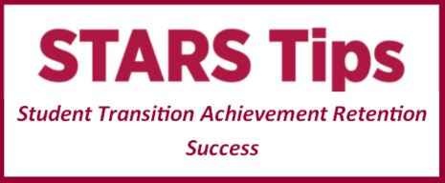
GET READY FOR EXAMS: CHECKLIST & TIPS
Check your personal exam timetable.
Go over 10 things to remember for your exams.
Read important exam information.
Plan your STUVAC time and consider forming a study group.
Check for any past exam papers for your units.
Practise Study Smart exam techniques.
Follow Academic Integrity principles. Penalties will apply for academic misconduct at exams.
Let friends, family and employers know about exams and create time and space for study.
Take regular study breaks. Try a relaxation recording or find movies, magazines and recreational reading through Study Break at the Library.
Need help? Call Student Infoline on 1300 668 370

