Slide 1
Presenter: Stephanie Lynch
Digital Learning Administration Officer,
Learning Futures
Notes:
Hi everyone,
This is our last pit stop in the Amazing Race workshop week.
Thank you to all that have attended, we will have the recordings available online late next week.

Slide 2
ACKNOWLEDGEMENT OF COUNTRY
With respect for Aboriginal cultural protocol and out of recognition that its campuses occupy their traditional lands, Western Sydney University acknowledges the Darug, Eora, Dharawal (also referred to as Tharawal) and Wiradjuri peoples and thank them for their support of its work on their lands (Greater Western Sydney and beyond).
Notes:
I would like to begin today’s workshop by acknowledging the Traditional Custodians of the land on which we meet today, and pay my respects to their Elders past and present. I extend that respect to Aboriginal and Torres Strait Islander peoples here today.
I am joining you today from [Darug] Lands. You may wish to add in the chat which lands you are joining us from.

Slide 3
Notes:
RECORDING/MUTE
This session will be recorded, please ensure your microphone is muted and disable your camera if you do not want to be visible on the recording.
QUESTIONS
Please enter your questions in the chat and my colleague will respond as we move through the session.

Slide 4
Notes:
Ok so, we’ve hit a speed bump!
Today we will look at a brief overview of question types, create a pool of questions in excel and upload into vUWS and finally we will create a quiz and deploy in the assessment zone.
Before we get started, just to mention that Blackboard call it a Test at Western we use the term Quiz, they are the same thing.

Slide 5
Question Types

Slide 6
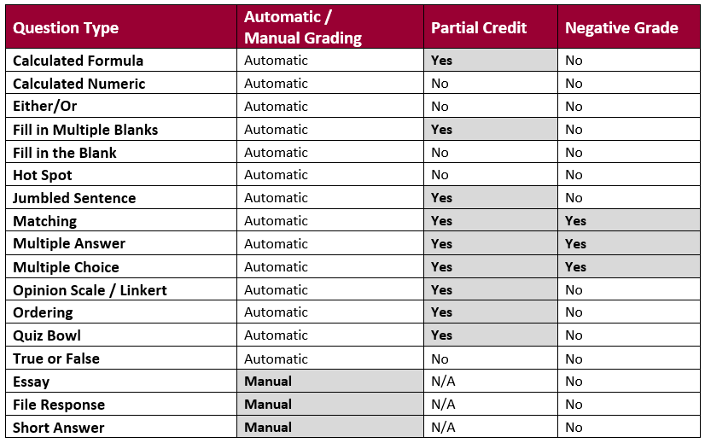
Notes:
To start, here is a list of the question types available in vUWS and whether they are automatically marked or require manual marking.
As you can see only the Essay, File response and Short answer are manually marked, and you can also attach a rubric to these question types.
In the next two columns we can see what questions allow partial credit or a negative grade. I have an example of this I will show you shortly.

Slide 7
Go to Live Demo

Slide 8
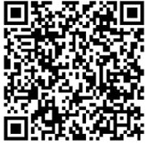
Further information
You can also find other Training Sessions on the Learning Futures Workshop Schedule website
Self help articles (vUWS support)
Support through Western Now
101 Support Consultation
Notes:
You can also find other Training Sessions on the Learning Futures Workshop Schedule website.
Self help articles (vUWS support): https://lf.westernsydney.edu.au/support/
Support - Contact us at Western Now
101 Support - https://outlook.office365.com/owa/calendar/DigitalLearningSupport101@westernsydneyedu.onmicrosoft.com/bookings/s/Zdai0b_bUk6ADvEtAmGWRQ

Slide 9
Tell us what you think!
Did you like the workshop design and delivery?
What would you like to know more about?
It should only take 3 minutes
**We use your feedback to fine-tune, create and schedule future workshops**
Notes:
Tell us what you think!
A link is going into the chat now, any and all feedback is welcome.
We use your feedback to fine-tune, create and schedule future workshops
We really appreciate your feedback and it should only take 3 minutes

Slide 10
End
Notes:
Any questions?

