Slide 2
Turbo Talk – vUWS Q & A
Presenter: Whole eLearning Team
LEARNING FUTURES

Slide 3
OPEN SESSION TO ASK ANY QUESTIONS ABOUT VUWS
The whole team is here to help you !
Do you have a specific question ?
If you have any further questions, please email- elearning@westernsydney.edu.au
TURBO
TALK

Slide 4
Support and Resources

Slide 5
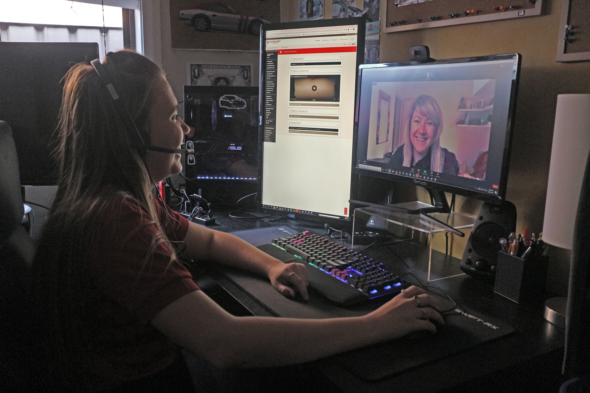
eLearning Support One to One (101)
Would you like to learn more about vUWS Blackboard tools and functionalities to enhance teaching and learning experience?
Learning Futures team is now able to offer personalised one-on-one eLearning support session via a zoom appointment. If you have any vUWS related queries, a member of our eLearning support team will support you through a tailored session specific to your needs.
Book a session today using our online form https://forms.gle/23UoDvsvSoybqHgZ6
If you have any additional queries, our contact email is elearning@westernsydney.edu.au
Notes:
Would you like to learn more about vUWS Blackboard tools and functionalities to enhance teaching and learning experience?
Learning Futures team is now able to offer personalised one-on-one eLearning support session via a zoom appointment. If you have any vUWS related queries, a member of our eLearning support team will support you through a tailored session specific to your needs.
Links for Chat:
One on one Consultation link:
https://forms.gle/23UoDvsvSoybqHgZ6

Slide 6
Additional Resources
Training
Upcoming Sessions
Recorded Sessions
eLearnathon page – Where you will find the PowerPoint slides
Support
Contact eLearning@westernsydney.edu.au
Notes:
Links for Chat:
Upcoming Sessions : https://www.westernsydney.edu.au/digital_futures/dft/services_and_resources/Learning_Futures_Online_Workshops/LF_Workshop_Schedule
Recorded Sessions: https://www.westernsydney.edu.au/digital_futures/dft/services_and_resources/Learning_Futures_Online_Workshops/recorded_sessions
eLearnathon page: https://www.westernsydney.edu.au/digital_futures/dft/services_and_resources/Learning_Futures_Online_Workshops/elearnathon

Slide 7
Feedback
Notes:
NEED LINK???

Slide 8
Tell us what you think!
Quick feedback form :
The URL in the chat. It should only take 2-3min (we promise!)
We actually use your feedback to fine-tune, create and schedule future workshops
Notes:
URL: https://forms.gle/JrUyGf3szvuLTJZc8

Slide 9
Thank you for attending

Slide 10
Notes:
Thank you for your time

