Slide 1





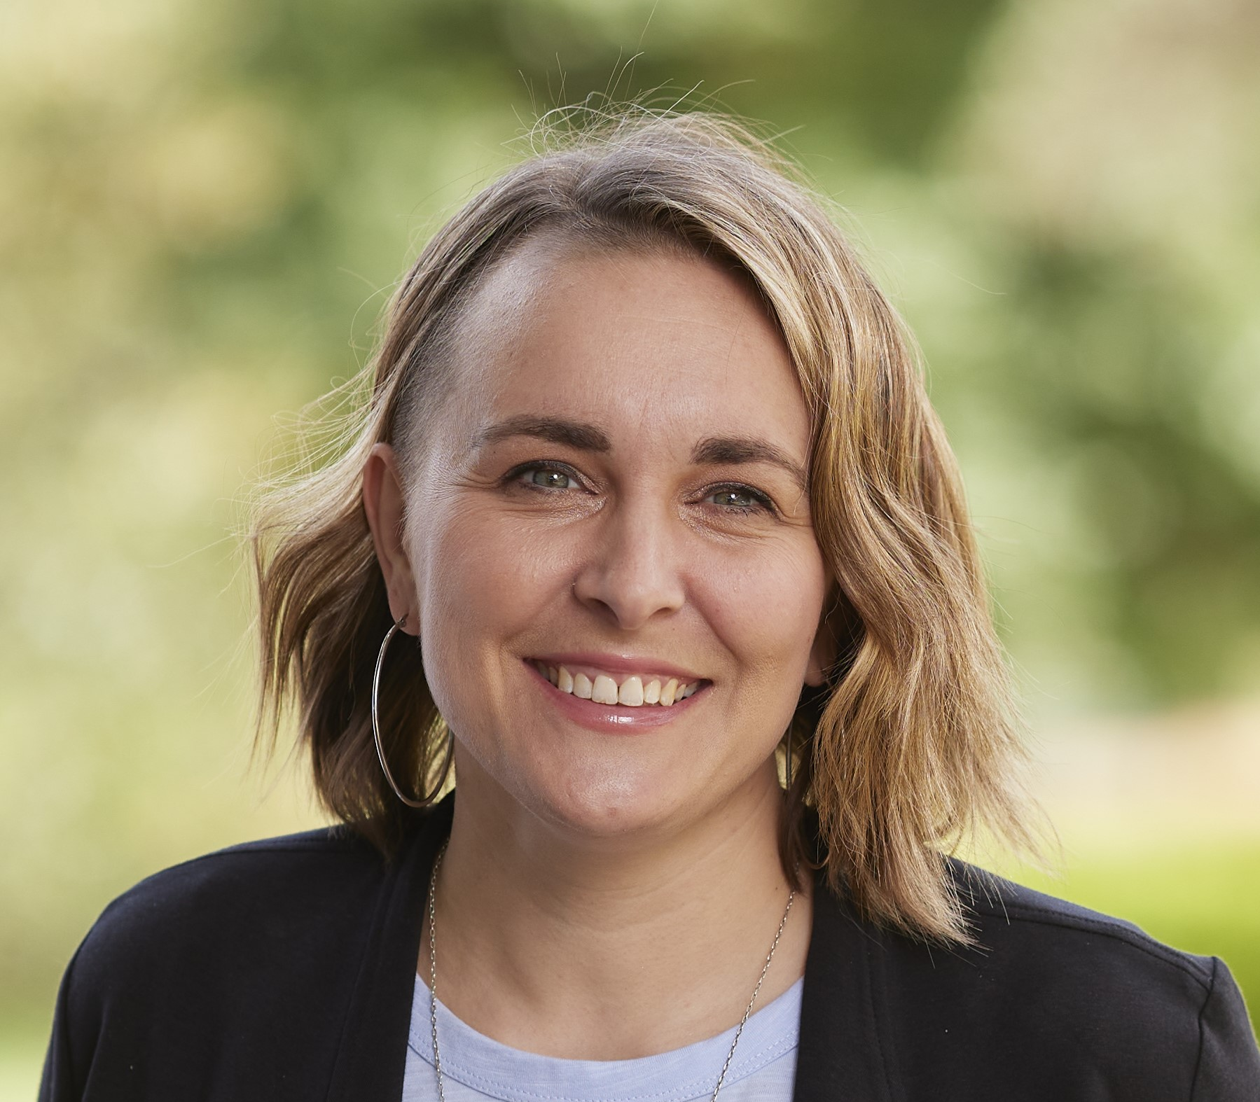


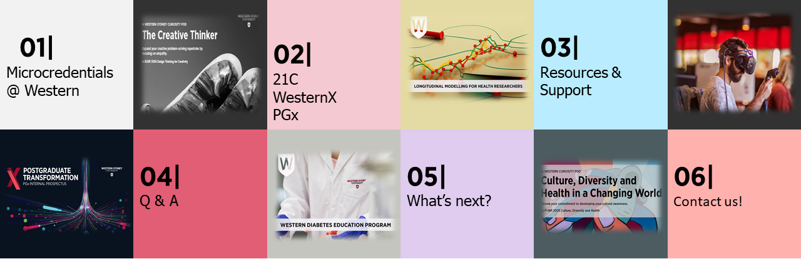
Microcredentials @
Western
Tuesday 28 March
Professor Simon Barrie
DVC, Academic
Professor Si Bedford
PVC, Learning Futures
Dr Nicolene Murdoch
PVC, Educational Partnerships and Quality
Cherie Diaz
Executive Director, Education Innovation
Dr Jenna Condie
21, Senior Lecturer in Digital Society, School of Social Sciences
Lynnae Venaruzzo Director, Postgraduate Transformation
Agenda
George Karliychuk WesternX Program Manager

Slide 2
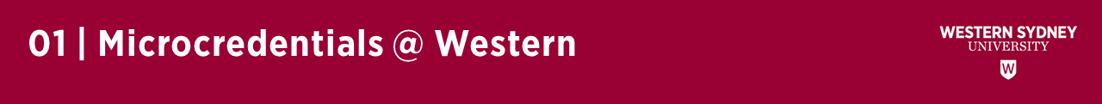
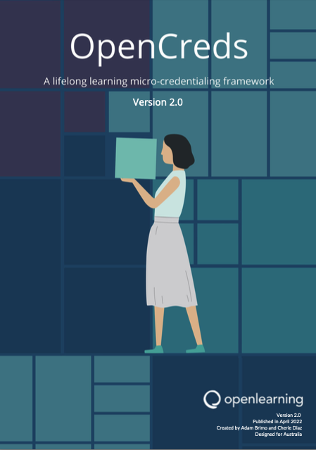
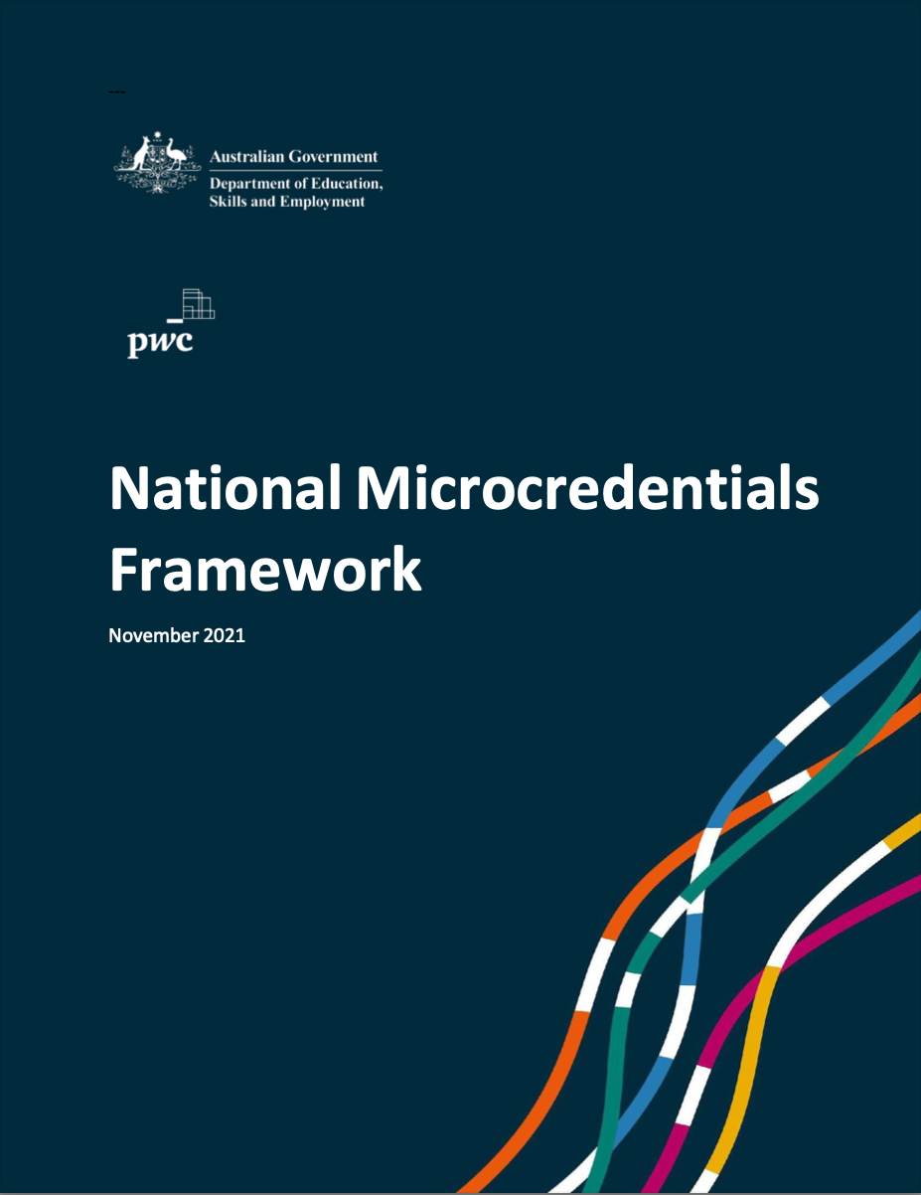
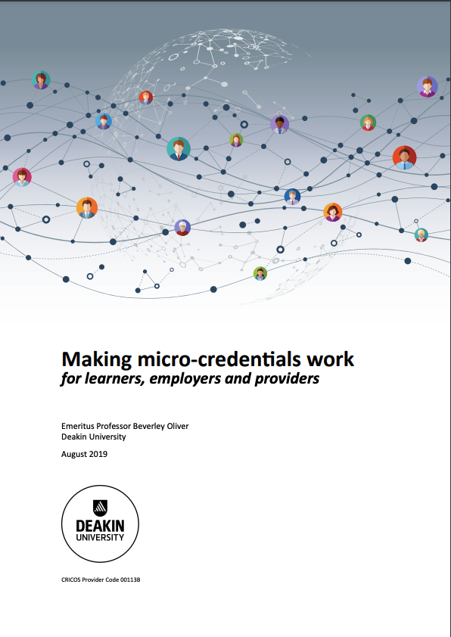

Drivers
Challenges
Frameworks
Ecosystem
National Microcredentials Framework (NMF)
“A microcredential is a certification of assessed learning or competency, with a minimum volume of learning of one hour and less than an AQF award qualification, that is additional, alternate, complementary to or a component part of an AQF award qualification.”subjects.
Notes:
“Lifelong learning must become a practical reality for people; it cannot stand as an abstract goal. Post-secondary education and training is conceived and redesigned as a diverse set of offerings, available through better linkages and pathways between the vocational education and training (VET) and higher education sectors. These linkages and pathways will no longer be linear and hierarchical; they will need to recognize that throughout adulthood, people need to develop new skills in different areas and at different levels.” (AQF Review, p.8, emphasis added).

Slide 3
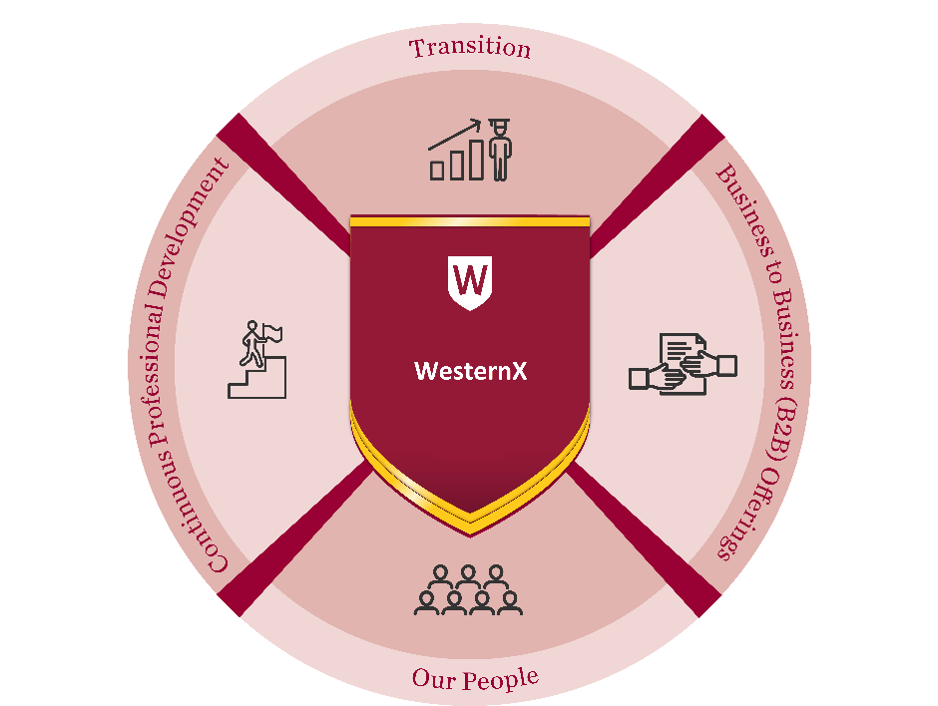

PGx
Current UG students Prospective UG students Community and Schools | Upskiller / Reskiller Prospective UG students Staff | new partnership model new ‘not’ degree model new subscription model
Notes:
21C: Curiosity Pods are 2CPs
Western X: Variable hours of learning
PGx: Minimum of 2CPs and flexible stacking to PG programs

Slide 4

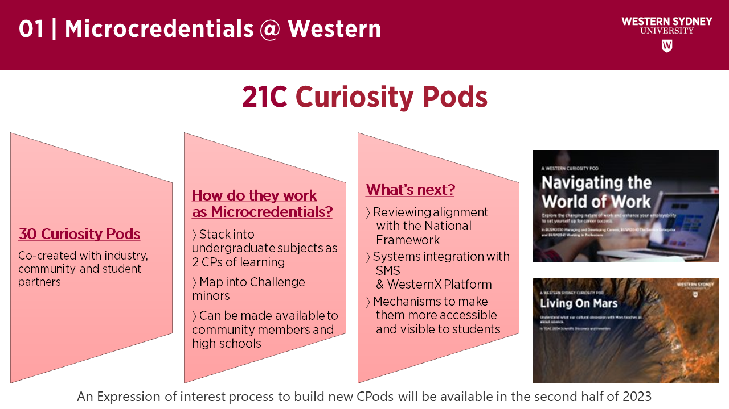
02 | 21C
Curiosity Pods = Undergraduate Microcredentials
30 Curiosity Pods | How do they work as Microcredentials? | What’s next
Co-created with community and student partners | Co-curricula, no pre-requisites Stack into UG Subjects (2 CPs) Map into Challenge minors Will be accessible to community and schools | Alignment with the National Framework Systems integration (SMS & WesternX) Accessibility and visibility to students EOI process for next builds (Spring 2023)
Notes:
(typically 15-30 hours of student learning) are one kind of microcredential we offer. They are designed as bite sized learning with no pre-requisites and are co-created with industry, community and student partners.

Slide 5
02 | A 21C Curiosity Pod in Action
Notes:
Jenna’s slide

Slide 6




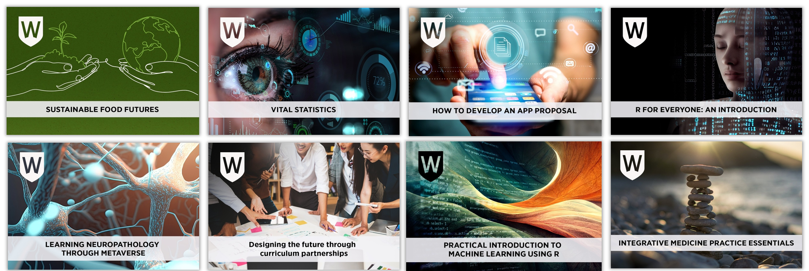
02 | WesternX
Notes:
The aim of WesternX is to develop and deploy new non-award product, for new learners, in new markets.
WesternX MCs are designed to address a particular pain point for Schools, Research Institutes or Divisions
The solutions WesternX offers ranges from transitions into UG programs, life-long learning opportunities where volume of learning varies widely, to serving professional learning of Our People (staff and students at Western)
The design and development focus is always on the learner and learner experience combined with sound UX being paramount

Slide 7
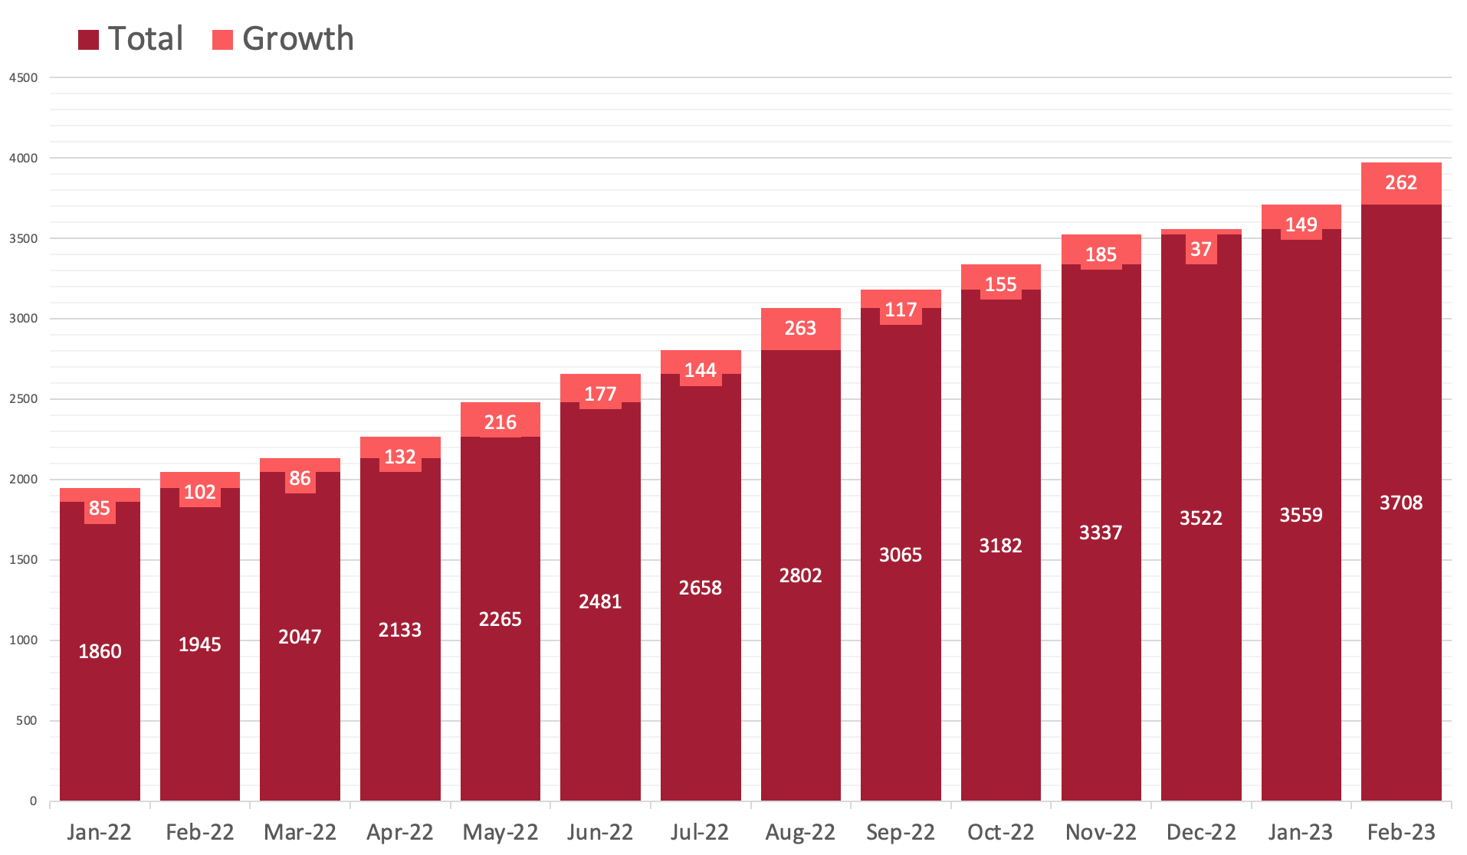
02 | WesternX
2022-2023 Growth of WesternX Learners
3910
Total Learners (as of Mar 2023)
2359
New Learners
(Jan 2022 – Feb 2023)
41 Active MCs
24 of those are listed on
MicroCred Seeker
Marketplace
Volume of Learning
from 1 – 180 hours
Enrolment fees range
From $15 - $1815
WesternX​
Notes:
The growth above was an organic acquisition over the past 15 months
WesternX collaborated with SEM (Marketing Team) on launching a marketing campaign to run for 3 months from March to May
Not all MCs are public facing, some are by-invitation only and are not listed on WesternX Portal

Slide 8
02 | WesternX
Microcredentials Procedures
Purpose & Context
Access
Naming
Development
Approval
Variation & Discontinuation
Learning Management System
Management and Quality Assurance
Assessment & Academic Integrity
Credentialing
Articulation and RPL
Fees
https://tinyurl.com/mc-procedures
This document sets out the purpose and procedures for the development, approval, management and quality assurance for Microcredentials offered by Western Sydney University. It does not apply to award programs or subjects.
Notes:
Re-order this to lead with 21C, then WX and PGx

Slide 9
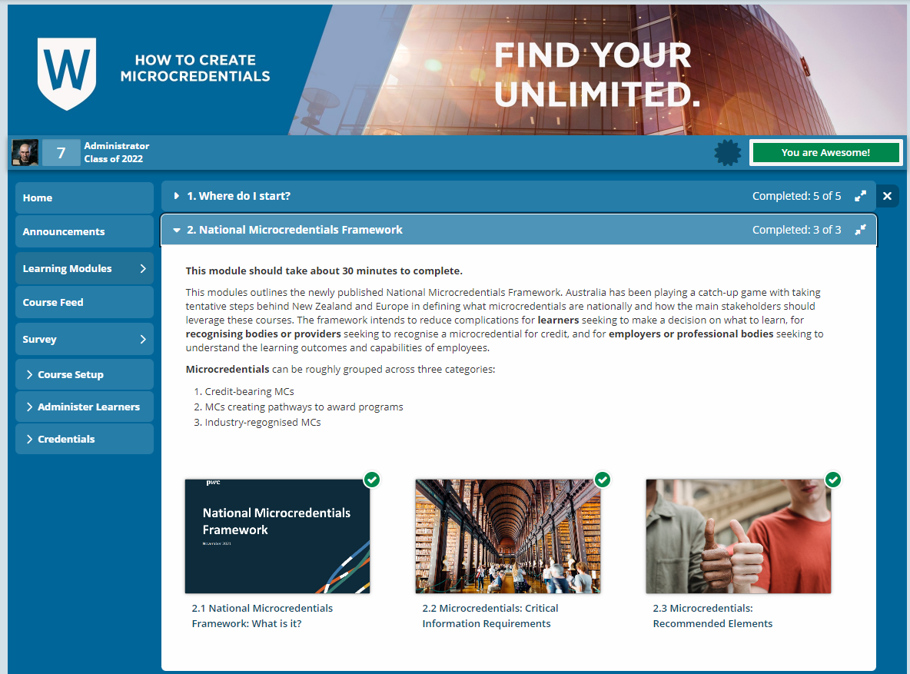
02 | WesternX
  A Microcredential on Microcredentials
  Learn about
    MC approval process
    Initiation steps
    Western digital badging taxonomy
    The considerations of how building mainstream curriculum is different from developing microcredentials
  Discover what your colleagues have already built and save time by emulating their successes
  Prepares you for the WesternX Expression of Interest Submission as the last step of the MC
Notes:
Talk about EoI

Slide 10
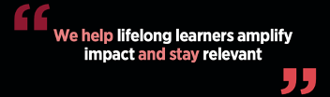
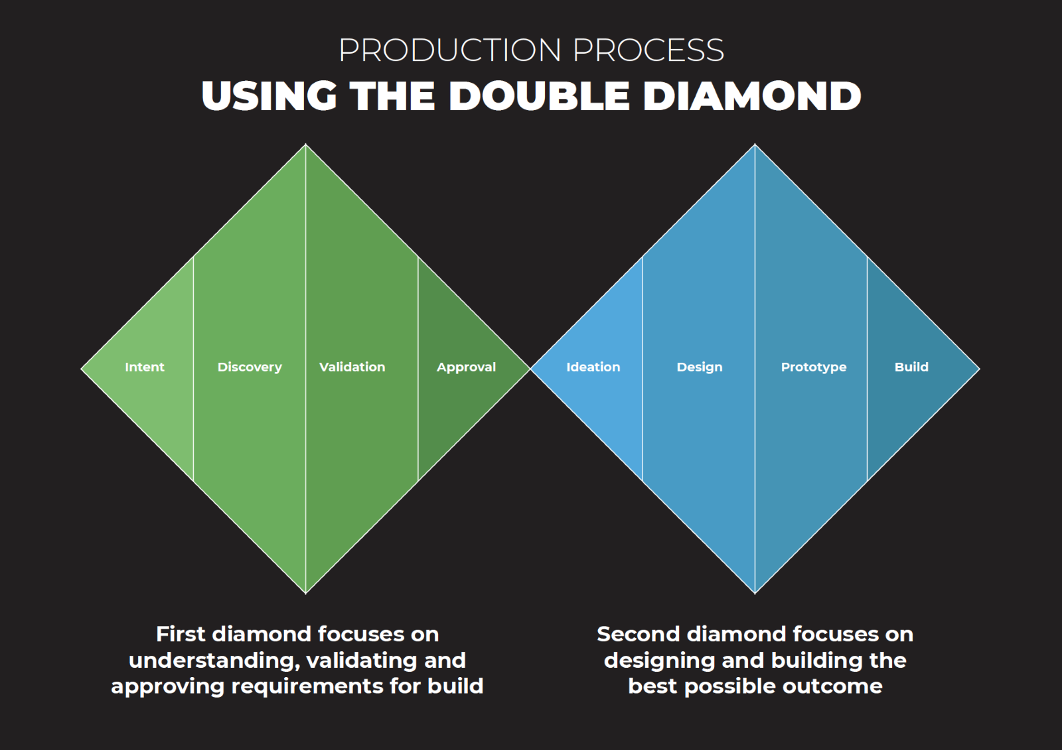
02 | Postgraduate transformation PGx
At PGx, we take a market demand approach with partners in B2B, B2G, and B2C to develop highly differentiated, sector-leading microcredentials and programs that address the upskilling needs of the workforce.
Differentiated Learning
Accelerated workplace skills
Differentiated Production
Compelling story-based learning journeys, immersive technology, high quality media and interactive content
PGx Program of Work
Focusing on Business, Health, Construction and Engineering, Sustainability, and other topics via EOI.
Notes:
Industries have been evolving faster than the education model we rely on to equip our future workforces. The future model of education must allow for a lifetime of top-up learning to support the frequency of change in skills, competency, capacity and the mental elasticity required to adapt.
PGx is reimagining postgraduate education and we recognize that our learners are experienced and bring with them a wealth of knowledge, skills, perspectives and stories to enrich their learning and make an impact in their profession.
PGx microcredentials build and expand upon learners’ knowledge, skills, capabilities, and competencies through industry co-designed courses that promote curiosity and develop the skills to take learners to new heights in their career. We leverage partner needs and market demand insights across B2B Business to Business:
The university partnering with business to meet employer / employee need, B2C Business to Community: Identified needs, such as sustainability, and B2G Business to Government:
Developing offerings that meet an identified need
PGx website (ft. educational model, external context, guides)
Workshop Program
Templates and design artefacts
EdTech Innovation Hub
EOI process

Slide 11
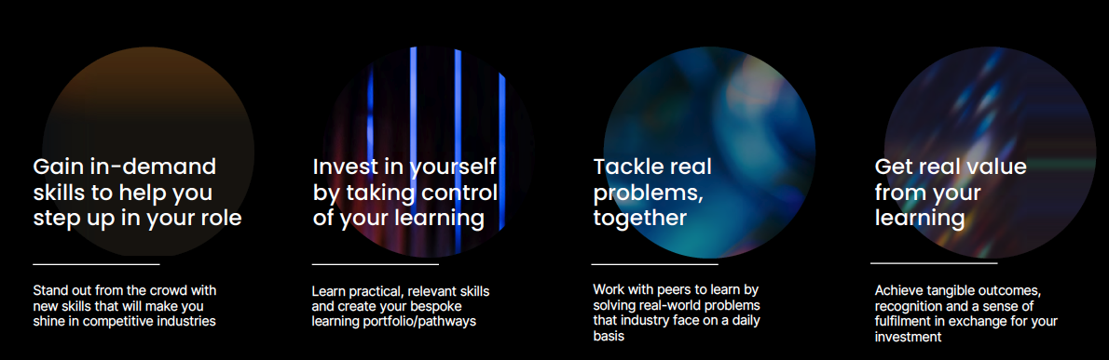
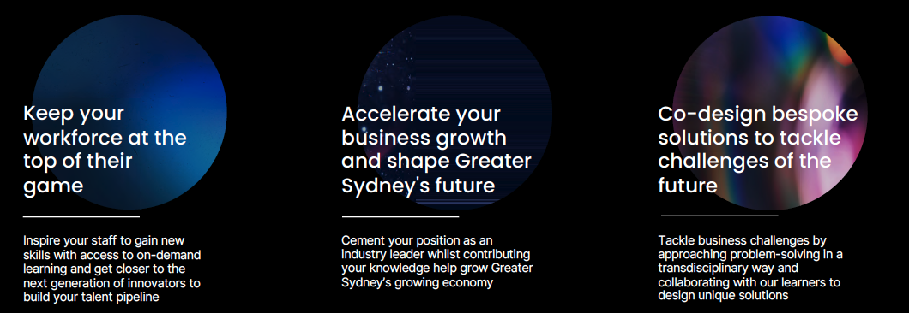
02 | PGx Foundational Promises to....
Learners
and Industry

Slide 12
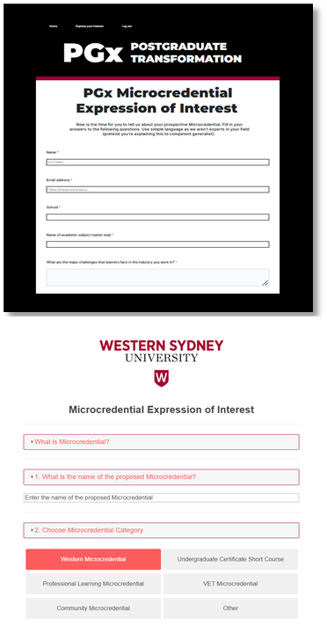

03 | EOI Processes
Got an idea for a Microcredential? Please complete an expression of interest (EOI) form.
The EOI will guide you through the planning process.
To begin, go to our website and click on the Microcredential tab.
PGx
https://pgx.westernsydney.edu.au/eoi
WesternX
https://tinyurl.com/wx-eoi
Curiosity Pods
EOI Coming Soon

Slide 13
04 | Q&A
What else would you like to know about Microcredentials @ Western?

Slide 14
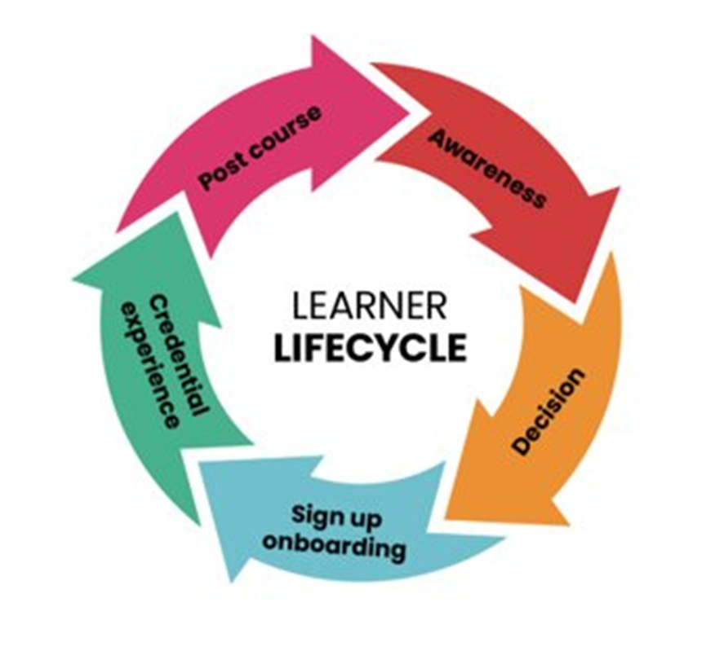
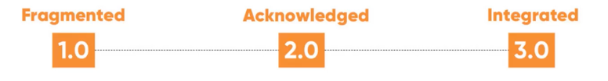
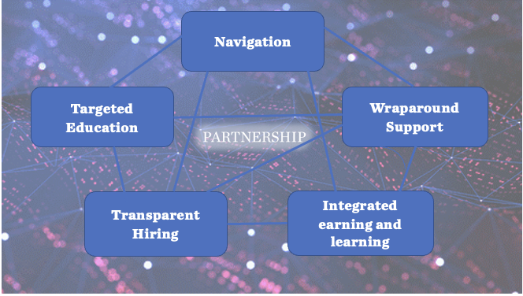
05 | What's next?
What we are working on next​
Microcredentials Support Ecosystem
Customer Relationship Management (CRM)
Marketing strategy​
Systems integration​
Learner support model​
Employer Recognition

Slide 15


06 | Contact us
Get in touch
 | PGx | WesternX | 21C Curiosity Pods
Support & advice | Cherie Diaz | Professor Si Bedford | Dr Jenna Condie
Website | pgx.westernsydney.edu.au | westernx.edu.au
Email | pgx@westernsydney.edu.au | westernx@westernsydney.edu.au | 21c@westernsydney.edu.au
Thank you!
To learn more or ask questions, please contact us.

