Slide 2
Australia and the Protection of Older Persons Professor Catherine Renshaw School of Law, Western Sydney University

Slide 3
Convention on the Rights of Older Persons (CROP)
Australia’s part in leading the development of a Convention
The role that Australian universities could and should play in advancing the development of CROP

Slide 4
Convention on the
Rights of Older Persons

Slide 5
Universal Declaration of Human Rights, Article 2
Everyone is entitled to all the rights and
freedoms set forth in this Declaration,
without distinction of any kind, such as
race, colour, sex, language, religion,
political or other opinion, national or
social origin, property, birth or other
status.

Slide 6
The International Covenant on Civil
and Political Rights
The International Covenant on
Economic, Social and Cultural Rights

Slide 7
The International Covenant on Civil and Political Rights Article 2
Everyone is entitled to all the rights and
freedoms set forth in this Declaration,
without distinction of any kind, such as
race, colour, sex, language, religion,
political or other opinion, national or
social origin, property, birth or other
status.

Slide 8
The International Covenant on Economic, Social and Cultural Rights Article 2
Everyone is entitled to all the rights and
freedoms set forth in this Declaration,
without distinction of any kind, such as
race, colour, sex, language, religion,
political or other opinion, national or
social origin, property, birth or other
status.

Slide 9
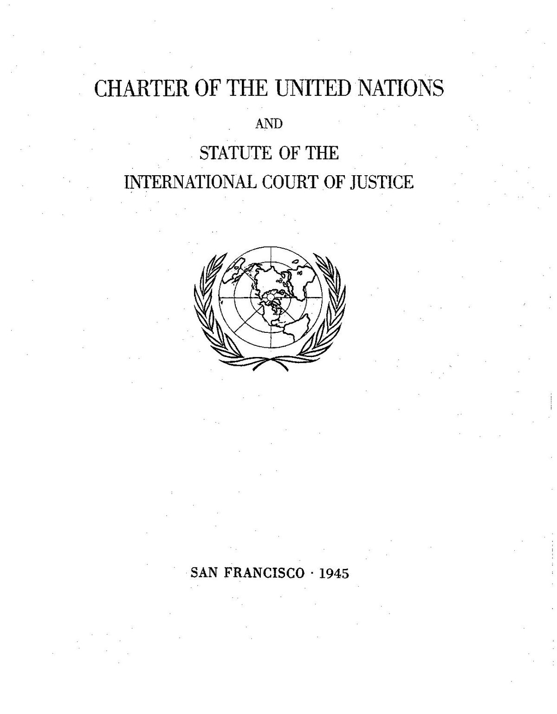

Slide 10
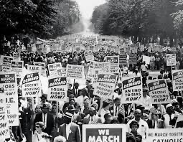
The International Convention on the Elimination of all forms of Racial Discrimination (1965)

Slide 11
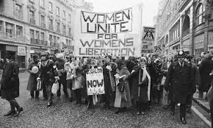
The Convention on the Elimination of all forms of Discrimination Against Women (1979)

Slide 12
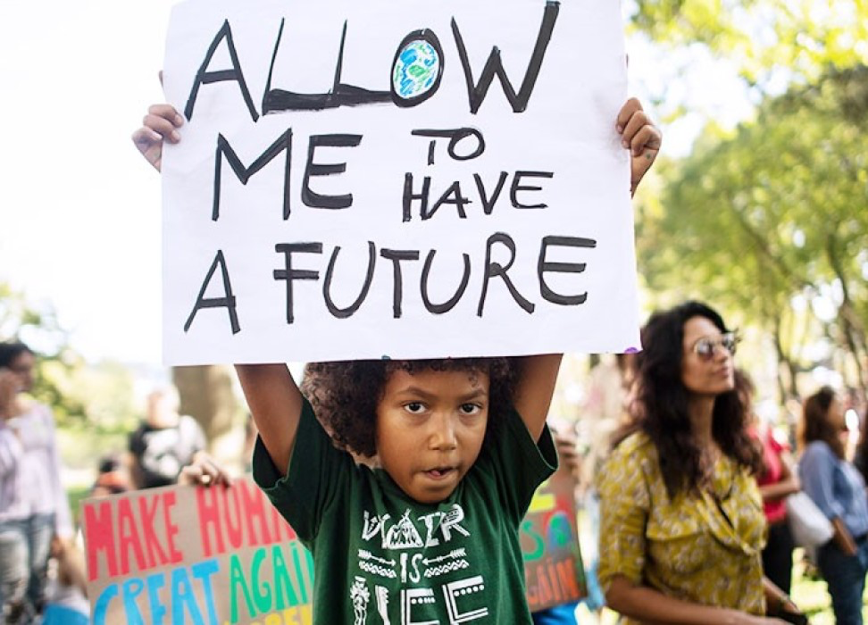
The Convention on the Rights of the Child (1989)

Slide 13
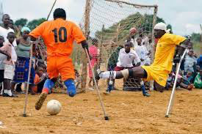
The Convention on the Rights of Persons with Disabilities (2006)

Slide 14
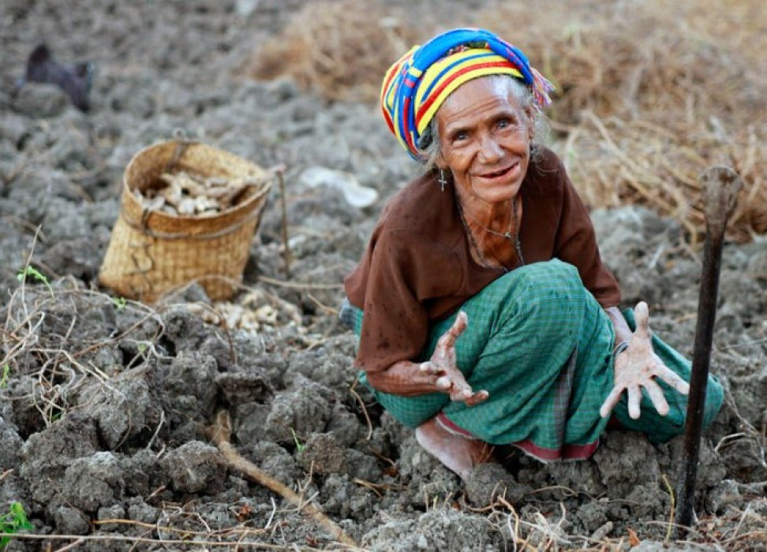
Convention on the Rights of Older Persons?

Slide 15
Define ‘older persons’
Address ageism
Intersectionality
First Nations people
Commonalities?

Slide 16
Australia’s role:
Historical contribution
First Nations people
Regional engagement

Slide 17
The role of universities:
At the forefront of the next frontier for
human rights?

