Slide 1
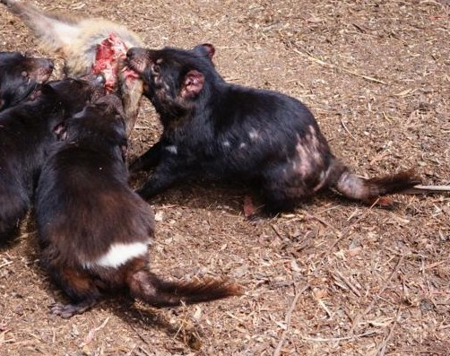
How attitudes towards animals can influence animal welfare outcomes
Sarah Wilks
May 2013

Slide 2
4 different life stories. During its interactions with people.....
A: will be fed, vetted and sheltered & will suffer minimal distress during its life. Its death will be humane.
B: was selectively bred to be functionally deformed & will suffer throughout its life due to this. Its life will be shorter than its wild-type relatives.
C: has >50% chance of experiencing very severe distress during a shortened life. It will be fed and sheltered but will be confined & unable to express normal behaviours.
D: will experience terror before/during death. It may suffer extreme distress for up to 2 days if poisoned, or for extended periods in a trap, or it may be shot (and perhaps wounded)

Slide 3
Animal welfare
The physical and psychological well being of animals
Animal welfare science
Behaviour
Physiology
Other factors that may shape welfare outcomes
Attitudes towards animals
Special/vested interests

Slide 4
Knowledge about how animals are treated
Pets: well known to most people
Farmed animals: generally poor
Distance (geography, complex supply chains)
Coping mechanisms (affected ignorance, dissimulative language)
Lab animals: some knowledge
Feral animals: blank spot
Special cases ≠ increased general knowledge but education can increase concern

Slide 5
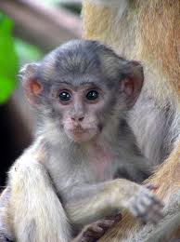
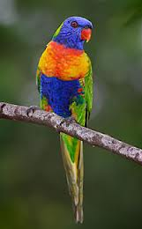
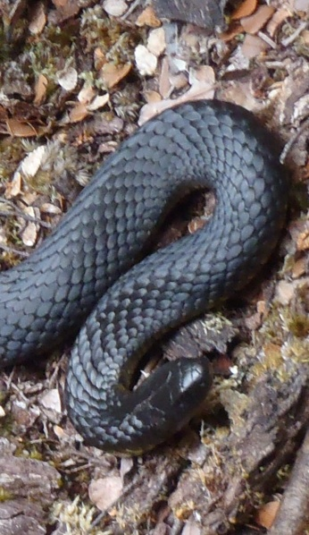
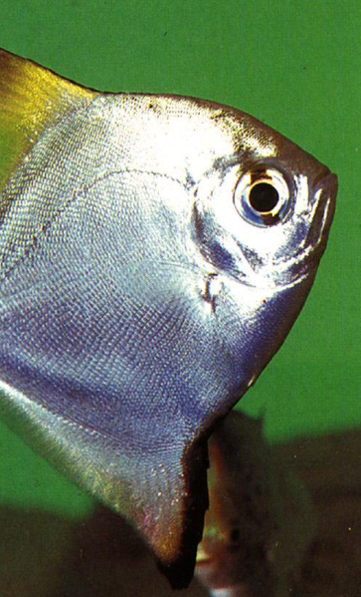
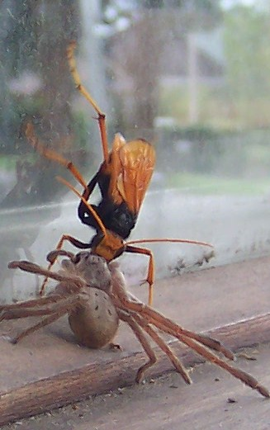
Attitudes towards animals
Gender
Occupation
Type of animal

Slide 6
Animal Welfare Legislation: Overview
All States/Territories have anti-cruelty provisions (essentially “it is an offence to be cruel to an animal”)
Variations (which animals are covered etc)
Have provisions which in effect exempt certain practices although they are in fact cruel

Slide 7
Get out of jail free cards
1. Subjective, qualifying words:
“it is an offence to cause.... “ (‘unnecessary,’ ‘unjustifiable’ or ‘unreasonable’) “......pain (suffering/distress etc) to an animal”
Exceptions eg animals used in research or ‘feral’ or ‘pest’ animals
Codes of Practice

Slide 8
 | Max penalty Yrs $K |  | Fish | cephalopod | Crustacea for human consumption | Undeveloped young
ACT | 2 | 22 | Y | Y | Y | N
NSW | 5 | 22 | Y | N | Y- at place of sale/prep’n | N
NT | 1 | 14 | in capti-vity | N | Y- at place of sale/prep’n | N
Qld | 2 | 100 | Y | May be prescribed | N | > Half gestational age foetus or pouch /egg young
SA | 4 | 50 | N | N | N | N
Tas | 1.5 | 26 | Y | N | N | N
Vic | 2 | 29 | y |  | Y (lobster, crab or crayfish only) | > Half gestational age foetus or pouch /egg young
WA | 5 | 50 | N | N | N | N

Slide 9
Codes of Practice (CoPs)
Tend to cover large scale/industrial settings inc. agriculture, pest control
Set out ways to do things to animals, operate in conjunction with the legislation
compliance shields against legal proceedings
minimum standard
outcomes vs prescriptive (Caulfied 2009)

Slide 10
Factors affecting an animals’ welfare fate
Community knowledge (and expectations?)
Attitudes towards the ‘type’ of animal it is
Animal welfare law and policy
Is there a CoP
is it exempt for some reason
( + in some instances- conservation ideas)

Slide 11
Changes needed?
Some animal welfare outcomes are out of step with welfare science & possibly out of step with community expectations
Present situation: values trade-off
Activism sometimes improves welfare
Money talks- buy high welfare products

