Slide 1
Zoom LTI
Presenter: Robert Ycasiano
Digital Learning Administration Officer,
Learning Futures

Slide 2
ACKNOWLEDGEMENT OF COUNTRY
With respect for Aboriginal cultural protocol and out of recognition that its campuses occupy their traditional lands, Western Sydney University acknowledges the Darug, Eora, Dharawal (also referred to as Tharawal) and Wiradjuri peoples and thank them for their support of its work on their lands (Greater Western Sydney and beyond).
Notes:
I would like to begin today’s workshop by acknowledging the Traditional Custodians of the land on which we meet today, and pay my respects to their Elders past and present. I extend that respect to Aboriginal and Torres Strait Islander peoples here today.
I am joining you today from [Darug] Land. You may wish to add in the chat which land you are joining us from.

Slide 3
Notes:
RECORDING/MUTE
Please note that this session will be recorded, please make sure your microphone is muted and disable your camera if you don’t want to be visible on the recording.
QUESTIONS
If you do have any questions, please post them in the chat and one of my colleagues will respond to you, I will also be available to answer your questions at the end of the workshop.

Slide 4
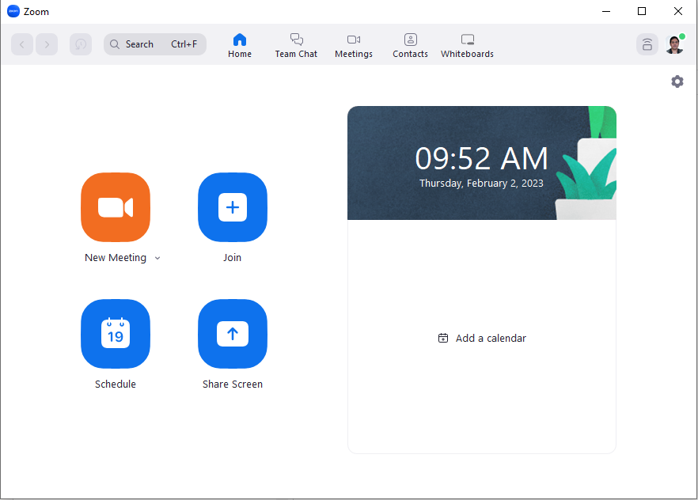
Welcome!
Today we will cover:
What is Zoom LTI?
Adding Zoom LTI Tool
Zoom LTI as Instructor & Student
Other features & FAQ’s

Slide 5
What is Zoom LTI?
The Zoom LTI Pro tool enables both instructors and students to directly access and launch Zoom meetings and recordings from within vUWS.
It has a wide range of features including, but not limited to, scheduling meetings, joining meetings and viewing recordings.

Slide 6
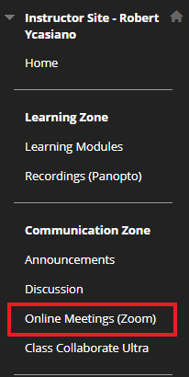
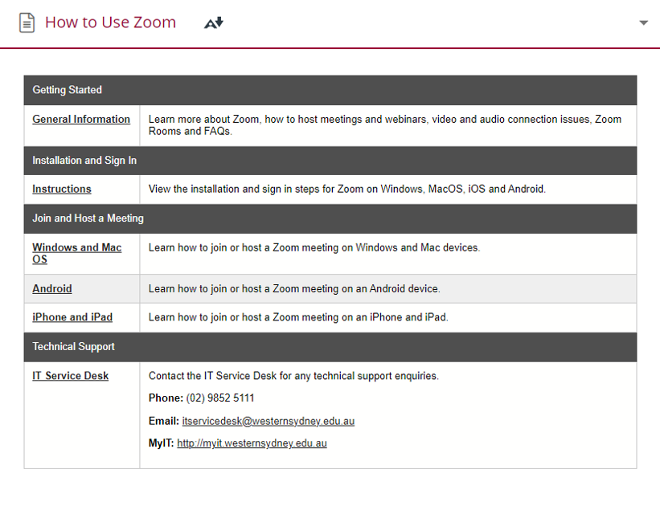
Adding Zoom LTI Tool to vUWS
Getting Started with Zoom
The Zoom LTI link must be added to your vUWS site

Slide 7
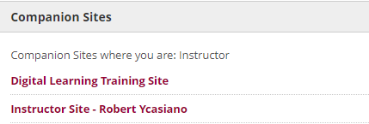
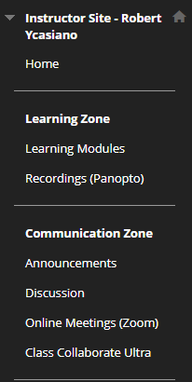
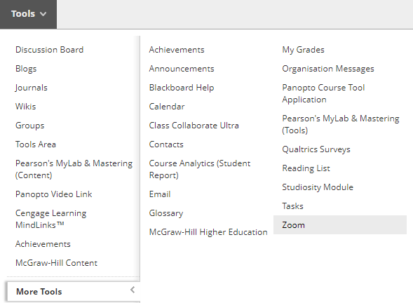
Adding Zoom LTI Tool to vUWS
Navigate to your vUWS site
Navigate to a Content Area - e.g. Online Meetings (Zoom)
Tools > More Tools > Zoom
1
3
5
2
4

Slide 8
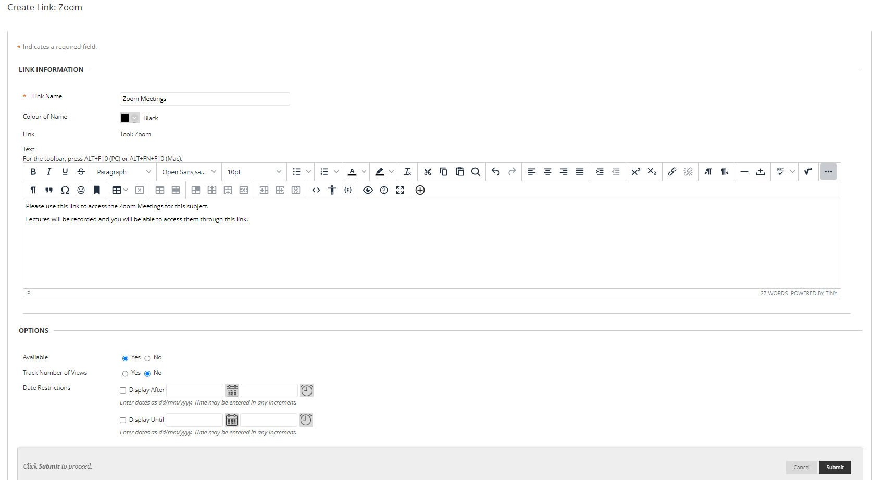
Adding Zoom LTI Tool to vUWS
Add a Content Item Name
Add a Description
Make Available: Yes
Display After & Display Until: (Optional)
Submit
1
2
3
4
5

Slide 9
Adding Zoom LTI Tool to vUWS
Zoom LTI content item has now been added
Rearrange order of content items by dragging the grey bar

Slide 10
Zoom LTI as Instructor – Zoom Dashboard
Three Main Sections
1. Navigation Tabs
2. Schedule New Meeting
3. List of Meetings
2
1
3

Slide 11
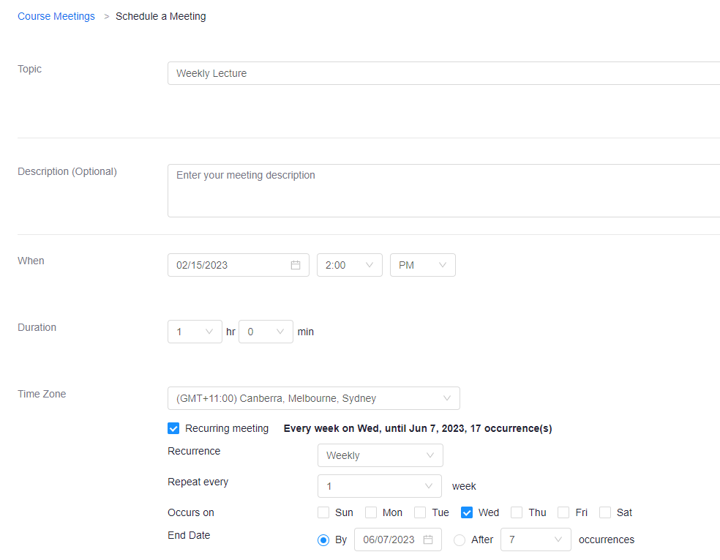
Zoom LTI as Instructor – Schedule a Meeting

Slide 12
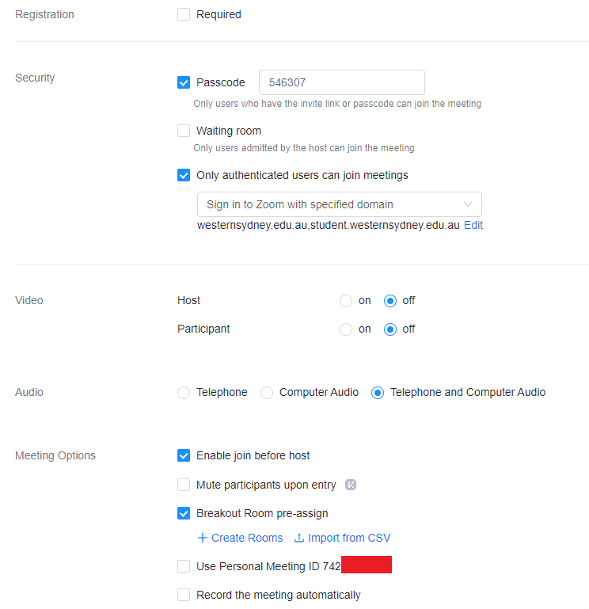
Zoom LTI as Instructor – Schedule a Meeting

Slide 13
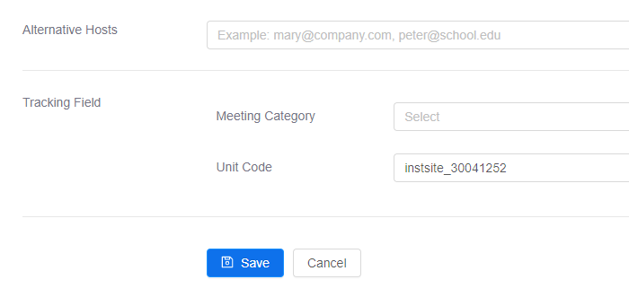
Zoom LTI as Instructor – Schedule a Meeting

Slide 14
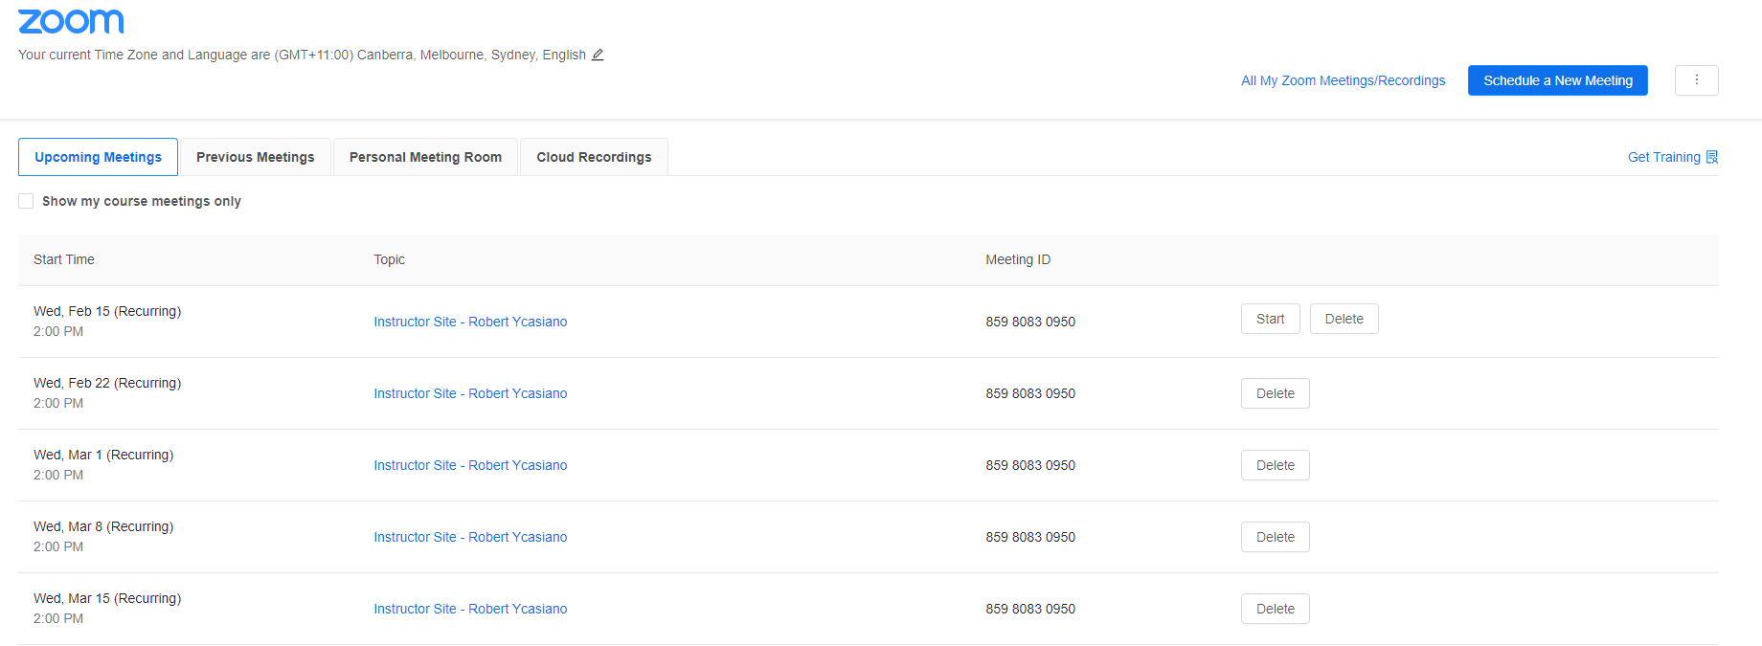
Zoom LTI as Instructor – Zoom Dashboard: Upcoming Meetings

Slide 15
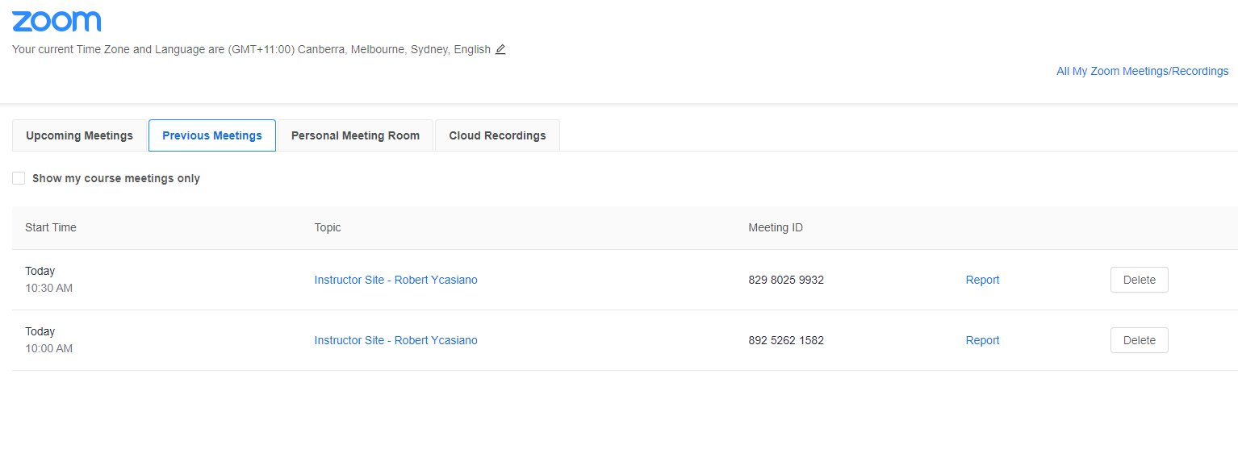
Zoom LTI as Instructor – Zoom Dashboard: Previous Meetings

Slide 16
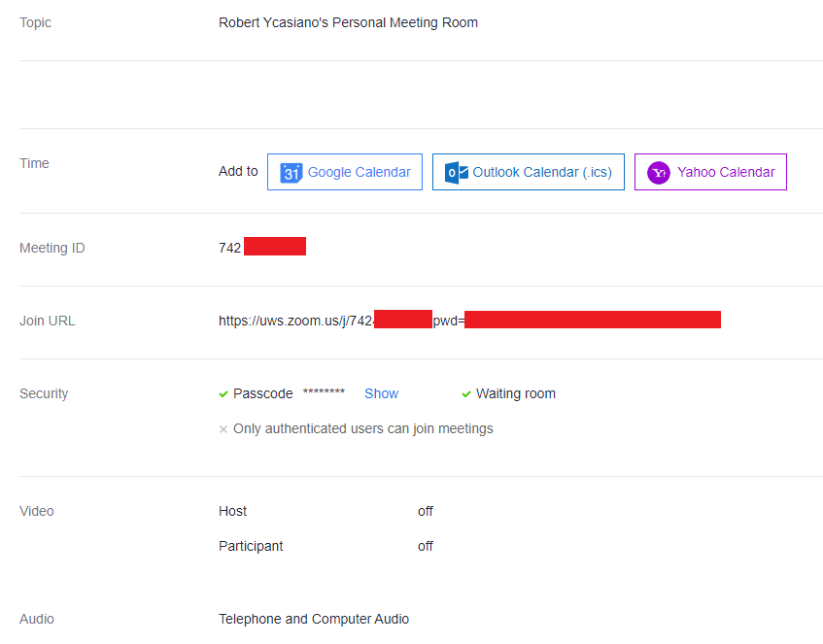
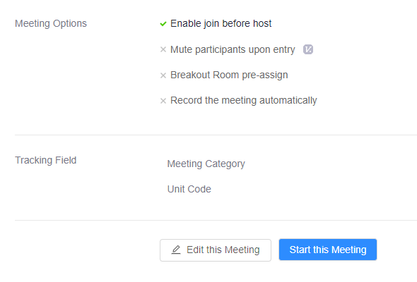
Zoom LTI as Instructor – Zoom Dashboard: Personal Meeting Room

Slide 17
Zoom LTI as Instructor – Zoom Dashboard: Cloud Recordings
Only Cloud Recordings will be visible in the LTI tool

Slide 18
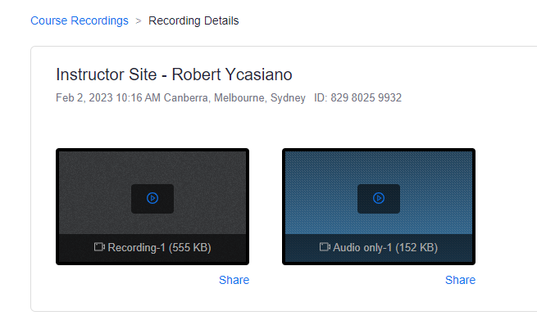
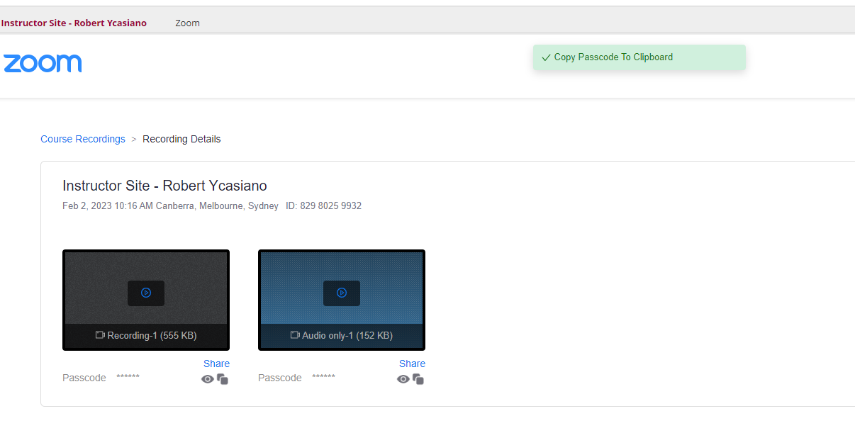
Zoom LTI as Instructor – Zoom Dashboard: Cloud Recordings
1. Recording Details
2. Save passcode to clipboard

Slide 19
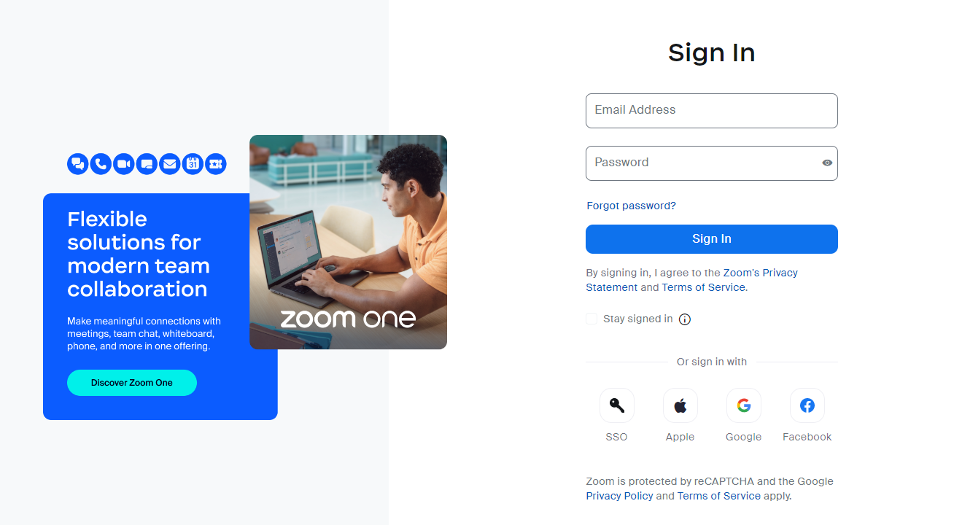
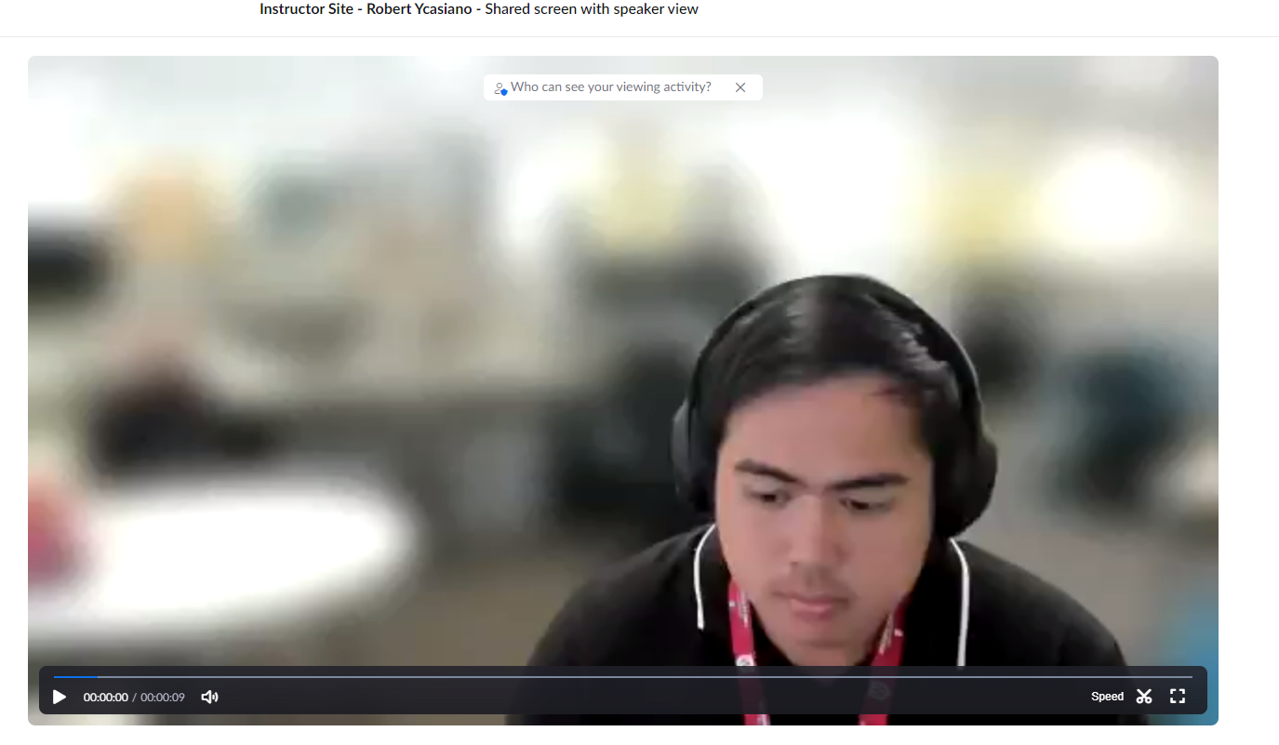
Zoom LTI as Instructor – Zoom Dashboard: Cloud Recordings
3. Sign in with WSU credentials
4. Watch Recording

Slide 20
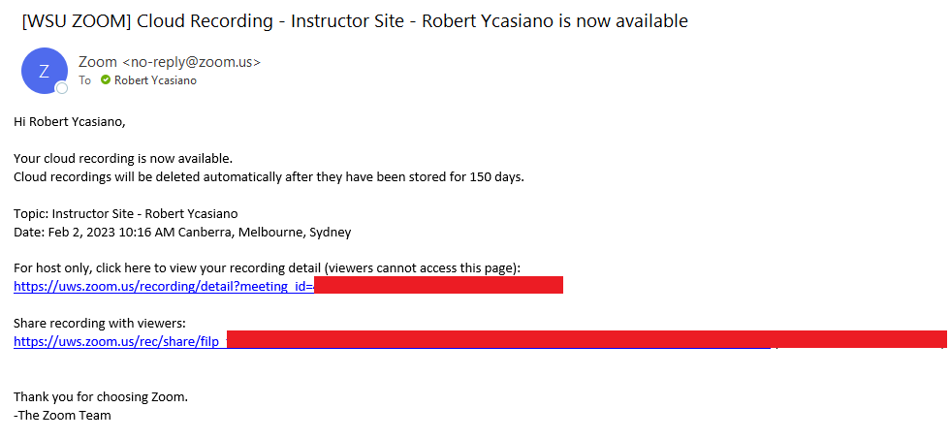
Zoom LTI as Instructor – Zoom Dashboard: Cloud Recordings
Recordings disappear after 150 days - Download recordings ASAP
Confirmation email of Zoom Cloud Recording

Slide 21
Zoom LTI as Student – Zoom Dashboard: Upcoming Meetings

Slide 22
Zoom LTI as Student – Zoom Dashboard: Previous Meetings

Slide 23
Zoom LTI as Student – Zoom Dashboard: Cloud Recordings

Slide 24
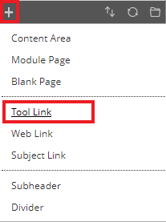
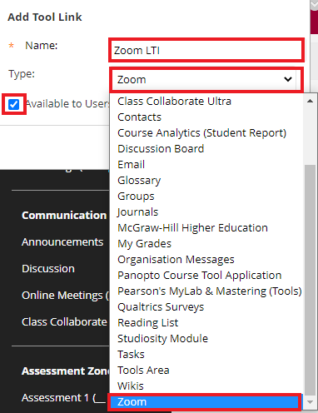
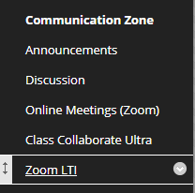
Other Features & FAQ’s: vUWS Tool Link
1.
2.
3.

Slide 25
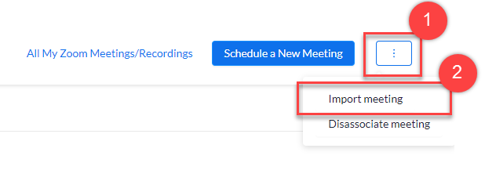
Other Features & FAQ’s: Importing Meetings
It is possible to import meetings into the Zoom LTI Pro tool. Firstly, login to vUWS and navigate to your vUWS site that you want the meetings associated with. Open the Zoom LTI Pro tool in this vUWS site.
In the Zoom LTI Pro tool, up the top right, click on the menu with the three ellipses icon, then click on Import meeting.

Slide 26
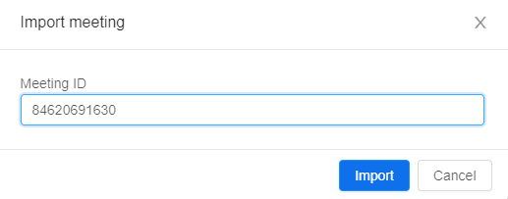
Other Features & FAQ’s: Importing Meetings
Now enter the Meeting ID from the Zoom meeting and click Import. The meeting will now appear in the Zoom LTI Pro tool on vUWS.

Slide 27
Other Features & FAQ’s: Importing Meetings
An ‘Import Success!’ Notification will display and your meeting imported meeting from Zoom is now shown on the Zoom LTI Dashboard.

Slide 28
Other Features & FAQ’s: FAQ’s
FAQs
All information below is referenced from The Hub: https://lf.westernsydney.edu.au/engage/technology/zoom-lti
Q: I cannot see the recording for my class?
The meeting host (usually the instructor of your vUWS site), or alternative host, needs to publish the recording prior to you viewing it.
Q: I run webinars for my lectures how come I cannot import or schedule a webinar from the LTI Pro tool?
Unfortunately, like the Zoom client, webinars can only be scheduled and managed from the web portal https://uws.zoom.us

Slide 29
Other Features & FAQ’s: FAQ’s
FAQs
All information below is referenced from The Hub: https://lf.westernsydney.edu.au/engage/technology/zoom-lti
Q: I cannot find where to pre-assign breakout rooms in the Zoom LTI
Unfortunately, like the Zoom client, pre-assigned breakout rooms can only be managed from the web portal (https://uws.zoom.us). You can schedule a meeting in the LTI Pro tool and then edit it to add breakout room pre-assignments at https://uws.zoom.us.
Q: Can I view attendance and poll reports in the Zoom LTI Pro tool?
The Zoom LTI Pro tool enables instructors to view reports on attendance and polls. In the Zoom LTI Pro Tool, navigate to the Previous Meetings tab and then click on the Report button that corresponds to the meeting you wish to view the reports for.

Slide 30
Other Features & FAQ’s: FAQ’s
FAQs
Q: Can I view attendance and poll reports in the Zoom LTI Pro tool?
The Zoom LTI Pro tool enables instructors to view reports on attendance and polls. In the Zoom LTI Pro Tool, navigate to the Previous Meetings tab and then click on the Report button that corresponds to the meeting you wish to view the reports for.

Slide 31
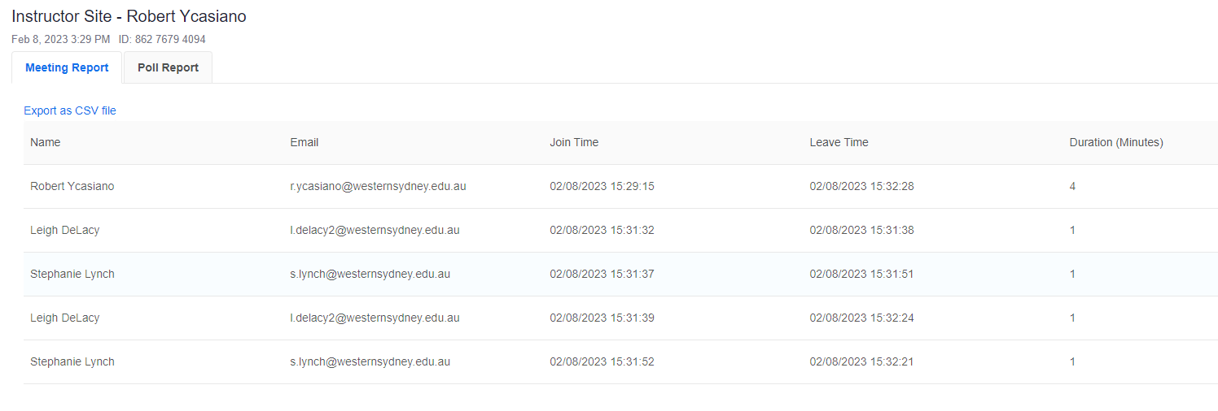
Other Features & FAQ’s: Reports
The report page has 2 tabs:
Meeting Report
Poll Report
Meeting Report – This is the landing tab and shows all the participants that joined the meeting including their name, email, join time, leave time and duration in the meeting. It is possible to export this data by clicking the Export as CSV file link.

Slide 32
Other Features & FAQ’s: Reports
Poll Report - This tab displays all the responses to the polls during your meeting. It includes the participants name, email, question and their answer. To download the report, click on the Export as CSV file link.

Slide 33
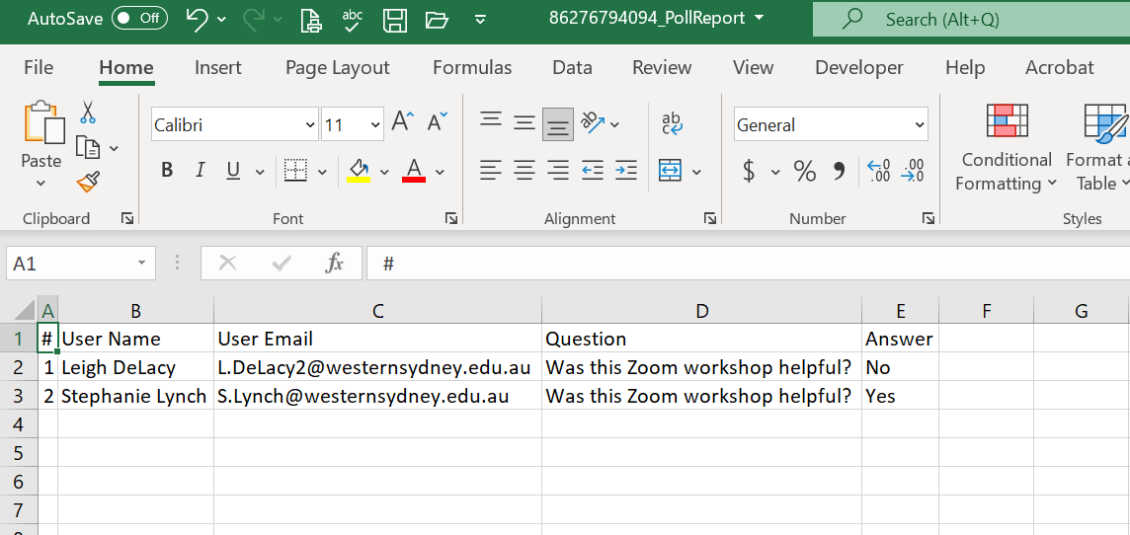
Other Features & FAQ’s: Reports
Downloading the file will open the Poll results in a .csv format in Excel

Slide 34
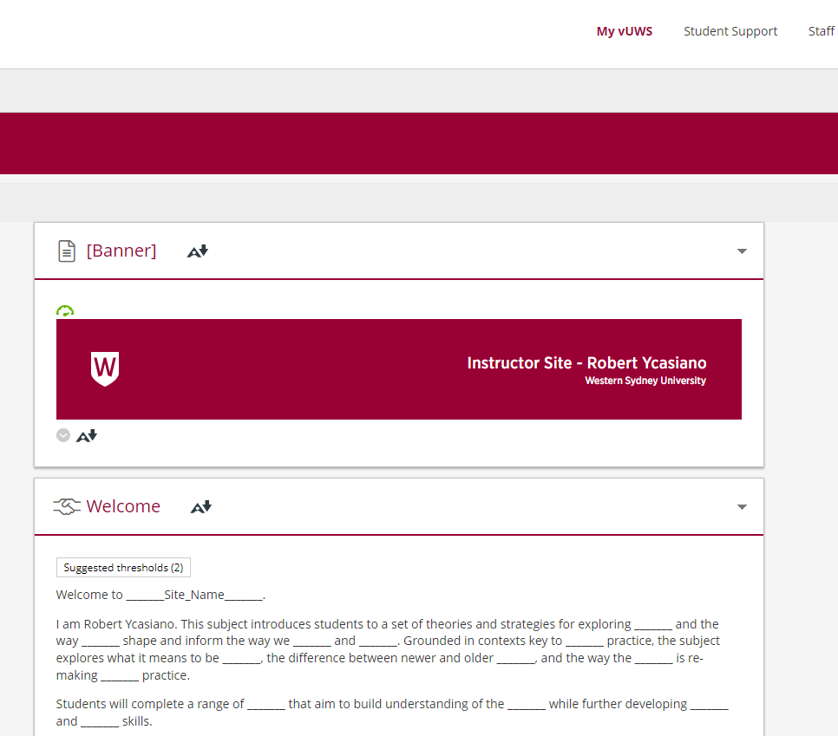
Go to Live Demo

Slide 35
Feedback
Presenter: Robert Ycasiano
Digital Learning Administration Officer,
Learning Futures

Slide 36
Tell us what you think!
Did you like the workshop design and delivery?
What would you like to know more about?
It should only take 3 minutes
**We use your feedback to fine-tune, create and schedule future workshops**

Slide 37
Support & Resources
Presenter: Robert Ycasiano
Digital Learning Administration Officer,
Learning Futures

Slide 38
Further Information
You can also find other Training Sessions on the Learning Futures Workshop Schedule website.
Self help articles (vUWS support): https://lf.westernsydney.edu.au/support/
Support - Contact us at Western Now
101 – Schedule a Booking
Digital Learning Support - Website
Notes:
You can also find other Training Sessions on the Learning Futures Workshop Schedule website.
We have Self help articles (vUWS support): https://lf.westernsydney.edu.au/support/
You can request for Support by contacting us at Western Now
You can also schedule a 101 booking with us via our Booking form

Slide 39
End

