Slide 1
Important
Recording
This session is being recorded and your audio, video and chat contributions may be captured and later shared online.
Please disable these if you wish to remain anonymous.
Questions
Please ask any questions via the chat for our co-presenter to either respond to or collect for a later response.
Support
If you have any unanswered or complex questions, please contact our support team via DFT@westernsydney.edu.au

Slide 2
Discussion Boards, Blogs, & Journals
Forrest Duxbury, LF
Shristi Barahi, LF
Rhoda O’Higgins, LF

Slide 3
Welcome!
Introduction
Discussion Boards
Blogs
Journals
Closure

Slide 4
Discussion Boards
Blogs
Journal
Overview
Key Features
Setup
Group Tools

Slide 5
Discussion Boards

Slide 6
Discussion Board – Video Overview

Slide 7
Hierarchy
Discussion Board
Forum 1: Social Forum
Thread Post 1: Introduce yourself!
Post 2: Hi, I’m Mike, I like cats.
Reply Post 4: I like cats too!
Post 3: Hi, I’m Sammi, I like dogs.
Thread Post 2: Summer Dance!
Forum 2: Learning Module 3 – Chemistry
Thread Post 1: Discuss exo & endothermic reactions

Slide 8
Key Options
Unit Wide vs Group forums
Must Create a Thread forums
Grading a Forum (needs marking view, rubrics)
Grading a Thread
Forum Subscription (Email)
Anonymous Posts
Mark as read/unread
Sort threads, filter posts
Collect posts
Due Date and Late Submissions
Permissions - delete / edit post, file attachment, ratings, tag posts
Draft Posts

Slide 9
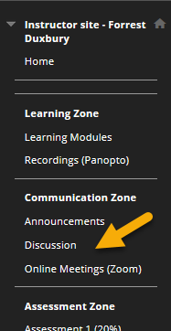
Where is it?
Enabled by default (Cortex)
Online Netiquette Video

Slide 10
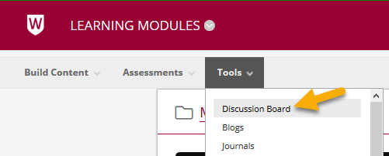
1. Adding to a Learning Module

Slide 11
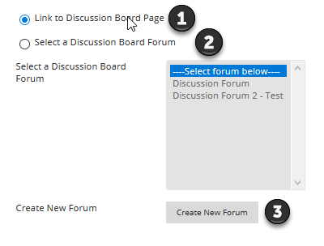
2. Where to link to?
View All
View One
Create New

Slide 12
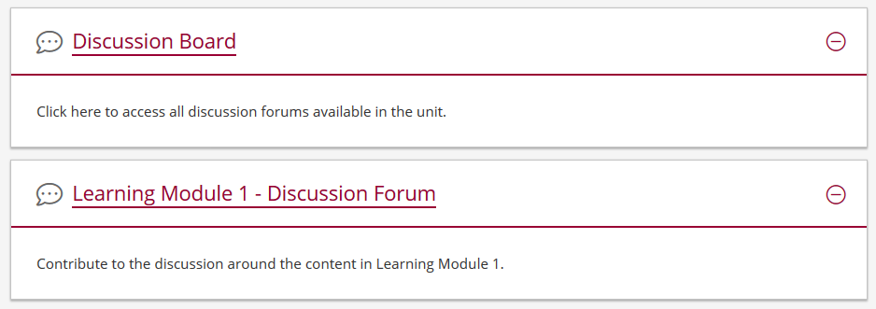
3. Page or Forum

Slide 13
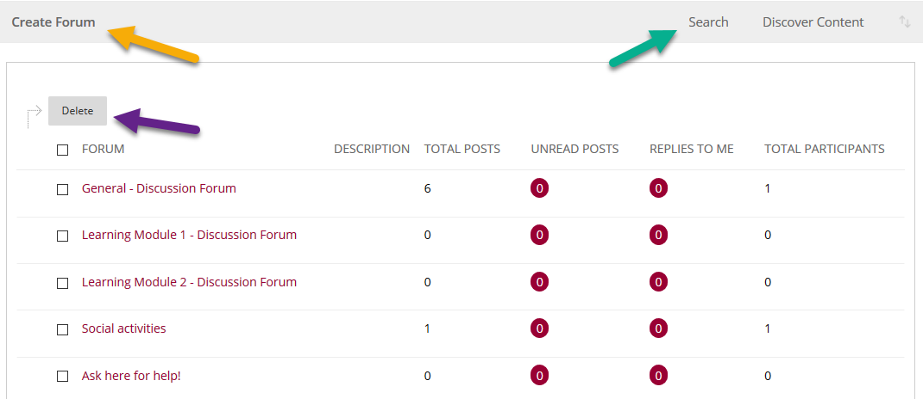
4. Discussion Board - All

Slide 14
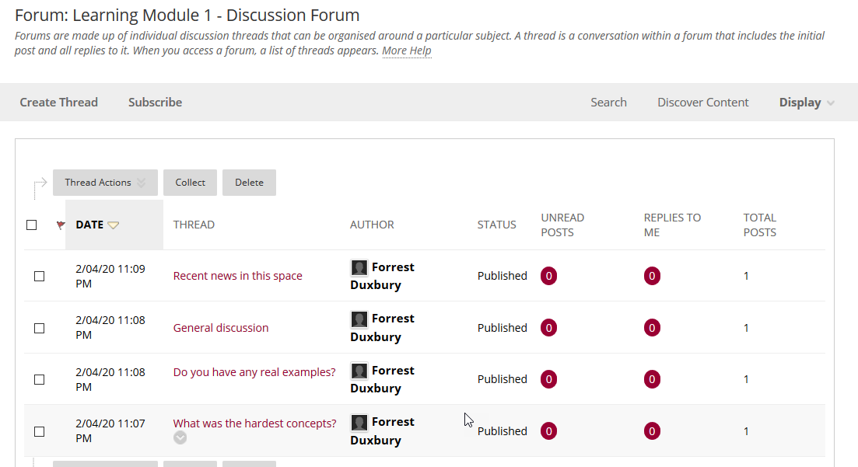
5. Discussion Forum & Threads

Slide 15
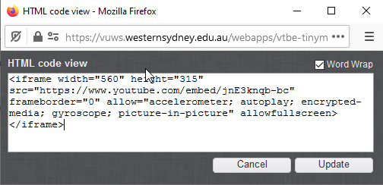
Creating Threads/Posts

Slide 16
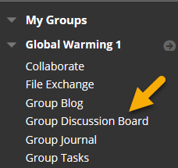
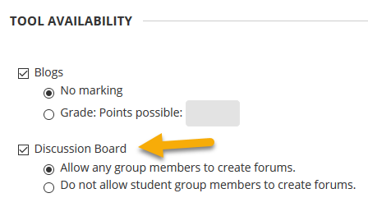
Group Forums

Slide 17
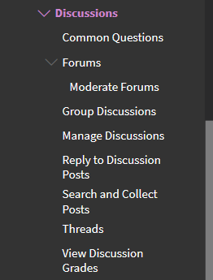
Discussion Forum Support

Slide 18
Blogs

Slide 19
Blogs – Video Overview

Slide 20
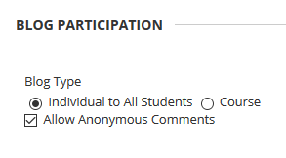
Key Options
Course (aka Unit) – all can post, all can read/comment
Group – group can post, all can read/comment
Individual – you can post, all can read/comment
Draft Posts, Rubrics

Slide 21
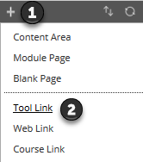
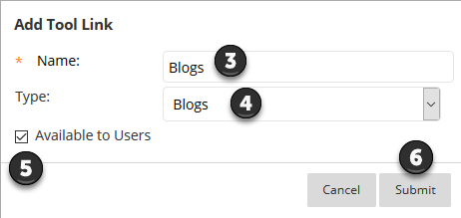
1. Adding to Side Menu

Slide 22
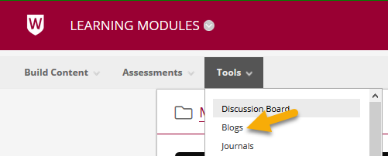
2. Adding to a Learning Module

Slide 23
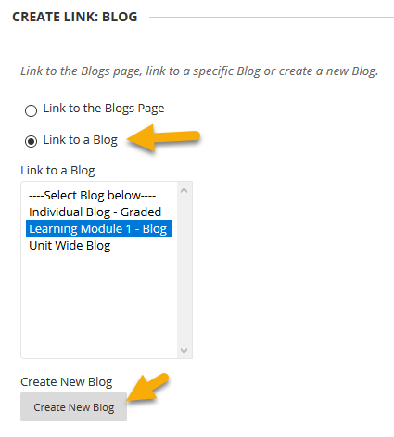
3. Linking

Slide 24
4. Linking within a Learning Module

Slide 25
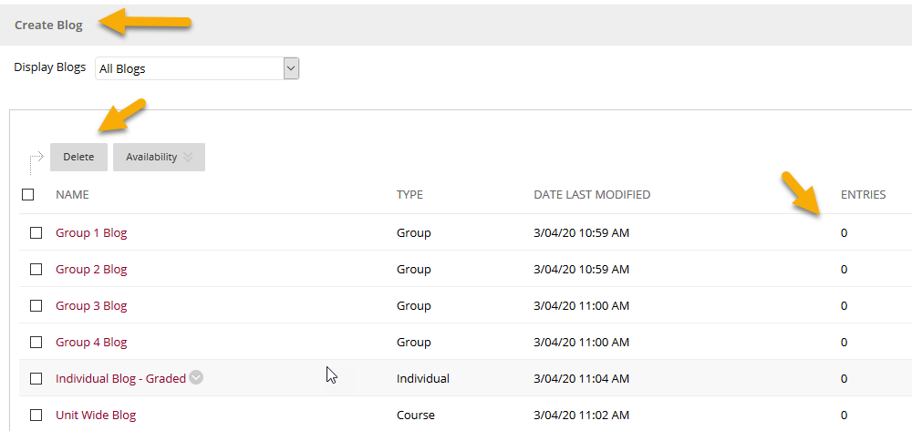
5. Link to all Blogs

Slide 26
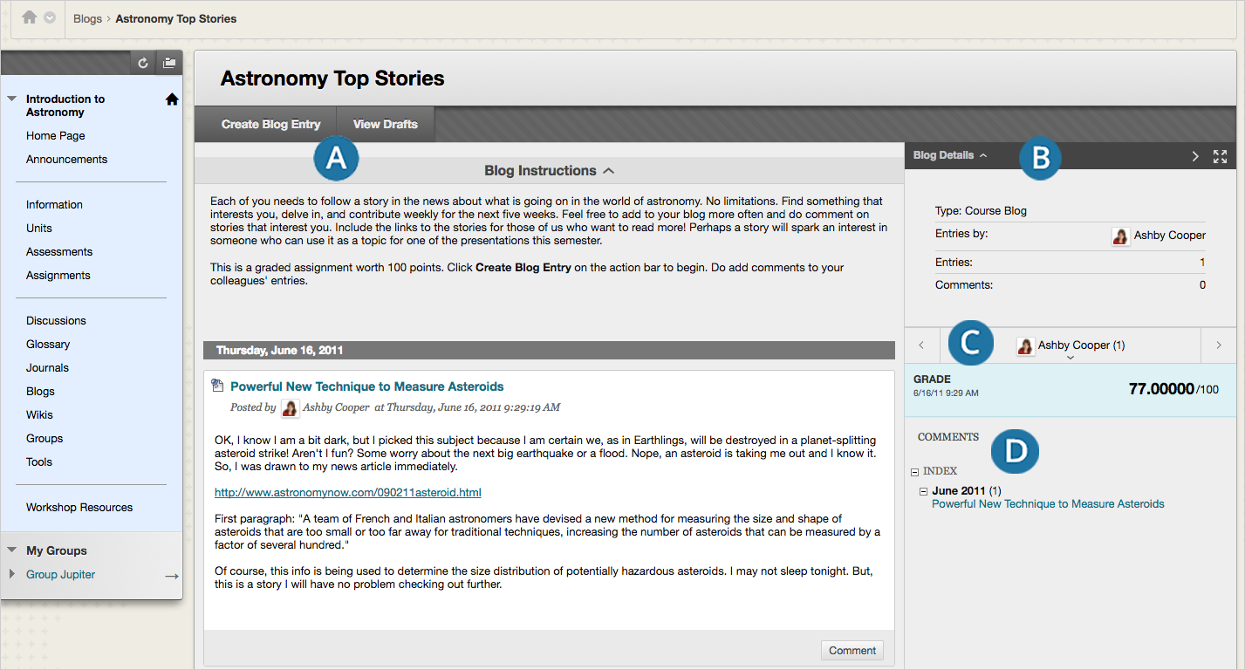
What does it look like?

Slide 27
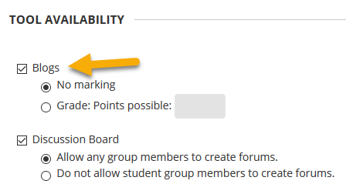
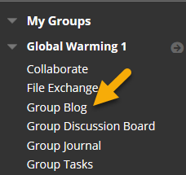
Group Blogs

Slide 28
Journals

Slide 29
Journals – Video Overview

Slide 30
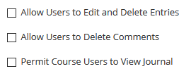
Key Options
Journals are typically for self-reflection, visible to student and instructor
Instructors can publish a journal to all.

Slide 31
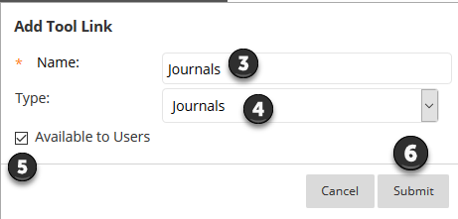
1. Adding to Side Menu

Slide 32
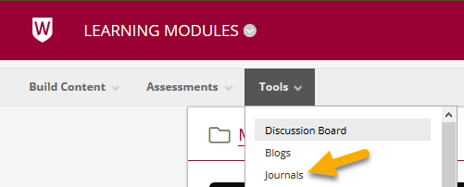
2. Adding to a Learning Module

Slide 33
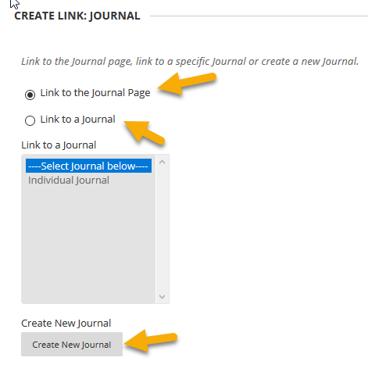
3. Linking

Slide 34
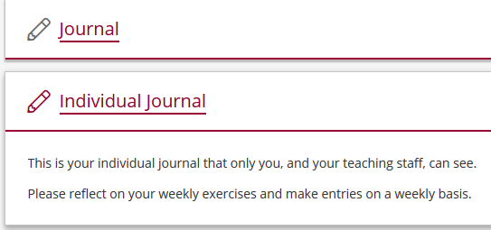
4. Linking within a Learning Module

Slide 35
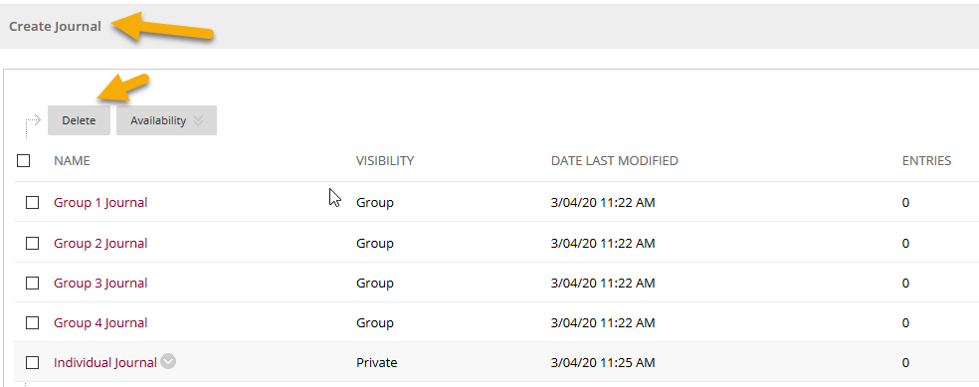
5. Link to all Journals

Slide 36
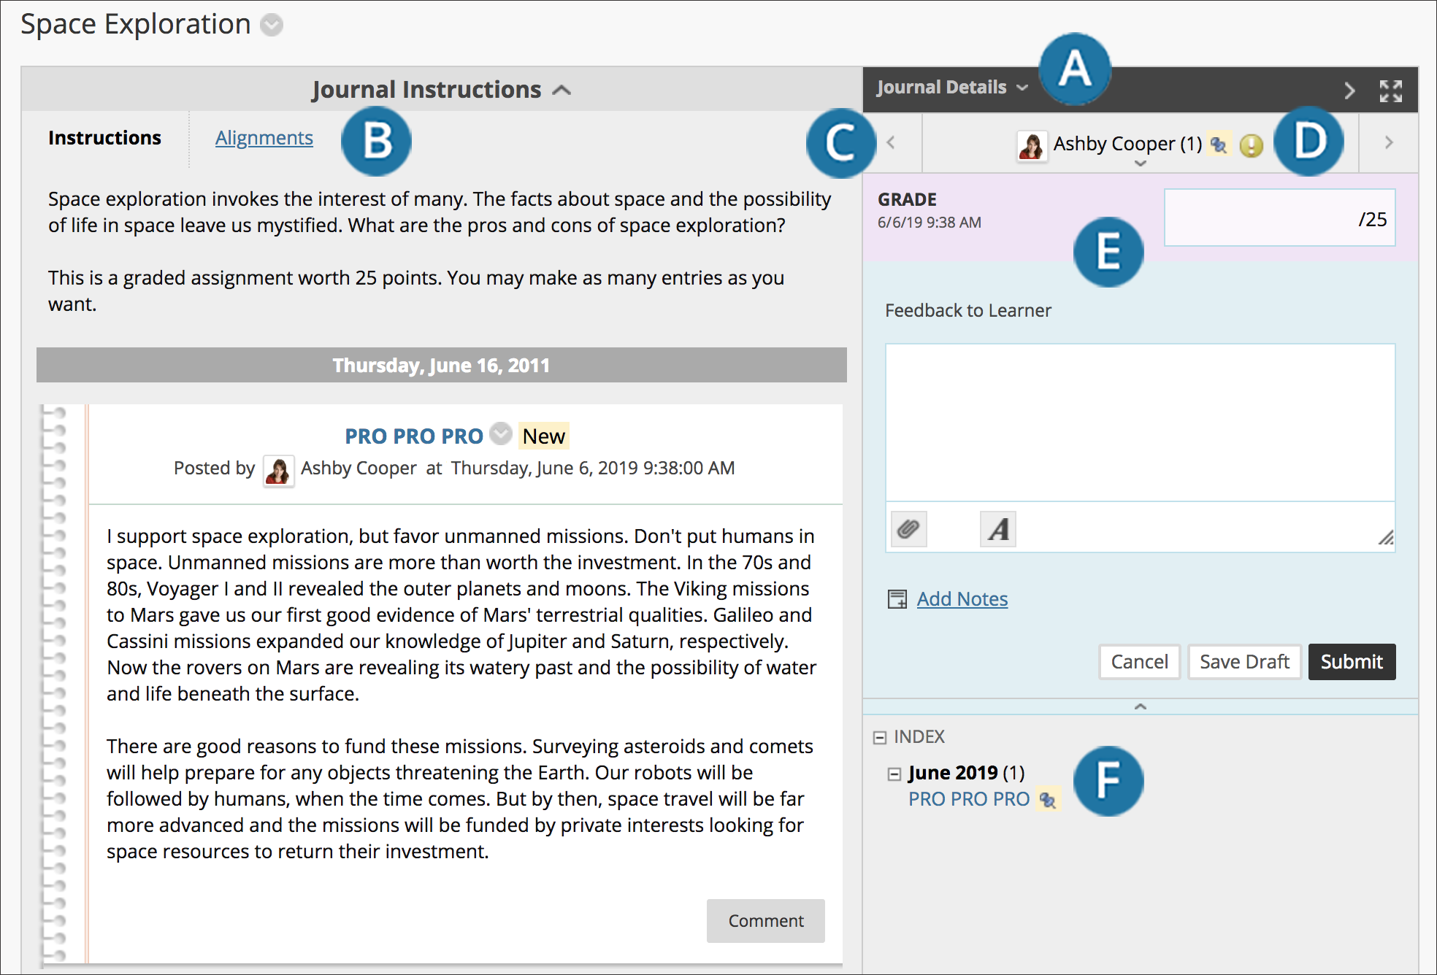
What does it look like?

Slide 37
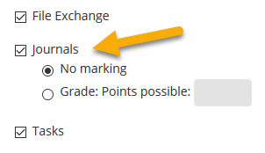
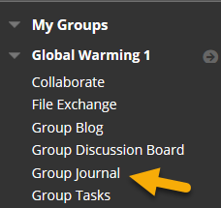
Group Journals

Slide 38
Further Information
Western Sydney Support Resources
https://dft.westernsydney.edu.au/support/
https://wsu.service-now.com/it
Bb Support Resources
Discussion Forums
Blogs
Journals
Bb & Accessibility
vUWS Accessibility
General vUWS Navigation
Discussion Forums

Slide 39
Need help?
Contact Us – dft@westernsydney.edu.au
Contact IT – itservicedesk@westernsydney.edu.au

Slide 40
Thank you for attending.

