Slide 1
APPLYING
THROUGH
UAC
Enhancing the links 2018

Slide 2
TIMELINE OF EVENTS
September
UAC early bird applications close
SRS applications close
November
Offer including SRS
EAS documents due
January
ATAR based offer rounds
August
UAC applications open
SRS & EAS applications open
October
HSC exams
October offers
December
ATARs released
Change of preferences
First ATAR based offer round

Slide 3
PREPARING FOR STUDY
Visit Career Expos and uni Open Days
Investigate all course possibilities
Check for additional selection criteria
Read all university information and the UAC guide for detailed course descriptions
Talk to universities, Career Advisers and UAC staff for details on courses and applying
Research using UAC’s ‘Course Search’ at www.uac.edu.au or the MYUAC App

Slide 4
APPLY
Applications open on in August.
Apply online
List up to 5 courses in your order of preference.
Pay processing charge.
Print confirmation and tax receipt.
Additional applications (EAS/ES/SRS).

Slide 5
PATHWAYS
Applying as a Year 12 student
In general entry is based on the ATAR.
Most universities offer early entry through the Schools Recommendation Schemes (SRS).
Always consider alternate pathway courses such as: uni foundation programs, diploma courses at either university, TAFE or private college.
Applying as a NON School leaver
Apply using ATAR, certificate III, IV, diplomas or uni studies.
Many universities offer preparation course such as uni foundation programs or diploma courses.

Slide 6
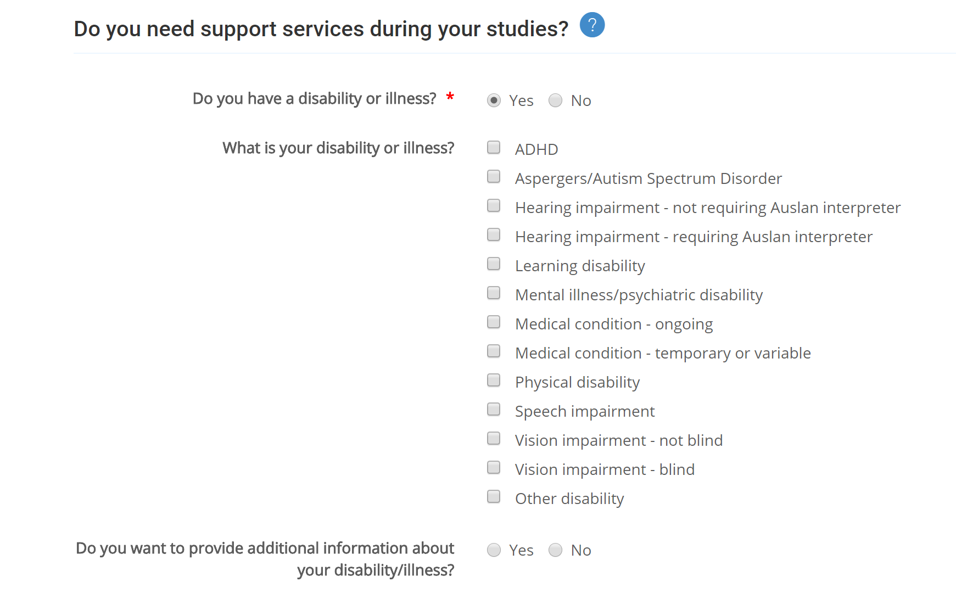
APPLYING
Within the application as student will be asked if they need support services during their studies.
The student will then have a chance to advise on the specific disability of illness they have so that the university can contact to discuss specific needs.

Slide 7
APPLYING
Applying with a disability
We encourage students to let us know of their disadvantage as this will help the institutions meet the educational needs of the student.
Universities are then able to provide:
Note takers
Learning assistance
Alternative assessment methods
Academic material in alternate formats
Parking for holders of RMS permits
If a student has troubles applying due to their disability they are encouraged to contact UAC direct for assistance.

Slide 8
Educational Access Schemes
Schools Recommendation Schemes
Equity Scholarships

Slide 9
EDUCATIONAL ACCESS SCHEME
Special consideration for students who have suffered some form of disadvantage which affected their schooling through Years 11 and/or 12.
Disadvantage lasting 6 months or longer and beyond a student’s control.
6 broad categories, 25 different disadvantage codes.
Apply online by 30 Nov to receive eligibility notice before ATAR release.
Additional documentation may be required.
Educational Impact Statement is a statement provided by your school in support of your application
If successful under EAS you may be eligible for some adjustment factors.

Slide 10
SCHOOLS RECOMMENDATION SCHEME
One way institutions make early offers using criteria other than, or in addition to, the ATAR.
You could be made an offer to uni before ATARs are even released!
Online application, open August 2018. Note, this is a secondary application to your main UAC application.
12 participating institutions (2017).
Not all courses are offered through SRS.
Institutions may use your Year 11 results, your school’s rating of your aptitudes and abilities and your EAS application (if applicable) when considering your application.
Conditional and unconditional offers made.

Slide 11
EQUITY SCHOLARSHIPS
Designed to assist financially disadvantaged students with the general costs associated with going to uni.
Most institutions award to applicants who are receiving Centrelink payments and/or who can demonstrate additional types of disadvantage.
Online application form via the UAC website. Note, this is a secondary application to a student’s main UAC application.
Supporting documents will be needed and can be uploaded online to your equity application.
Other Scholarships
Check with individual institutions for information on the scholarships they offer.

Slide 12
THANK YOU FOR YOUR ATTENTION

