Slide 1
Presenter: Rhoda O’Higgins
Digital Consultant, Learning Futures
Notes:
Hi everyone,
Welcome to the Amazing Race – vUWS Assessment Zone workshop week.

Slide 2
ACKNOWLEDGEMENT OF COUNTRY
With respect for Aboriginal cultural protocol and out of recognition that its campuses occupy their traditional lands, Western Sydney University acknowledges the Darug, Eora, Dharawal (also referred to as Tharawal) and Wiradjuri peoples and thanks them for their support of its work on their lands (Greater Western Sydney and beyond).
Notes:
ACKNOWLEDGEMENT OF COUNTRY
I would like to begin today’s workshop by acknowledging the Traditional Custodians of the land on which we meet today and pay my respects to their Elders past and present. I extend that respect to Aboriginal and Torres Strait Islander peoples here today.
I am joining you today from Dharawal (also referred to as Tharawal) Lands. You may wish to add in the chat which lands you are joining us from.

Slide 3
Notes:
RECORDING/MUTE
This session will be recorded, please ensure your microphone is muted and disable your camera if you do not want to be visible on the recording.
QUESTIONS
Please enter your questions in the chat and my colleague will respond or if we have time at the end we can go through some questions.
If we run out of time I will ensure to respond to your questions directly to you.

Slide 4
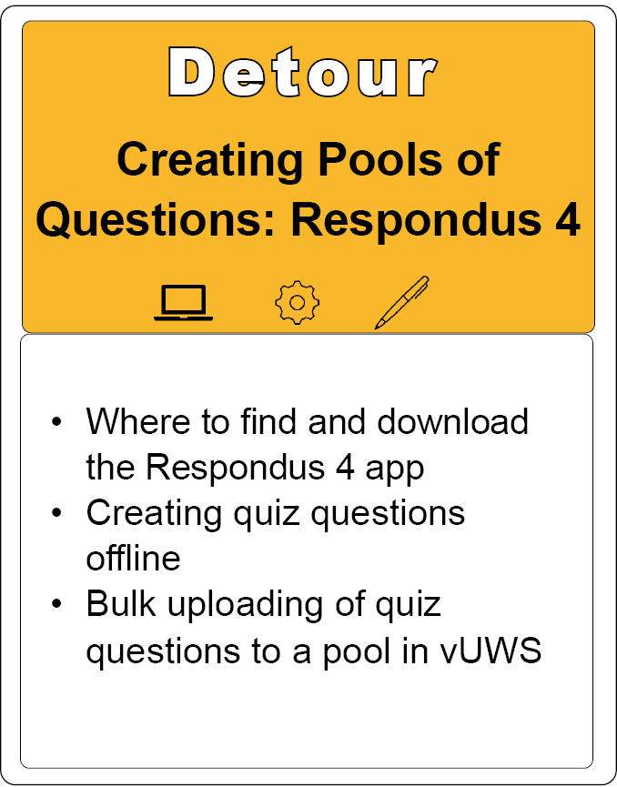
Notes:
This session will provide an overview of:
Where to find and download Respondus 4.
Creating quiz questions offline.
Bulk uploading of quiz questions into a question pool in vUWS

Slide 5
Find Respondus 4 in vUWS.
Login into vUWS
Select Staff Support from the top right menu
Centre panel, you will find the download link for Respondus 4.
Notes:
Login in to vUWS
Select Staff Support from the top right menu,
and in the Centre panel, you will find the download link for Respondus 4.
Make sure you have all Microsoft applications closed, as the math equation program does not like to be installed while any Microsoft product is open. The installation only takes a couple of minutes.

Slide 6
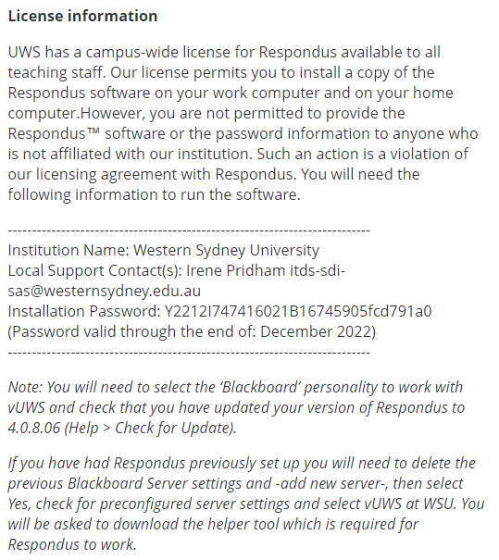
Respondus 4 license info.
When you open Respondus 4 for the first time, you will be asked for the license detail.
You will find them just under the download link.
ITDS will also add a note with any instructions you may need to do before or after updating the license.
Notes:
When you open Respondus 4 for the first time, you will be asked for the license detail. You will find them just under the download link.
These details are updated every January, and you will need to update them each year.
ITDS will also add a note with any instructions you may need to do before or after updating the license.

Slide 7
Respondus Versus…
Respondus 4 | Excel Spreadsheet | Quiz generator: https://lf.westernsydney.edu.au/quiz/
PC user only | PC or Mac | PC or Mac
Download app on desktop | Microsoft Excel file | In-Browser
From within Respondus you get access to multiplied pools from desktop | Have to open multiple files | Generated on file at a time
You can import from a pool within Respondus, Word, CSC file, text file or vUWS | Copy and past from another location into the file | Copy and paste from another location into the Browser
You can export to vUWS, Zip file, Word Documents | You can export as Text delaminated file. | You can export as a Zipped file.
Large range of text formatting options (bullets etc.) | Basic text formatting options | Basic text formatting options
Add images/video/audio | ---- would have to be done individually in each question in vUWS after uploading | ---- would have to be done individually in each question in vUWS after uploading
Preview before uploading | ---- | ----
Merge Pools | ---- | ----
Notes:
So, a quick comparison of the three options for uploading questions to vUWS.

Slide 8
Automatic | Can import from Word | Manually create |  | Manual grading | Can import from Word | Manually create
Multiple choice |  |  |  | Short answer | Type: E
Multiple answer | Type: MA |  |  | Essay | Type: E
Fill in the blanks | Type: F |  |  | File response
Fill in multiple blanks | Type: FMB
Hot spot
Ordering | Type: ORD
Matching | Type: MT
True/false - Either/or – Yes/No
Jumbled sentence | Type: JUM
Opinion scale and Likert
Quiz bowl
Calculated formula
Calculated numeric
Notes:
Most questions in vUWS are Automatically marked. The three question types, essay, short answer, and file response, require you to Manual grade the questions.
Respondus 4 allows you to create all but one type of vUWS question, the hot spot. Hot spot requires pinpoint coordinates that must be set up directly in vUWS. But aside from that, all other types are available to you.
The five in grey will require you to create/write them inside of Respondus 4 manually. The other can be imported from a Word or Text document or spreadsheet. Provided they have been correctly formatted for importing.

Slide 9
Multiple Choice formatting – Word doc Example
Title: Effective vaccination program
1) Which of the following is not a requirement for an effective vaccination program?
~ Correct. Well Done
@ Incorrect. Please review chapter 10
*a) Clear knowledge of the method of transmission of the infection
b) A guarantee that there will be no adverse side effects to the vaccine
c) Identification of high-risk individuals to prioritise for vaccination
d) The vaccine must be able to stimulate an immune response and the formation of memory cells
e) It must be possible to isolate the relevant antigens to create the vaccine
Notes:
Multiple Choice formatting – Word doc Example
You can give your question a tile, or if you leave this blank, Respondus 4 will take the first 20 characters of the question. As the title needs to be unique to that pool, and if you have already used this title on another question, Respondus 4 will add a Roman numeral to the end of the title to make it unique.
You should number your question BUT do not use auto-numbering. Using this indents the question/answers and adds code that you can’t see but will create problems when importing.
Another reason for not using auto numbering/lettering is that you must add a * before the letter/number of the correct answer in the question.
It does not matter if the question or answers are indented or not. So long as the autonumbering has not been applied.

Slide 10
Multiple Answer formatting - Word doc Example
Type: MA
Title: Signs of pregnancy
10) What are some common signs of pregnancy?
a) Excessive energy
*b) Slight bleeding
*c) Nausea and/or vomiting
*d) Mood swings
e) Hunger
Notes:
As you saw from the private table, some questions required you to add a Type to help identify what kind of question it is.
The Teypo0 come first
Then the title
Then the numbered question
This would be followed by any images you may want to add to the question
Then the * is added to the correct answers.
We have examples of all question types and how to format them on the Respondus 4 HUB page.

Slide 11
Common Errors that show when trying to import to Respondus:
• Space between the asterisks (*) and question letter. * 1) This is ……
• Double space after the question letter and the start of the text.
*1) This is ……
• Forgetting to number a question or having the question number repeated.
• Correct answer not identified with an asterisk (*).
• Using Auto-numbering or bulleting when writing the questions.
Notes:
Common Errors that show when trying to import to Respondus:
• Space between the asterisks (*) and question letter. * 1) This is ……
• Double space after question letter and start of text. *1) This is ……
• Forgetting to number a question or having the question number repeat.
• Correct answer not identified with an asterisk (*). Respondus will take the first answer as the list a correct if you do not identify what the correct answer is.
• Using Auto-numbering or bulleting when writing the questions.
(Question will not be imported).

Slide 12
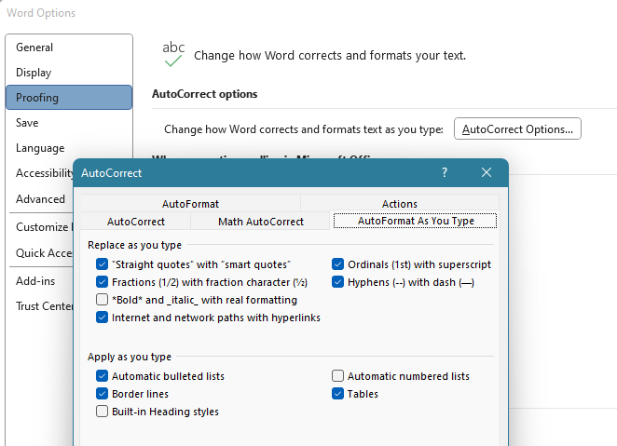
Turning off AutoCorrect
File > Options >
Proofing > AutoCorrectOptions… >
AutoFormat As You type > Automatic numbered list.
Notes:
Turning off AutoCorrect
File >
Options>
Proofing >
AutoCorrectOptions… >
AutoFormat As You type >
Untick Automatic numbered list

Slide 13
Go to Live Demo

Slide 14
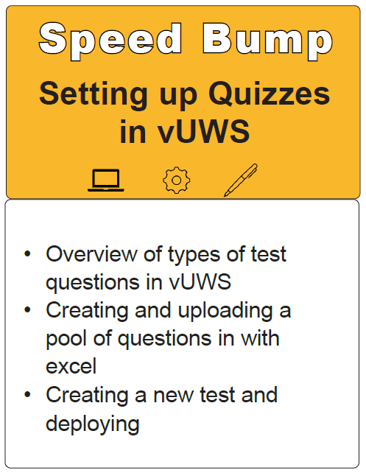
Notes:
https://www.westernsydney.edu.au/learning_futures/home/professional_learning/L_and_T_Workshops/elearning_events/the_amazing_race

Slide 15
Online Engagement and Teaching Hub
Respondus 4
Quizzes in vUWS
Notes:
Head to the Online Engagement and Teaching Hub for support articles and tutorials and so much more!
https://lf.westernsydney.edu.au/engage/technology/h5p

Slide 16
Further information
Digital Learning Support Page
You can also find other Training Sessions on the Learning Futures Workshop Schedule website
Self help articles (vUWS support)
Support through Western Now
101 Support Consultation
Notes:
You can also find other Training Sessions on the Learning Futures Workshop Schedule website.
Self help articles (vUWS support): https://lf.westernsydney.edu.au/support/
Support - Contact us at Western Now
101 Support - https://outlook.office365.com/owa/calendar/DigitalLearningSupport101@westernsydneyedu.onmicrosoft.com/bookings/s/Zdai0b_bUk6ADvEtAmGWRQ2

Slide 17
Tell us what you think!
Did you like the workshop design and delivery?
What would you like to know more about?
It should only take 3 minutes
**We use your feedback to fine-tune, create and schedule future workshops**
Notes:
Tell us what you think!
A link is going into the chat now, any and all feedback is welcome.
We use your feedback to fine-tune, create and schedule future workshops
We really appreciate your feedback and it should only take 3 minutes

Slide 18
End
Notes:
Any questions?

