Slide 1
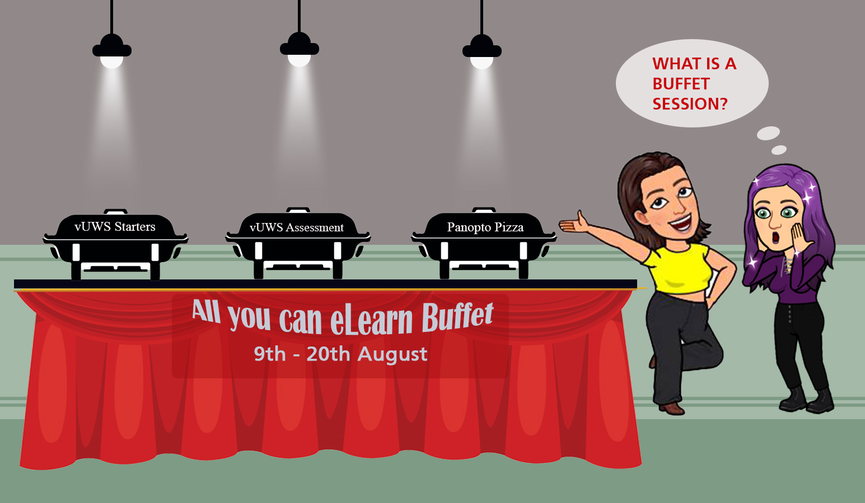
Self-Serve Assessments in vUWS
Notes:
Thank you all for attending the All you can eLearn Buffet event were are conducting from 9th -20th Aug. Today’s session is on vUWS Assessments and we hope that you have your questions ready for us. My name is Nosh – I work in the eLearning team at Learning Futures along with my colleagues Alex, Shristi, Diane and Emina who are here today to help me out with your questions.

Slide 2
Zoom Chat – Attendance
Before we begin, can everyone please type into the Zoom chat:
Your Full name
Your School
Your Email Address
Notes:
Before we get started, can I please request everyone to enter their full name, school and email address in the chat section.

Slide 3
Notes:
This session will be recorded. Please

Slide 4
What MYSTERY FLAVOUR would you like to see?
Get voting!
Notes:
What MYSTERY FLAVOUR would you like to see us run a training session on?
Grade Centre
Panopto Capture
Video Assignments
Discussion Boards, Blogs & Journals
Zoom & Blackboard Collaborate

Slide 5
Do you have questions around:
Turnitin
vUWS Assignments
vUWS Tests
Marking and giving feedback to Assessments
Get them ready ☺

Slide 6
Support and Resources

Slide 7
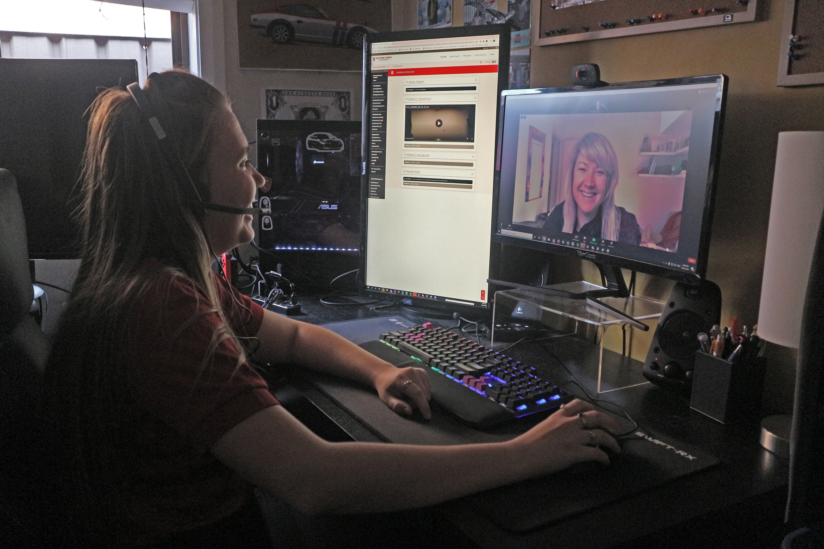
eLearning Support One to One (101)
Would you like to learn more about vUWS Blackboard tools and functionalities to enhance teaching and learning experience?
Learning Futures team is now able to offer personalised one-on-one eLearning support session via a zoom appointment. If you have any vUWS related queries, a member of our eLearning support team will support you through a tailored session specific to your needs.
Book a session today using our online form https://forms.gle/23UoDvsvSoybqHgZ6
Notes:
Would you like to learn more about vUWS Blackboard tools and functionalities to enhance teaching and learning experience?
Learning Futures team is now able to offer personalised one-on-one eLearning support session via a zoom appointment. If you have any vUWS related queries, a member of our eLearning support team will support you through a tailored session specific to your needs.
Links for Chat:
One on one Consultation link:
https://forms.gle/23UoDvsvSoybqHgZ6

Slide 8
Featured Resources
Online Engagement and Teaching Hub
vUWS Support Page
Notes:
Online Engagement and Teaching Hub: https://lf.westernsydney.edu.au/engage/
vUWS Support: https://lf.westernsydney.edu.au/support/#creating-other-resources

Slide 9
Additional Resources
Training
Upcoming Sessions
Recorded Sessions
All You Can e-Learn page – Where you will find the PowerPoint slides
Support
Contact eLearning@westernsydney.edu.au
Notes:
Links for Chat:
Upcoming Sessions : https://www.westernsydney.edu.au/learning_futures/home/teaching_support/professional_learning/LF_Workshop_Schedule
Recorded Sessions: https://www.westernsydney.edu.au/learning_futures/home/teaching_support/professional_learning/recorded_sessions_and_resources

Slide 10
Feedback

Slide 11
Tell us what you think!
Quick feedback form :
The URL in the chat. It should only take 2-3min (we promise!)
We actually use your feedback to fine-tune, create and schedule future workshops
Notes:
One on one Consultation link:
https://forms.gle/23UoDvsvSoybqHgZ6
Support Email:
elearning@westernsydney.edu.au
Upcoming Sessions : https://www.westernsydney.edu.au/learning_futures/home/teaching_support/professional_learning/LF_Workshop_Schedule
Recorded Sessions: https://www.westernsydney.edu.au/learning_futures/home/teaching_support/professional_learning/recorded_sessions_and_resources
Feedback Form URL: https://forms.gle/dnENjibjpDRS5Q8E9

