Slide 1
21st Century Curriculum Project
Vice Chancellor and Chair of Academic Senate Academic Forum
23 November 2017
Notes:
Thank you for joining the discussion today
Some of you are already working on aspects of this project in your schools or portfolio teams - however for some of you this might be the first time you have heard about it.

Slide 2

External Context Drivers
Disrupted future of work and society:
  Multiple career paths
  New combinations of skill sets
  Premium on (re) learning
Increased competition:
  other universities expanding into GWS
  increase in private providers
  industry-focused education learning packages, alternative-credentialing
  Advantage a degree provides
  Lifetime earning advantage (but fluctuations in graduate employability)
  Higher education capabilities (critical thinkers, self directed learning skills etc.)
University status advantage vs. regulatory compliance:
  TEQSA standards, AQF, Professional Accreditation
  Government funding and policy directions
Anchor institution for Western Sydney region:
  Economic and population growth
  University mission and responsibility
Notes:
The 21C project is framed in response to the external context we are in.
These will be familiar drivers and issues to this group the project balances these risks and opportunities in its approach.
We are not the only university responding to this context – they all are!
It is interesting that as other universities reviewal their plans – there is a reassuring underlying consistency in our collective response to the challenge.
The key elements we identified over a year ago are emerging in announcements like todays from Melbourne and LA Trobe – and confirms we are on the right track.
TEQSA Standards, AQF, and Professional Accreditation: curriculum renewal, transformation and innovation has to be compliant with the standards and registration for practice. Eg. TEQSA has a definition of WIL that would regulate universities’ own innovations in that space. We need to ensure that compliance doesn’t drive our curriculum innovations.
Fluctuations in Graduate Employability: The general trend is that full time employment in particular degrees is declining and uncapped places mean that the University is slow to respond. The cost of degrees is going up and if this is not matched with positive employment outcomes, then it drives the sector in thinking about alternatives to a university degree.
Increased Competition: Increase in private and online accredited providers and alternative education opportunities particularly in entrepreneurship and IT skills, just in time/on demand education opportunities that also offer networking. They are providing education that is more flexible and valued by industry.
Changing nature of Work: the challenge of providing degree programs for knowledge areas that have yet to be invented. The challenge of providing shorter/sharper microcredentialled courses. Professional development is happening not through degrees but by other means. The challenge in securing relevant community, industry and government partnerships for curriculum that will scale for courses with 1000+ students. Ensuring degrees address challenges of interdisciplinarity.

Slide 3

A mandate to innovate
21C Curriculum Project Principles
Produce efficiencies arising from a manageable set of shared course architectures.
Deliver new flexibility for the university to help us future proof our offerings.
Deliver courses that are more attractive to future students.
Encourage wider access and participation.
Build student retention and employability success.
Provide clarity for students, their families and employers.
Engage staff and our community as contributors to our educational aspirations.
(Project Brief: 21st Century Curriculum Renwal)
Notes:
Produce efficiencies arising from a manageable set of shared course architectures that speak to the existing underlying affinities between the curricula in our Schools and courses.
Deliver new flexibility for the university to help us future proof our offerings by allowing us to innovate within shared curriculum structures with a minimum of bureaucracy, and to collaborate and innovate at scale across the university utilising alignments between different curricula.
The curriculum renewal and new architectures should assist us to build revenue by enabling us to offer and market courses that are more attractive to future students as a result of the adaptability of our curriculum to student aspirations, its flexibility (including fully online), and significantly; the distinctive learning experiences our curriculum entails and the outcomes it leads to.
Encourage wider access and participation, through the inclusion of flexible modes of study and flexible pathways into study. Alignment between programs will facilitate transfer between courses, with multiple exit and re-entry points.
Build student retention and employability success as the new curriculum structures will assist the university to explicitly scaffold support for academic success and career development to ensure graduates are highly competitive in the future job market.
Provide clarity for students, their families and employers making it easier to see what is possible from learning at Western Sydney, and better enabling our students to navigate their degrees and achieve the outcomes they aspire to.
Engage staff and our community providing opportunities and encouragement for them to contribute in creative scholarly ways to the educational aspirations of the university.

Slide 4
Further info: www.westernsydney.edu.au/21c
21st Century Curriculum Project
Four strands of work
Strengthen current degrees.
Create new future-facing degrees and new curriculum elements.
Develop alternative credentials.
Future proof institutional capacity for curriculum renewal.
Five Initiatives
1. Planning & Analysis
(Jan 2017 -
June 2017)
3. Future of Work
(Aug 2017-
June 2019)
5. Integrate & Optimize
(Mar 2017- Dec 2020)
2. School
Curriculum Pilots
(July 2017 - Feb 2018)
4. Flagship
Curriculum Projects
(Nov 2017 - Feb 2019)
Notes:
This project has four key Strategic Goals
Strengthen our current degrees – The core business of the university is its degrees & Western has some excellent degrees, However some of our degrees are not sufficiently distinctive to be competitive in the face of other university brands. Our degree structures make it difficult to flexibly combine study across different domains or embed new learning and skills development relevant to our students needs. Our legacy degree architectures make if difficult for us to respond nimbly to emergent opportunities . We also need to manage our course profile so we focus our resources on the degrees that have a future. We need new mechanisms to strategically invest in developing or promoting new programs and to support decisions to retire programs.
Building on the work of strengthening our current degrees we will create new future-facing curriculum elements to embed in this degrees and new 21C degrees – we need to offer new learning opportunities to our students to equip them for future success. This will enable a students to access a great mix of disciplinary learning or degrees and customised on demand learning in multiple modes
We will develop alternative credentials for those for whom a university degree is not the best pathway to their career or educational aspirations. We will use those opportunities to build new pathways into university and employment. We will use shorter cycle learning opportunities that target Professional learning needs for short courses, executive education and FoW upskilling. We will particularly leverage our co-locations with industry and community partners in Parramatta and Liverpool to deliver this.
Importantly we need to go about this work in a way that future proofs the institutional capacity for curriculum renewal – and long term that is probably the most important strand. The need for renewal and transformation is not a one-off. The pace of change and workplace place disruption will accelerate – by intentionally building the industry and community partnerships to co-create our curriculum this time we will ensure we are intimately connected to and aware of those changes – we will also be better positioned to influence them. We will go about this process in a way that engages staff in new professional learning opportunities so they develop the capacity for curriculum innovation. We will design and implement new curriculum approval systems that allow innovation while also s ensuring we do not put at risk professional accreditations or our precious Higher education provider status with TEQSA.
We are ambitious and we will achieve those goals.
The Project is built as five overlapping initiatives – there is a detailed description of each of these and timeline in the Project Overview which is available on the website.
Planning and analysis - laid the groundwork for the project – explored the external context and analyzed our current offerings – identified and created new data sources and tools (CLPG) to inform the more strategic curriculum renewal – created a basis for change initiated through the pilots
Pilots – Provided Schools with the agency and opportunity to review their current degree structures and identify proposals for simpler structures. Build the necessary cross university collaboration to enable multi disciplinary curriculum architectures and exchanges – established the frameworks to insert new FOW curriculum elements.
FOW – this initiative connects staff with the ideas and opportunities presented by a disrupted future of work and society – helps them to understand the need for a 21 C curriculum - the outcomes we must develop for graduates and the opportunities that co-creating our curriculum with our partners provides.
FCP – this is the key initiative that runs next year and it supports the University community in building on the ideas in the FOW forums to co-create with industry and community partners, a range of innovative new curriculum elements. These range in scope from from learning pods that area accessible to all students and potentially to members of the community and industry employees interested in upskilling for the 21C FOW – to new accelerator units available as electives across many degrees - new advantage sub majors and majors and new 21 C degrees.
Integrate and optimize – this ensures we have the necessary systems and processes in place to implement new curriculum in a more nimble way without exposing us to unnecessary risk – it also is the longer term initiative to build new staff capacity in our workforce to design 21C curriculum.

Slide 5





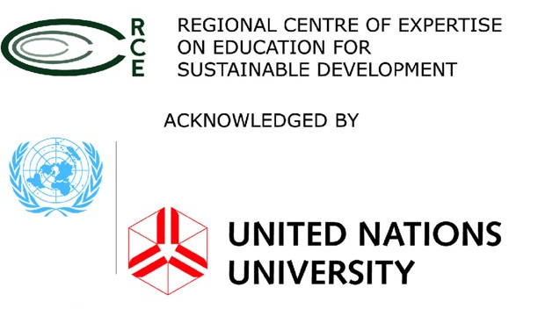

Leveraging Our Partnerships to offer aspirational
Signature Learning Experiences
Western Sydney Research Institutes
Notes:
We have already started t doing this

Slide 6

Flagship Curriculum Projects
21C
Futures Degrees
Advantage Major
Advantage Sub-major
Supports the development of new:
    Learning pods (boot camps, modules);
    ‘Accelerator’ units;
    ‘Advantage’ majors and sub-majors; and
    ‘21C Futures’ degrees
These new curriculum elements will be co-created and offer students the capacity to add breadth and meaningful depth to their higher education experiences to increase their career success.
Alternative pathways
Alternative credentials
EOI due 31st January 2018
Pod
Unit
Notes:
Projects will be supported through funding and ‘Curriculum Intensives’ run by the Learning Transformations and Digital Futures teams.

Slide 7
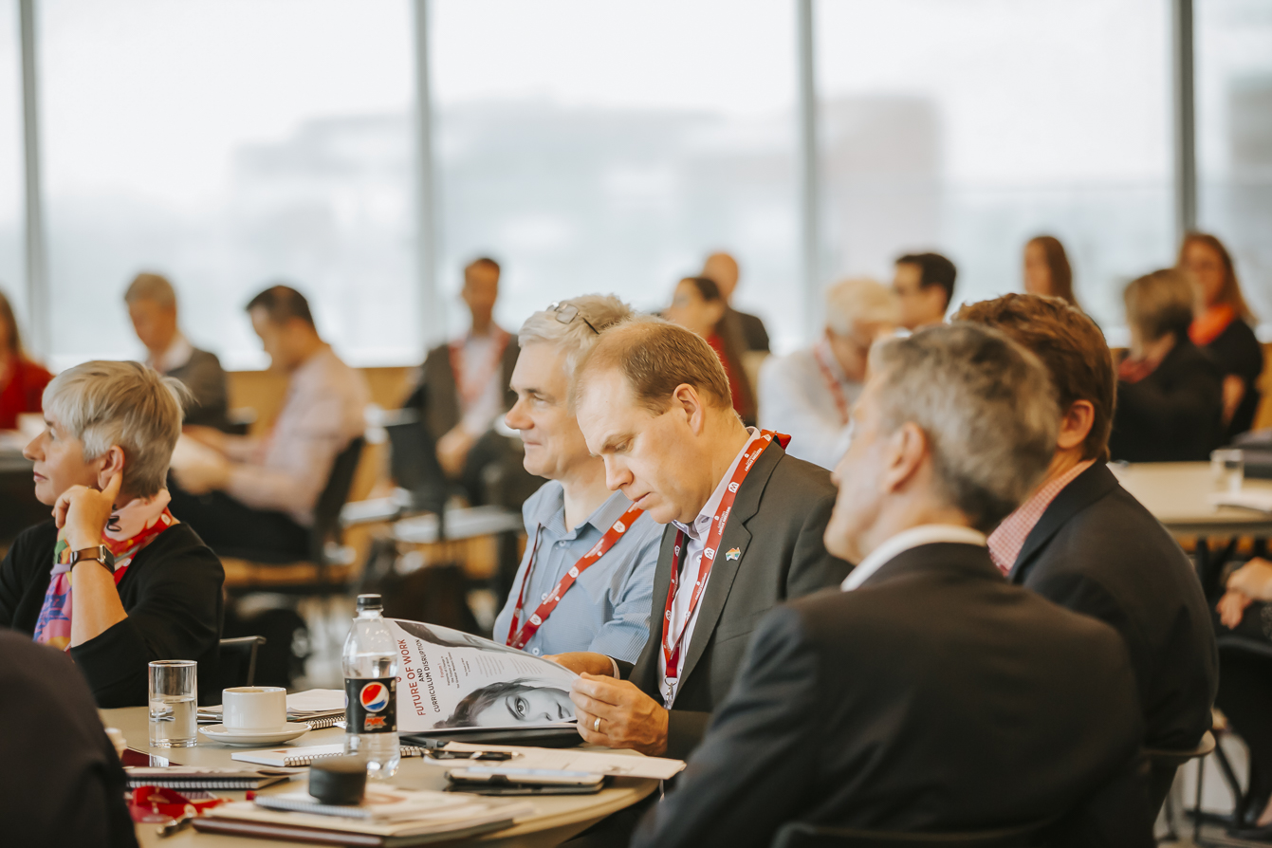
Future of Work and Society: Curriculum Disruption Forums
Forum 1: Patterns of Change in the Future of Work for Greater Western Sydney
8th November 2017 (resources online)
Dr Andrew Reeson - Data61, CSIRO
Professor Phillip O’Neill - Centre For Western Sydney
Forum 2: Professional Learning in Changing Contexts
1st December 2017
Professor Tara Fenwick - University of Stirling
Professor Richard Edwards - University of Stirling
Forum 3: The Future of Public Service and Work
7th February 2018
Professor Peter Shergold, Chancellor WSU
Forum 4: Catalyst West
Date TBC
Forum 5: TBC
11th April 2018
Register at: www.westernsydney.edu.au/registerfowforums
Notes:
Supporting engagement and ideas generation for 21C FCP
Forums that will bring together Staff, Students and External Partners to explore key ideas and new perspectives on the Future of Work and Society that might inform the development of new curricula.
Forum 2: will be on the 1st December, open to all WSU staff
Forum 3:
in 2018

Slide 8
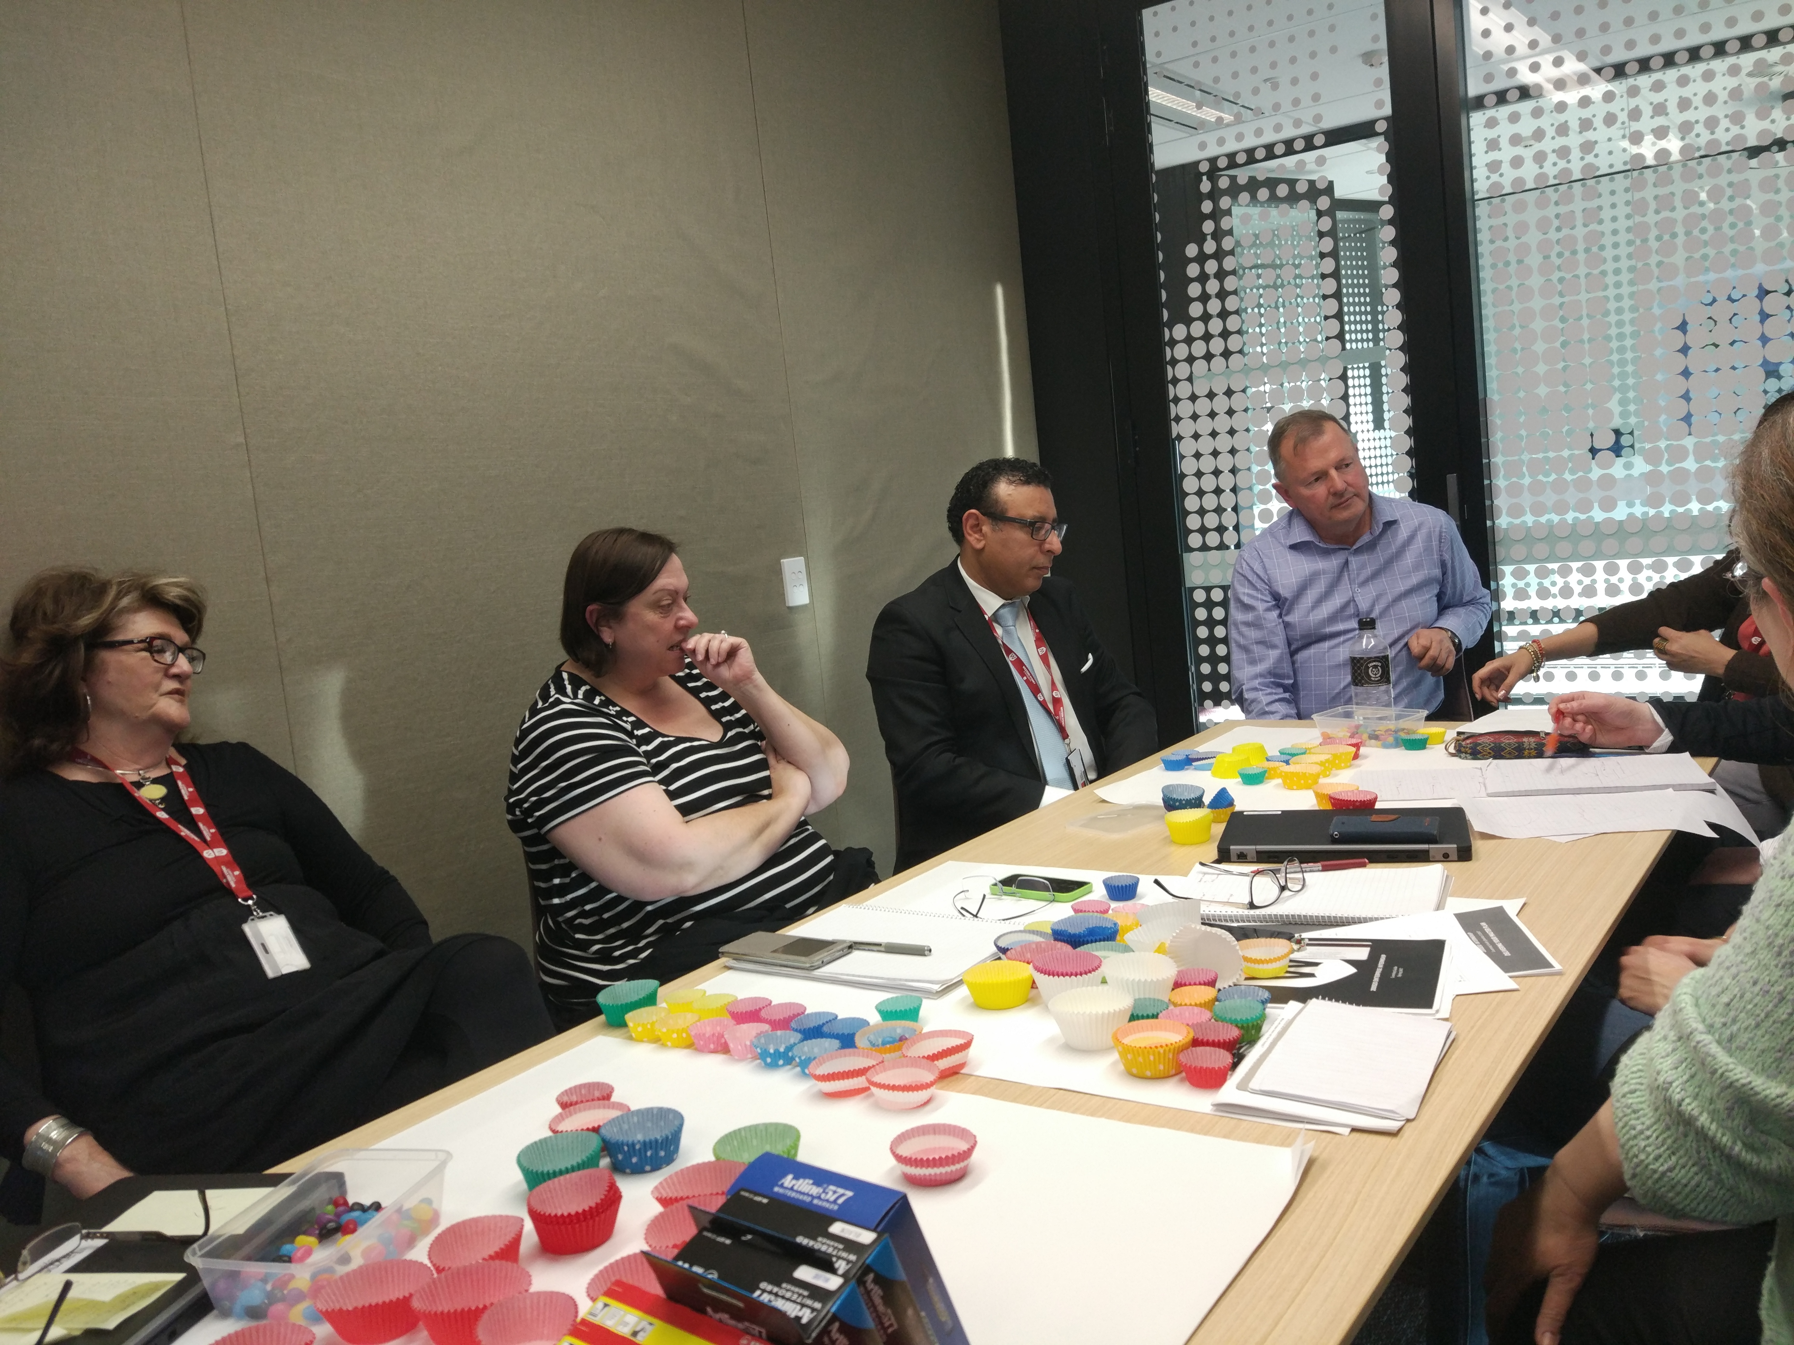

Curriculum Scholars Network
Higher Education Academy
Educational Fellowship scheme
A collaborative curriculum ‘makerspace’ that brings together the teams of staff across Schools working the on 21C project.
Ideas, critique, collaborations, fun!
Next meeting: 3pm-5pm Thursday 7th December
PC-01.3.39 (Please come along)
Access partnership with the UK Higher Education Academy.
An opportunity for academic and professional staff to apply for international peer reviewed recognition of their learning and teaching practice.
PAGE 8
Notes:
Support –
CSN
HEA
Curriculum intensives
The aims of the CSN are to:
provide a supportive forum for staff to share the insights, strategies and resources to problem-solve challenges related to progressing their School Pilots;
engage staff in identifying curriculum renewal issues for further discussion/conversation (including improvements to university systems and processes that will assist Schools to achieve the aims of their Pilots);
identify opportunities for collaboration around curriculum, teaching and learning research and scholarship;
ensure alignment with the intentions and outcomes of the 21C.
HEA
From October 2017- June 2018, staff of the university can apply for a HEA Fellowship at half price. The Learning Transformations team will provide resources and support to members of the university community – academic and professional staff – applying for HEA fellowships.

Slide 9
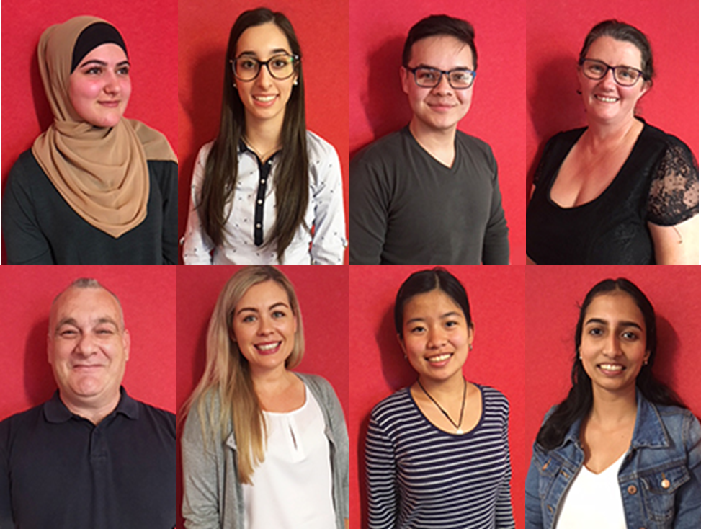
Students as Curriculum Partners
(L to R): Fay Ballouk (BA)
Marisse Manthos (BA-Secondary Pathways)
Hassan Reza (BBus/Arts)
Raquel Hines (BMedSci)
Paul Mascellani (BSocSci)
Ashley Beathe (BA-Secondary Pathways)
Kathy Nguyen (BNatSci)
Chinnu Jose (BLaw/Bus)
Follow us on twitter:
@WesternSydU_SAP
#westernsyneyu_fow
www.westernsydney.edu.au/learning_futures/home/ct/curriculum/21st_century_curriculum_project/students_as_partners
PAGE 9
Notes:
Support –
CSN
HEA
Curriculum intensives
The aims of the CSN are to:
provide a supportive forum for staff to share the insights, strategies and resources to problem-solve challenges related to progressing their School Pilots;
engage staff in identifying curriculum renewal issues for further discussion/conversation (including improvements to university systems and processes that will assist Schools to achieve the aims of their Pilots);
identify opportunities for collaboration around curriculum, teaching and learning research and scholarship;
ensure alignment with the intentions and outcomes of the 21C.
HEA
From October 2017- June 2018, staff of the university can apply for a HEA Fellowship at half price. The Learning Transformations team will provide resources and support to members of the university community – academic and professional staff – applying for HEA fellowships.

Slide 10
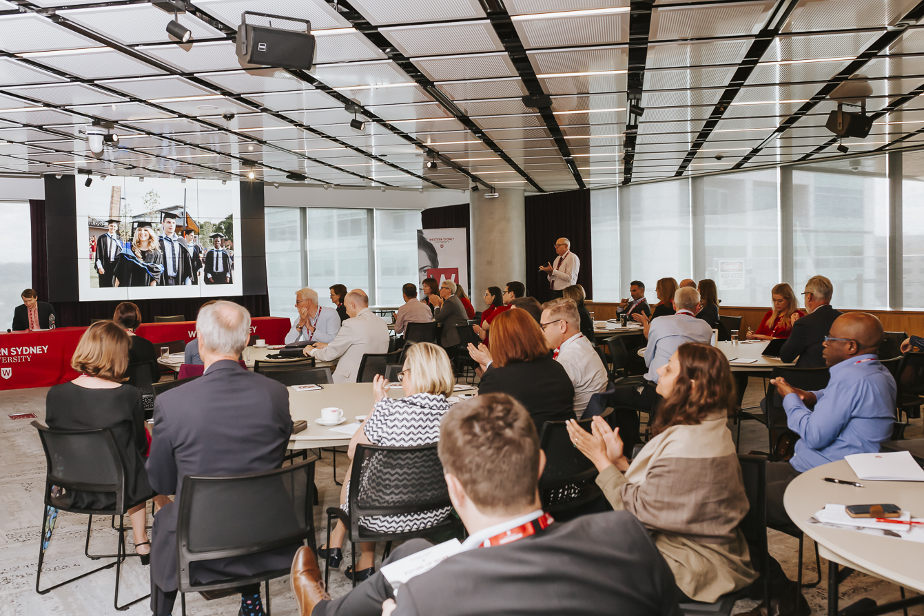
Questions?
Grab a coffee
Discussion: 21C renewal of our Graduate Attributes
Poster Presentation – Students as partners
PAGE 10
Notes:
Support –
CSN
HEA
Curriculum intensives
The aims of the CSN are to:
provide a supportive forum for staff to share the insights, strategies and resources to problem-solve challenges related to progressing their School Pilots;
engage staff in identifying curriculum renewal issues for further discussion/conversation (including improvements to university systems and processes that will assist Schools to achieve the aims of their Pilots);
identify opportunities for collaboration around curriculum, teaching and learning research and scholarship;
ensure alignment with the intentions and outcomes of the 21C.
HEA
From October 2017- June 2018, staff of the university can apply for a HEA Fellowship at half price. The Learning Transformations team will provide resources and support to members of the university community – academic and professional staff – applying for HEA fellowships.

Slide 11
Co-creating our 21C Graduate Capabilities
Future Thinkers: Creative inquiry-led, multidisciplinary, future focused, novel solution-oriented thinkers.
Citizen Scholars: Informed and engaged local and global citizens, culturally competent, (particularly in regard to Indigenous cultures), committed to sustainability and the value of diversity, adept communicators and stewards of our Western Sydney community and their chosen communities.
Innovation Entrepreneurs: Resilient, technologically savvy leaders with advanced knowledge and practical skills.
Notes:
The basis for the 21C project was the work by the University’s leadership team at the beginning of 2016 articulating the outcomes we aspire to for our graduates as part of the planning of the TWSU initiatives:
Those high-level outcomes have provided a guiding strategy shaping the development of the 21C Project from the very first project brief that was endorsed by Executive. It is now time to flesh those out and contextualise them in the disciplinary and practice contexts our students learn in.
More importantly it is time to give them real meaning, beyond words on a page, by articulating them in the learning experiences we will offer to students, drawing on the strengths of our partnerships as pedagogy.
The work today will inform the refresh of our current Graduate Attributes policy – and possibly generate some ideas for proposals for Flagship Projects.
Outline the task: Tables develop a poster for presentation

Slide 12
Co-creating our 21C Graduate Capabilities
What are the 21C Graduate Capabilities in each domain?
Prompt: What do they look like in your discipline / professional context?
2. What student learning experiences might develop these capabilities?
Prompt: Consider curriculum and co-curriculum, UG / PG /HDR contexts.
3. One poster per table
30 minutes to prepare, Student Partners as Scribes and co-presenters
4. Poster Session

Slide 13

Partnership Pedagogies Co-creation Co-production Authentic situated experiential learning
Citizen Scholars: Informed and engaged local and global citizens, culturally competent, (particularly
In regard to indigenous cultures), committed to sustainability and the value of diversity, adept
communicators, and stewards of our Western Sydney community and their chosen communities
Future Focused: Creative inquiry-led, multidisciplinary,
novel solution-oriented thinkers
Innovation Entrepreneurs: Resilient, technologically savvy leaders with
advanced knowledge and practical skills
What learning experiences might assist students to develop these?
Reciprocity Renewal
Complexity uncertainty risk Networks
What are the constituent Graduate Capabilities?

Slide 14
www.westernsydney.edu.au/21c
Thank you

