Slide 1

Innovative Approaches to Post-School Social Participation and Transition to Work

Slide 2
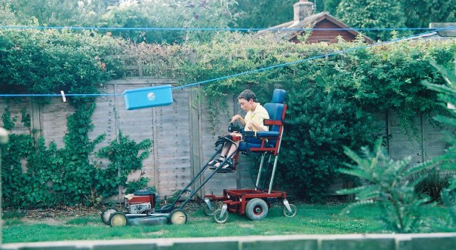

Slide 3


ABOUT FIGHTING CHANCE
Fighting Chance, designs, builds and scales social enterprises that moves the dial for Australians with disability and their family.
Our approach is simple - we work with our community to identify the challenges, hurdles and barriers faced by people with disability in their everyday lives, and then design and build sustainable social businesses which resolve these issues.
Our mission is to ask ‘what if?’, to see the world as it isn’t yet, to imagine a future quite different to the present. And then to make it happen.

Slide 4
A co-working space leveraging micro enterprise and the sharing economy, to empower people with profound and severe disability to participate fully in the economy and in society, and to develop skills and confidence.

Slide 5

A social business which trains people with disability for work in work.

Slide 6

The online platform for people with disability to find, hire and manage support workers who fit their needs and share their interests.

Slide 7

Thank you!
Laura O’Reilly
CEO, Fighting Chance
laura@fightingchance.org.au
0433777109

