Slide 1
Respondus 4
Presenter: Robert Ycasiano
Digital Learning Administration Officer,
Learning Futures
Notes:
Welcome everyone, thank you for joining the workshop: (Respondus 4), my name is Robert from Learning Futures, and I will be your Digital Learning presenter for today's session.
Joining me today and monitoring the chat we have my colleague Stephanie Lynch in the Digital Learning team.

Slide 2
ACKNOWLEDGEMENT OF COUNTRY
With respect for Aboriginal cultural protocol and out of recognition that its campuses occupy their traditional lands, Western Sydney University acknowledges the Darug, Eora, Dharawal (also referred to as Tharawal) and Wiradjuri peoples and thank them for their support of its work on their lands (Greater Western Sydney and beyond).
Notes:
I would like to begin today’s workshop by acknowledging the Traditional Custodians of the land on which we meet today, and pay my respects to their Elders past and present. I extend that respect to Aboriginal and Torres Strait Islander peoples here today.
I am joining you today from [Darug] Land. You may wish to add in the chat which land you are joining us from.

Slide 3
Notes:
RECORDING/MUTE
Please note that this session will be recorded, please make sure your microphone is muted and disable your camera if you don’t want to be visible on the recording.
QUESTIONS
If you do have any questions, please post them in the chat and one of my colleagues will respond to you, I will also be available to answer your questions at the end of the workshop.

Slide 4
Welcome!
Today we will cover:
Where to find and download Respondus 4.
Creating quiz questions offline – Word Doc
Bulk uploading of quiz questions into a question pool in vUWS
Notes:
Before I begin, if you’re a MAC user, you will not be able to use Respondus as this is only compatible with Windows PCs. Feel free to stay in the workshop if you would still like to learn Respondus but just know that this is only compatible on Windows.
In this session we will look over the following items:
Where to find and download Respondus 4.
Creating quiz questions offline via Word Doc.
Bulk uploading of quiz questions into a question pool in vUWS

Slide 5
Why use Respondus?
Respondus is a powerful tool for creating and managing exams that can be printed to paper or published directly to vUWS.
Exams can be created offline using a familiar Windows environment.
Can import existing questions from Respondus into new pools
More information can be found on The Hub
Notes:
Why use Respondus?
Respondus is a powerful tool for creating and managing exams that can be printed to paper or published directly to vUWS.
Exams can be created offline using a familiar Windows environment.
Can import existing questions from Respondus into new pools
More information can be found on The Hub – Steph if you could paste the link in here with the Respondus resources on The Hub, I will refer to information on The Hub during the live demo so if you could all have that link ready for later.

Slide 6
Respondus Versus…
Respondus 4 | Excel Spreadsheet | Quiz generator: https://lf.westernsydney.edu.au/quiz/
PC user only | PC or Mac | PC or Mac
Download app on desktop | Microsoft Excel file | In-Browser
From within Respondus you get access to multiplied pools from desktop | Have to open multiple files | Generated on file at a time
You can import from a pool within Respondus, Word, CSV file, text file or vUWS | Copy and past from another location into the file | Copy and paste from another location into the Browser
You can export to vUWS, Zip file, Word Documents | You can export as Text delaminated file. | You can export as a Zipped file.
Large range of text formatting options (bullets etc.) | Basic text formatting options | Basic text formatting options
Add images/video/audio | ---- would have to be done individually in each question in vUWS after uploading | ---- would have to be done individually in each question in vUWS after uploading
Preview before uploading | ---- | ----
Merge Pools | ---- | ----
Notes:
So, a quick comparison of the three options for uploading questions to vUWS.
Respondus can only be used on PC, sorry to all the Mac users out there, you can still use Excel Spreadsheet or Quiz Generator, although I will not be covering those two methods for todays workshop
Download app on desktop
From within Respondus you get access to multiplied pools from desktop
You can import from a pool within Respondus, Word, CSV file, text file or vUWS
You can export to vUWS, Zip file, Word documents
Large range of text formatting options (such as bullet points)
Can add images/video/audio
Preview before uploading
Merge pools

Slide 7
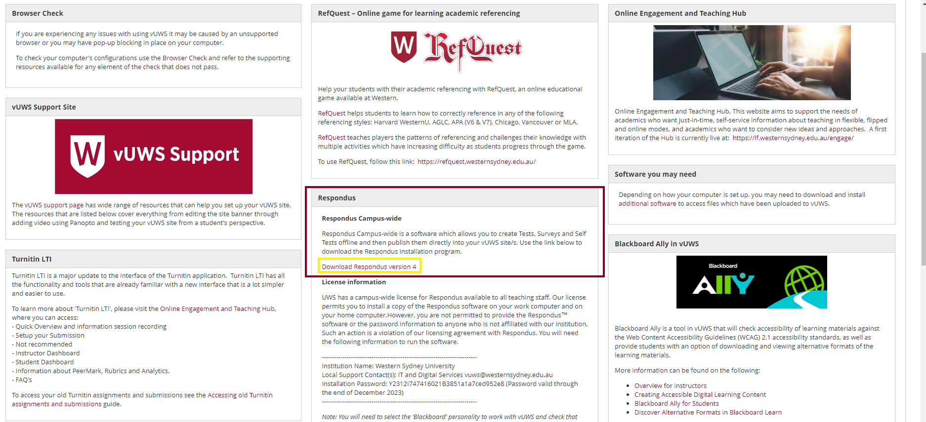
Find Respondus 4 in vUWS.
Login into vUWS
Select Staff Support from the top right menu
Centre panel, you will find the download link for Respondus 4.
Notes:
Now, how to find Respondus 4 in vUWS
First you login in to vUWS, select Staff Support from the top right menu, and in the Centre panel, you will find the download link for Respondus 4.
Make sure you have all Microsoft applications closed, as the math equation program does not like to be installed while any Microsoft product is open. The installation only takes a couple of minutes.

Slide 8
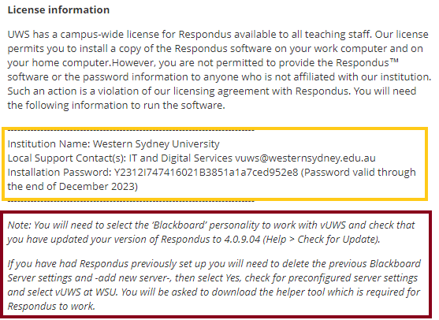
Respondus 4 license info
When you open Respondus 4 for the first time, you will be asked for the license detail.
You will find them just under the download link.
ITDS will also add a note with any instructions you may need to do before or after updating the license.
Notes:
When you open Respondus 4 for the first time, you will be asked for the license detail. You will find them just under the download link.
These details are updated every January, and you will need to update them each year.
ITDS will also add a note with any instructions you may need to do before or after updating the license.
I will show you just exactly where to go to grab that information

Slide 9
Downloading Respondus

Slide 10
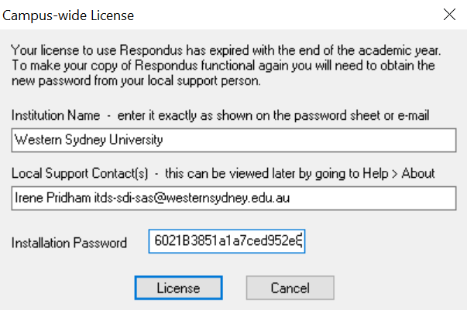
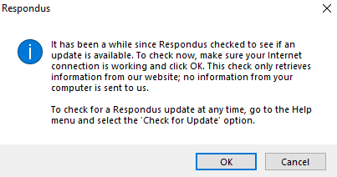
Downloading Respondus

Slide 11
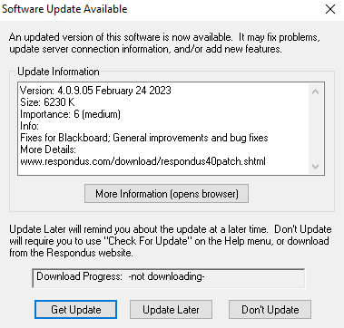
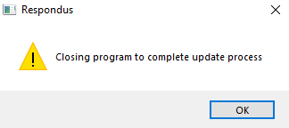
Downloading Respondus

Slide 12
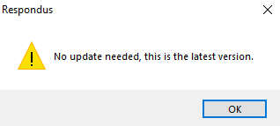
Downloading Respondus

Slide 13
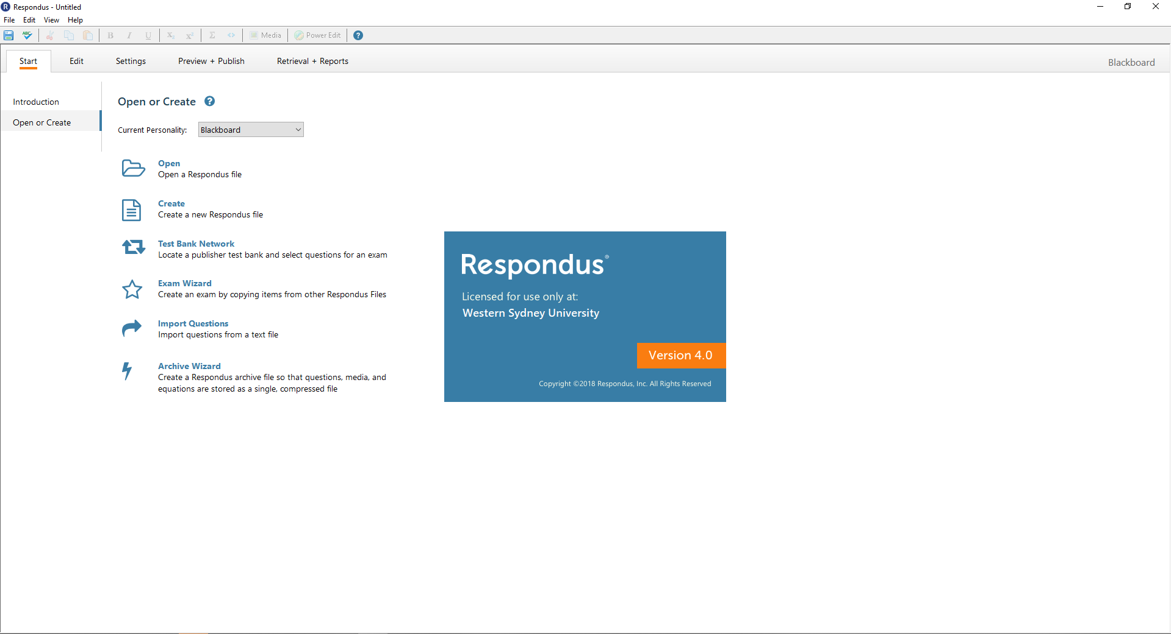
Downloading Respondus

Slide 14
Automatic | Can import from Word | Manually create |  | Manual grading | Can import from Word | Manually create
Multiple choice |  |  |  | Short answer | Type: E
Multiple answer | Type: MA |  |  | Essay | Type: E
Fill in the blanks | Type: F |  |  | File response
Fill in multiple blanks | Type: FMB
Hot spot
Ordering | Type: ORD
Matching | Type: MT
True/false - Either/or – Yes/No
Jumbled sentence | Type: JUM
Opinion scale and Likert
Quiz bowl
Calculated formula
Calculated numeric
Notes:
This may look confusing at first, but I will explain as I go through the live demo and it should start to make more sense.
Most questions in vUWS are Automatically marked. The three question types, Essay, Short Answer and File Response, require you to manually grade the questions.
Respondus 4 allows you to create all but one type of vUWS question which is Hot Spot. Hot spot requires pinpoint coordinates that must be set up directly in vUWS. But aside from that, all other types are available to you.
The five in grey (Opinion scale and Likert, Quiz Bowl, Calculated formula, calculated numeric, file response) will require you to create/write them inside of Respondus 4 manually. The other can be imported from a Word or Text document or spreadsheet. Provided they have been correctly formatted for importing.

Slide 15
Multiple Choice formatting – Word doc Example
Title: Effective vaccination program
1) Which of the following is not a requirement for an effective vaccination program?
~ Correct. Well Done
@ Incorrect. Please review chapter 10
*a) Clear knowledge of the method of transmission of the infection
b) A guarantee that there will be no adverse side effects to the vaccine
c) Identification of high-risk individuals to prioritise for vaccination
d) The vaccine must be able to stimulate an immune response and the formation of memory cells
e) It must be possible to isolate the relevant antigens to create the vaccine
Notes:
Multiple Choice formatting – Word doc Example
You can give your question a title, or if you leave this blank, Respondus 4 will take the first 20 characters of the question. As the title needs to be unique to that pool, and if you have already used this title on another question, Respondus 4 will add a Roman numeral to the end of the title to make it unique.
You should number your question BUT do not use auto-numbering. Using this indents the question/answers and adds code that you can’t see but will create problems when importing.
Another reason for not using auto numbering/lettering is that you must add a * before the letter/number of the correct answer in the question.
It does not matter if the question or answers are indented or not. So long as the autonumbering has not been applied.

Slide 16
Multiple Answer formatting - Word doc Example
Type: MA
Title: Signs of pregnancy
10) What are some common signs of pregnancy?
a) Excessive energy
*b) Slight bleeding
*c) Nausea and/or vomiting
*d) Mood swings
e) Hunger
Notes:
As you saw from the private table, some questions required you to add a Type to help identify what kind of question it is.
The Type comes first
Then the title
Then the numbered question
This would be followed by any images you may want to add to the question
Then the * is added to the correct answers.
We have examples of all question types and how to format them on the Respondus 4 HUB page.

Slide 17
Common Errors that show when trying to import to Respondus:
• Space between the asterisks (*) and question letter. * 1) This is ……
• Double space after the question letter and the start of the text.
*1) This is ……
• Forgetting to number a question or having the question number repeated.
• Correct answer not identified with an asterisk (*).
• Using Auto-numbering or bulleting when writing the questions.
Notes:
Common Errors that show when trying to import to Respondus:
I have the issues highlighted here in yellow
• Space between the asterisks (*) and question letter. * 1) This is ……
• Double space after question letter and start of text. *1) This is ……
• Forgetting to number a question or having the question number repeat.
• Correct answer not identified with an asterisk (*). Respondus will take the first answer as the list a correct if you do not identify what the correct answer is.
• Using Auto-numbering or bulleting when writing the questions.
(Question will not be imported).

Slide 18
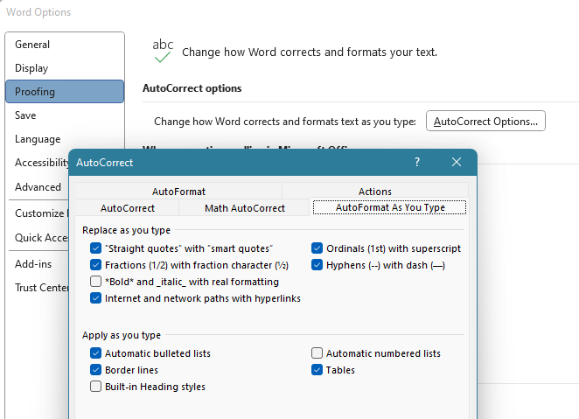
Turning off AutoCorrect
File > Options >
Proofing > AutoCorrectOptions… >
AutoFormat As You type > Automatic numbered list.
Notes:
Turning off AutoCorrect
File >
Options>
Proofing >
AutoCorrectOptions… >
AutoFormat As You type >
Untick Automatic numbered list

Slide 19
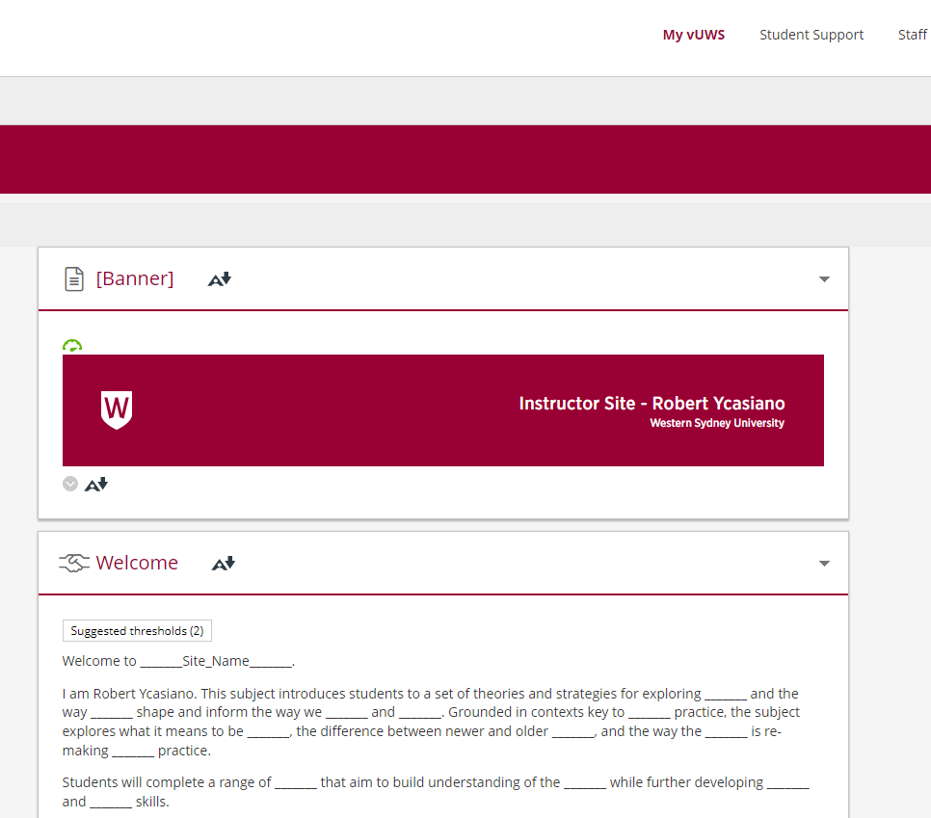
Go to Live Demo
Notes:
I’m going to explain in the Live Demo that you can upload a word doc into Respondus, but you can also create questions within Respondus itself – it is a personal preference to either create your questions in a word doc or within Respondus, either process is correct.
This workshop will mostly be creating a word doc, and then importing that into Repondus, but I will show an example of creating a question in Respondus as well.

Slide 20
Feedback
Presenter: Robert Ycasiano
Digital Learning Administration Officer,
Learning Futures
Notes:
Welcome everyone, thank you for joining the workshop: (Zoom LTI), my name is Robert Ycasiano from Learning Futures, and I will be your Digital Learning presenter for today's session.
Joining me today and monitoring the chat we have my colleague Stephanie Lynch in the Digital Learning team.

Slide 21
Tell us what you think!
Did you like the workshop design and delivery?
What would you like to know more about?
It should only take 3 minutes
**We use your feedback to fine-tune, create and schedule future workshops**
Notes:
Tell us what you think!
A link is going into the chat now, any and all feedback is welcome.
We use your feedback to fine-tune, create and schedule future workshops
So please take the time to fill it in, It should only take 3 minutes

Slide 22
Support & Resources
Presenter: Robert Ycasiano
Digital Learning Administration Officer,
Learning Futures
Notes:
Welcome everyone, thank you for joining the workshop: (Zoom LTI), my name is Robert Ycasiano from Learning Futures, and I will be your Digital Learning presenter for today's session.
Joining me today and monitoring the chat we have my colleague Stephanie Lynch in the Digital Learning team.

Slide 23
Further Information
You can also find other Training Sessions on the Learning Futures Workshop Schedule website.
Self help articles (vUWS support): https://lf.westernsydney.edu.au/support/
Support - Contact us at Western Now
101 – Schedule a Booking
Digital Learning Support - Website
Notes:
You can also find other Training Sessions on the Learning Futures Workshop Schedule website.
We have Self help articles (vUWS support): https://lf.westernsydney.edu.au/support/
You can request for Support by contacting us at Western Now
You can also schedule a 101 booking with us via our Booking form

Slide 24
End
Notes:
Any questions?

