Slide 1
Workplace Inspections and Record Keeping
Work Health Safety & Wellbeing Unit

Slide 2
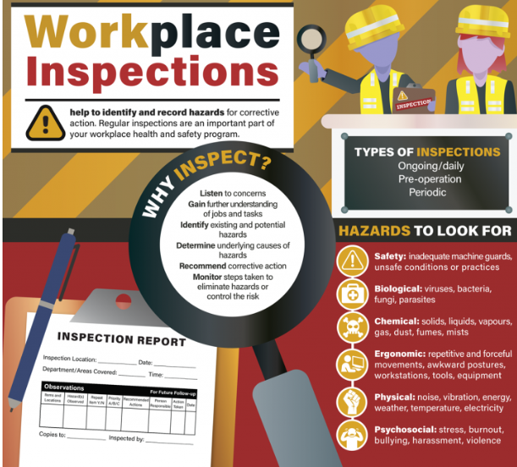
What is a Workplace Inspection?
A workplace inspection is the process of critically examining the workplace for the identification and mitigation of workplace hazards and to ensure that all standards are met and the workplace is in fact safe and free from any risks. Workplace inspections are an ongoing process that play an important role in actively monitoring an organization's safety and adherence to safe practices. They need to be carried out regularly.

Slide 3
What is a Hazard?
“A hazard is anything that has the potential to cause harm”

Slide 4
The six main categories of hazards are:
Biological: Biological hazards include viruses, bacteria, insects, animals, etc., that can cause adverse health impacts. For example, mould, blood and other bodily fluids, harmful plants, sewage, dust and vermin.
Chemical: Chemical hazards are hazardous substances that can cause harm. These hazards can result in both health and physical impacts, such as skin irritation, respiratory system irritation, blindness, corrosion and explosions.
Physical: Physical hazards are environmental factors that can harm an employee without necessarily touching them, including heights, noise, radiation and pressure.
Safety: These are hazards that create unsafe working conditions. For example, exposed wires or a damaged carpet might result in a tripping hazard. These are sometimes included under the category of physical hazards.
Ergonomic: Ergonomic hazards are a result of physical factors that can result in musculoskeletal injuries. For example, a poor workstation setup in an office, poor posture and manual handling.
Psychosocial: Psychosocial hazards include those that can have an adverse effect on an employee’s mental health or wellbeing. For example, sexual harassment, victimisation, stress and workplace violence.

Slide 5
Why should we do inspections?
Because regular inspections critically examines the workplace to identify and report potential hazards that can be removed or avoided and allow you to engage directly with staff about safety.

Slide 6
When should you inspect?
You need to inspect and review your risk control measures:
When a control measure is not working (eg when someone is injured or experiences a ‘near miss’)
Before workplace layout or practices are changed
When new equipment, materials or work processes are introduced
If a new problem is found
If consultation shows a review is necessary
If a health and safety representative requests it

Slide 7
Who should do the inspection?
Persons in charge of workplaces.
Shared facilities - Persons in charge of workplaces need to formally organise the inspection between facilities.
Facilities/Buildings with no nominated person in charge – Facilities management should nominate a person to be in charge for inspections
HSRs and WHS & Wellbeing have the legal right to inspect any facility without notice.

Slide 8
Conducting a Workplace Inspection
During an inspection, identify any unsafe conditions and activities that may cause injury or illness, and figure out how to eliminate or minimise them.
Follow these steps:
Checklist
Hazards
Observe
Ask
Record
Consider

Slide 9
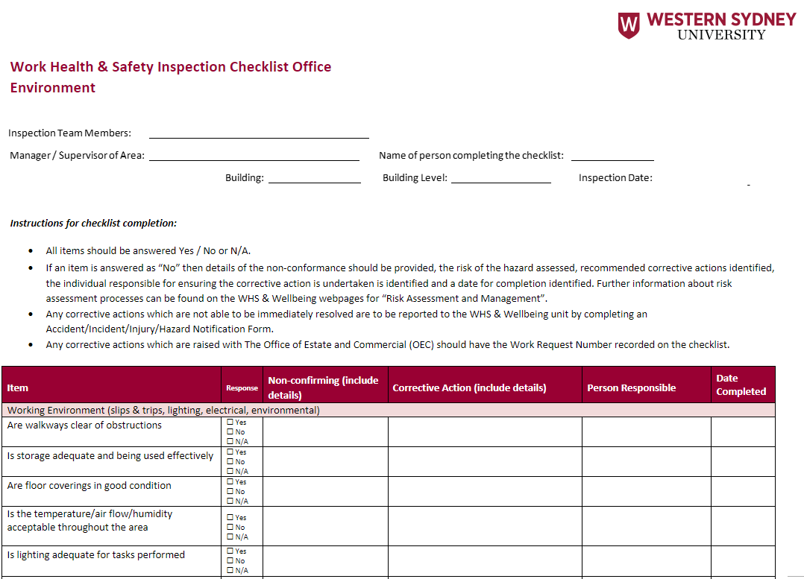
Checklist? – We have one for you
Use this checklist to make sure your inspection is thorough and consistent with previous inspections.
This will also serve as a record of your inspection.

Slide 10
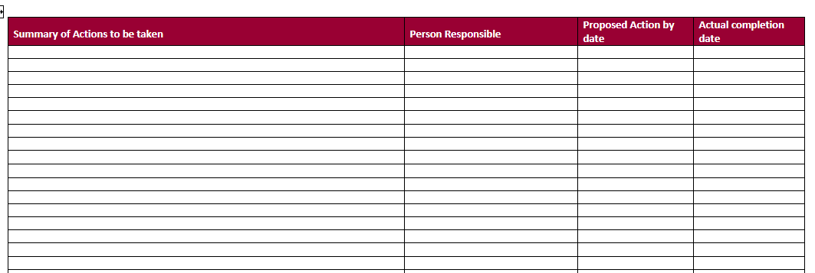
Action Items Sheet
The purpose of the action item sheet is to ensure that the summary of actions or resolutions related to the identified hazard include the appropriate person responsible with a proposed action by date and actual completion date.

Slide 11
Who should keep the inspection reports?
Low risk areas - Persons in charge of workplaces.
Medium and High risk areas - Persons in charge of workplaces and Work, Health, Safety & Wellbeing.

Slide 12
Thank you!
Thank you for partaking in our Workplace Inspections and Record Keeping Training presentation, We hope you enjoyed it.
If you would like further information regarding this presentation or anything Work Health Safety & Wellbeing related,
Please visit our webpage: Work Health Safety & Wellbeing | Western Sydney University
or
Email us at whs@westernsydney.edu.au

