Slide 1
GRILLED GROUPS

Slide 2
Zoom Chat – Attendance
Before we begin, can everyone please type into the Zoom chat:
Your Full name
Your School
Your Email Address

Slide 4
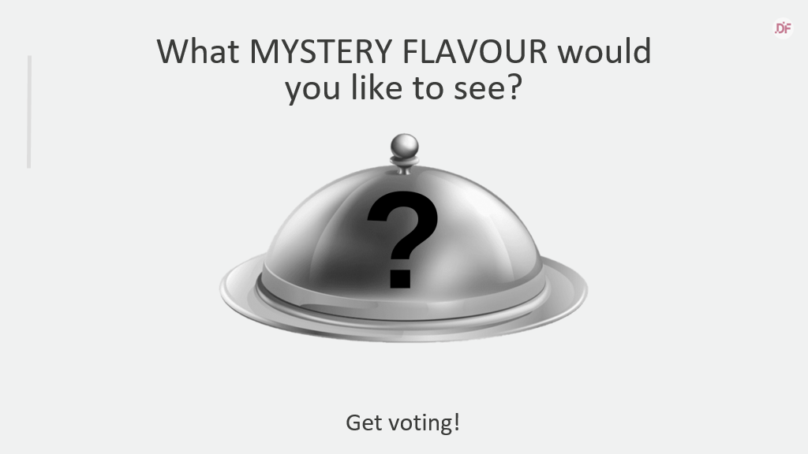
Notes:
What MYSTERY FLAVOUR would you like to see us run a training session on?​
​
Grade Centre ​
Panopto Capture ​
Video Assignments ​
Discussion Boards, Blogs & Journals ​
Zoom & Blackboard Collaborate

Slide 5
Session Outline
Import Allocate+ Groups​
Create Smart Views​
Add Groups to Favourites

Slide 6
Learning Outcomes
Student data from Allocate+​
Convert it to vUWS readable format
Upload data to vUWS​
Create smart views and favourites

Slide 7
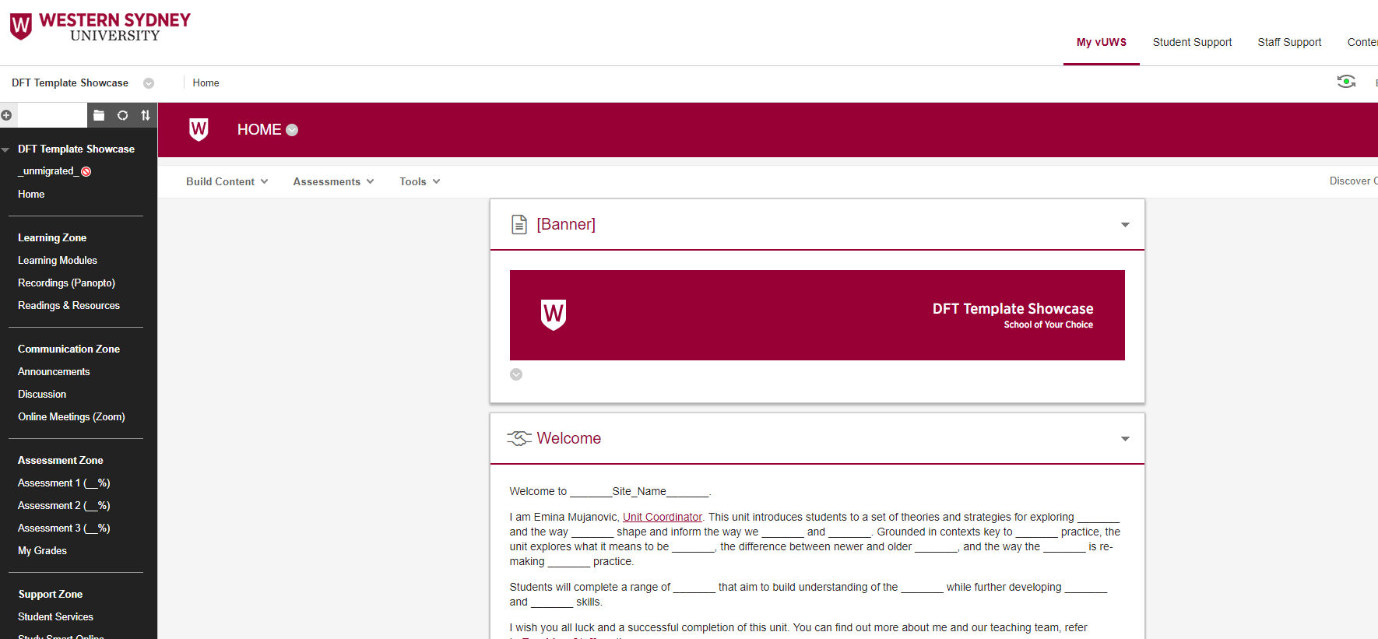
Live Demo

Slide 8
Support and Resources

Slide 9
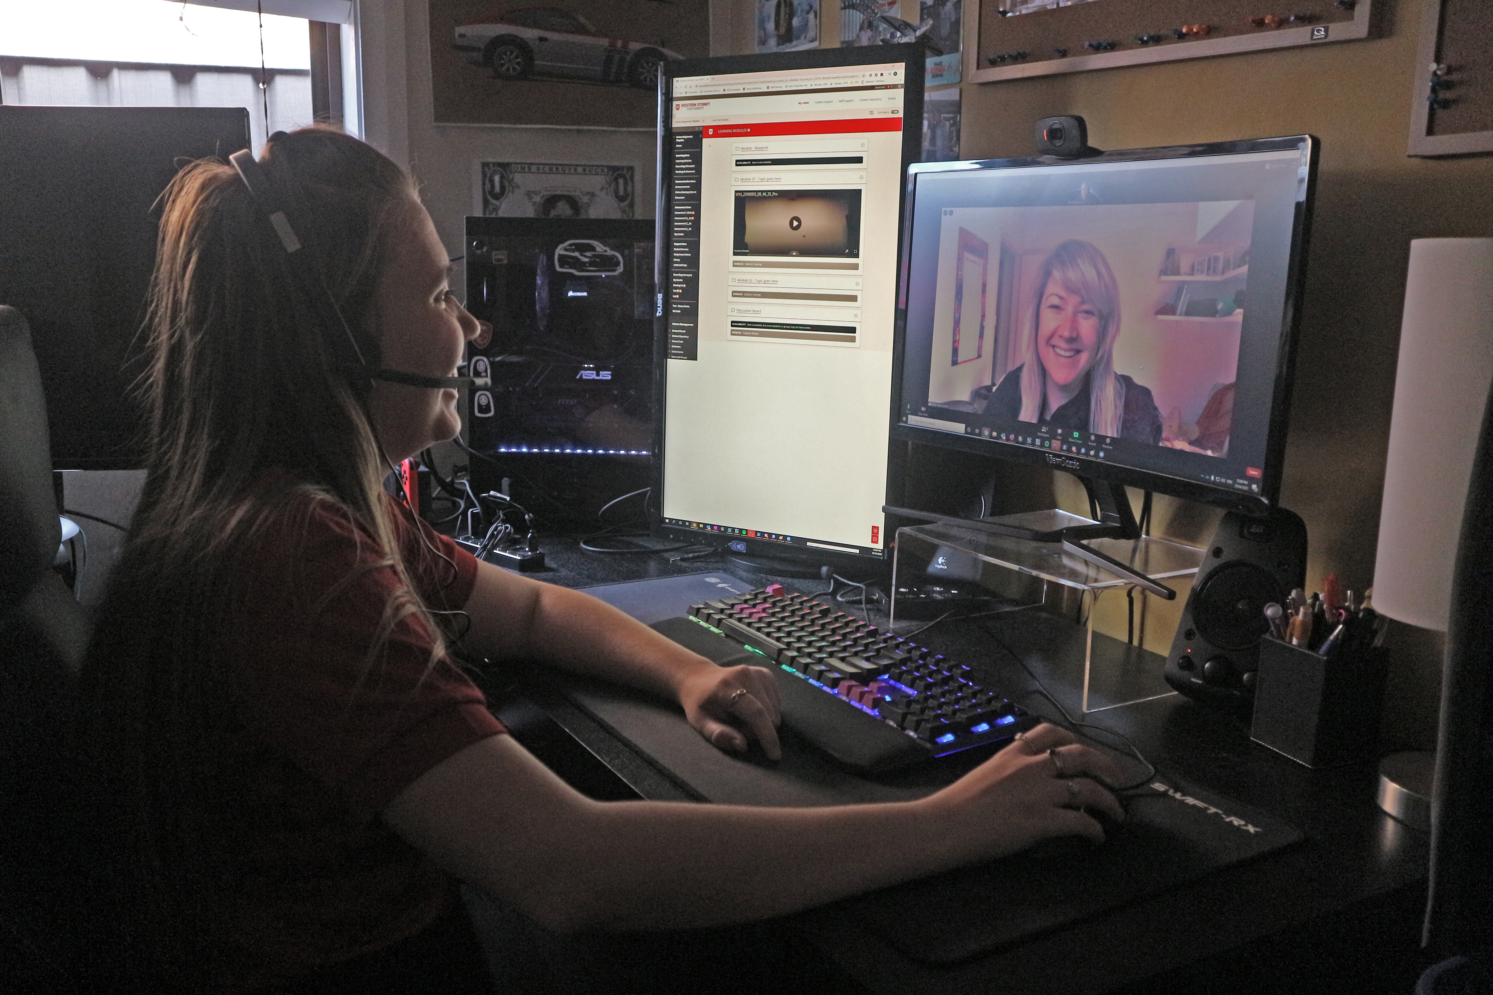
eLearning Support One to One (101)
Would you like to learn more about vUWS Blackboard tools and functionalities to enhance teaching and learning experience?
Learning Futures team is now able to offer personalised one-on-one eLearning support session via a zoom appointment. If you have any vUWS related queries, a member of our eLearning support team will support you through a tailored session specific to your needs.
Book a session today using our online form https://forms.gle/23UoDvsvSoybqHgZ6
Notes:
Would you like to learn more about vUWS Blackboard tools and functionalities to enhance teaching and learning experience?
Learning Futures team is now able to offer personalised one-on-one eLearning support session via a zoom appointment. If you have any vUWS related queries, a member of our eLearning support team will support you through a tailored session specific to your needs.
Links for Chat:
One on one Consultation link:
https://forms.gle/23UoDvsvSoybqHgZ6

Slide 10
Featured Resources
Online Engagement and Teaching Hub
vUWS Support Page
Notes:
Online Engagement and Teaching Hub: https://lf.westernsydney.edu.au/engage/
vUWS Support: https://lf.westernsydney.edu.au/support/#creating-other-resources

Slide 11
Additional Resources
Training
Upcoming Sessions
Recorded Sessions
All You Can e-Learn page – Where you will find the PowerPoint slides
Support
Contact eLearning@westernsydney.edu.au
Notes:
​
Links for Chat: ​
​
Upcoming Sessions : https://www.westernsydney.edu.au/learning_futures/home/teaching_support/professional_learning/LF_Workshop_Schedule​
Recorded Sessions: https://www.westernsydney.edu.au/learning_futures/home/teaching_support/professional_learning/recorded_sessions_and_resources​
​

Slide 12
Feedback

Slide 13
Tell us what you think!
Quick feedback form :
The URL in the chat. It should only take 2-3min (we promise!)
We actually use your feedback to fine-tune, create and schedule future workshops
Notes:
One on one Consultation link:​
https://forms.gle/23UoDvsvSoybqHgZ6​
​
Support Email:​
elearning@westernsydney.edu.au ​
​
Upcoming Sessions : https://www.westernsydney.edu.au/learning_futures/home/teaching_support/professional_learning/LF_Workshop_Schedule ​
​
Recorded Sessions: https://www.westernsydney.edu.au/learning_futures/home/teaching_support/professional_learning/recorded_sessions_and_resources​
​
Feedback Form URL: https://forms.gle/dnENjibjpDRS5Q8E9

