Slide 1
The Transformation of Australia’s Electoral Boundaries
John Juriansz

Slide 2
Overview
Introduction and background
Issues of Justiciability: the role of the High Court in determining matters of electoral regulation
The key judicial landmarks
What equality principles may be divined from the Constitution?
Next step: Key legislative landmarks
Concluding remarks
Notes:
Part 2 describes the key legal and institutional features of Australia’s federal electoral system in so far as they relate to redistribution.
Part 3 summarises the main population trends in Australia since federation.
Part 4 identifies five redistribution triggers and discusses their historical significance.
Part 5 analyses the three redistribution triggers that have demographic relevance, namely, increases in the size of the legislature; changes in the electoral entitlements of the states as a result of relative population shifts between them; and changes in the number of voters within each electorate beyond the permitted margins of tolerance.
Part 6 uses longitudinal data to assess whether voter equality has improved in Australia over the past 110 years, using demographic data from the Australian Bureau of Statistics and electoral data from the Australian Electoral Commission and other published sources.
Part 7 analyses the impact of projected population growth on electoral redistribution over the next 40 years.

Slide 3
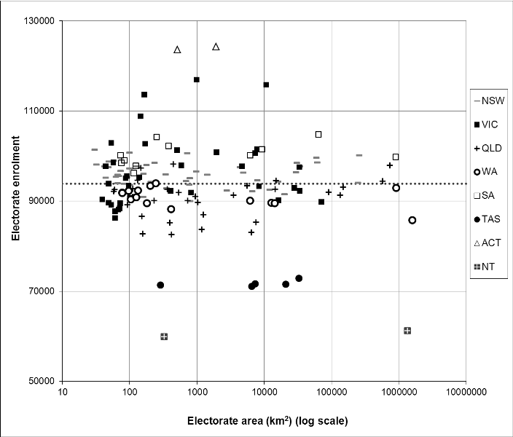
Number of enrolled voters and area of electorates, 2010 election
Notes:
Demographic change is accommodated by allowing electorates to vary in size by 10 per cent more or 10 per cent less than the average enrolment of voters in that state. As the number of electorates allocated to each state is roughly proportional to the number of residents in that state rather than the number of voters, and as the entitlements formula generates problems of rounding referred to above, the subsequent calculation of average voter enrolment is peculiar to each state. Accordingly, variations of voter enrolment between states may be significantly greater than the ±10 per cent variation permitted within a state.
This can be seen in this Figure, which shows the number of voters enrolled in 150 electorates contested in the 2010 federal election, plotted against the geographical area of the electorate in logarithmic scale. All electorates within the same state or territory are shown with identical markers. The national average enrolment per electorate (93,912 voters) is shown as the dotted horizontal line. By definition, electoral enrolments are clustered around the national mean, but the graph provides insights into several aspects of voter inequality.
The comparatively low enrolments for the five Tasmanian electorates (TAS) reflect the constitutional guarantee of five seats despite a population share that would presently entitle Tasmania to only three. The outlying values for the Australian Capital Territory (ACT) and the Northern Territory (NT) reflect the consequences of rounding electoral entitlements up or down in jurisdictions with a small number of electorates. And the vertical range in data points for a particular state or territory reflects the extent of malapportionment from that jurisdiction’s average enrolment—most evident for Victoria (VIC) whose electorates varied from 86,220–116,976 voters.

Slide 4
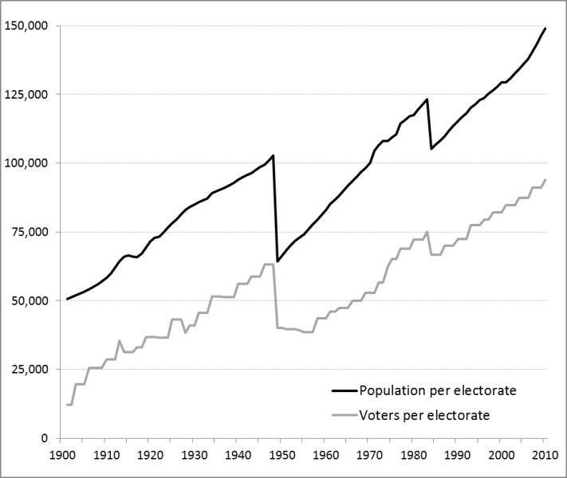
Population and voters per electorate, 1901-2010
Juriansz and Opeskin 2012
Notes:
This figure provides an overview of the major trends in Australia’s resident population since federation. As seen here, this population will inevitably differ in size and composition from the sub-population of voters. Voting in Australia is restricted to citizens or permanent residents who are at least 18 years of age. The relative size of the two groups can be seen in this Figure, but there may also be compositional differences that may be significant for some purposes at the level of individual electorates. Changes in Australia’s population can be considered across four interconnected dimensions: population size, the components of population change, population structure, and spatial distribution.
The effect of enlargement of the legislature on the average number of residents represented by each member of the lower house, and on the average number of voters enrolled in each electorate, is shown here. Increases in the size of the legislature brought sharp downward adjustments to the ratio of residents to electorates, and voters to electorates, but the effects have been systematically eroded over time. The benefits of enlarging the lower house in 1948 were fully offset within 23 years, while the benefits of the smaller enlargement in 1983 lasted only 13 years. Thus, while the size of the lower house has increased as the population has grown, the increase has been less than proportionate. This has been a common phenomenon globally—parliaments cannot be allowed to expand indefinitely, or even in strict proportion to population, because as they grow they become less and less capable of functioning as assemblies.
A proportionate increase would be represented by a horizontal line in Figure 1.

Slide 5
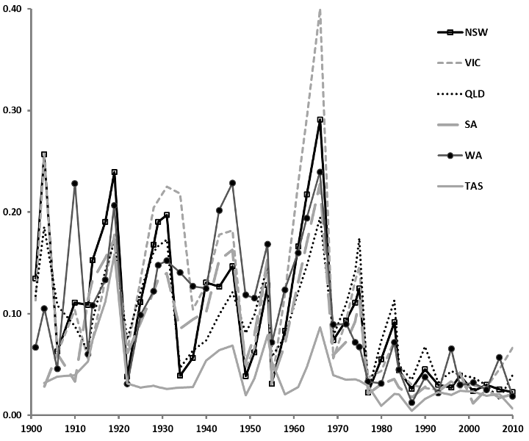
Malapportionment: Index of Enrolment Deviation, 1901-2010
Juriansz and Opeskin 2012
Notes:
This metric measures, for each election and each state, the average proportion by which the number of voters in electorates deviates from the average voter enrolment in that state. This measure has the desirable qualities of being independent of the size and number of electoral districts; of taking into account all data points in the distribution of electorates; and of avoiding skewness that can arise from the deviations being either positive or negative. The derivation of the metric—called the Index of Enrolment Deviation (IED)—involves calculating the average number of voters per electorate; determining the proportion by which enrolment in each electorate deviates from the average; and aggregating the deviations through a weighted average, using the number of voters in each electorate as weights. The result of applying this process across all 43 federal elections and all states since 1901 is shown here.
There are several notable features of the graph. The first seven decades of the 20th century were characterised by a high degree of malapportionment, which frequently exceeded 20 per cent of the average state enrolment. Malapportionment was particularly pronounced in the 1960s when recommendations of the Distribution Commissioners were routinely thwarted by partisan politics. The level of malapportionment shows a distinct cyclical pattern during these early decades, and the remedial effects of electoral redistributions are revealed in the successive troughs in the index, followed by a rise of voter inequality in succeeding elections. Since the 1970s, there has been a dramatic reduction in the both the extent and variability of malapportionment, corresponding with the reduction in permissible variation in the number of electors in an electorate to ±10 per cent in 1973; the introduction of mandatory redistribution triggers in 1977; and the expansion in the range of triggers in 1983. For the past thirty years, malapportionment has fallen within a narrow band in all states —generally 2–7 per cent of average state enrolment.

Slide 6
Notions of voter equality in Australia
Is this reticence an obfuscation of the High Court of Australia’s constitutional jurisdiction?
If not the judiciary, what has been the stimulus for electoral reform as it relates to concepts of voter equality, electoral redistribution and notions of one vote, one value, one person, one vote?
If left to the legislature, what has been the role of partisan politics in shaping Australia’s electoral law as regards voter equality?

Slide 7
Issues of Justiciability
High Court of Australia as court of final appeal
Adjudication of constitutional matters
Original and additional original jurisdiction of the High Court of Australia: Sections 75 and 76(i) of the Constitution

Slide 8
Section 76 original jurisdiction
The Parliament may make laws conferring original jurisdiction on the High Court in any matter:
(i) arising under this Constitution, or involving its interpretation;
(ii) arising under any laws made by the Parliament

Slide 9
Judicial reticence as precedence
‘The determination of this matter is particularly reserved to the Parliament, as a matter properly conusable by them, and to them it belongs to determine the fundamental rights of their House, and of the constituent parts of it, the members; and the Courts of Westminster shall not tell them who shall sit there. Besides, we are not acquainted with the learning of elections, and there is a particular cunning in it not known to us, nor do we go by the same rules, and they often determine contrary to our opinion without doors’: Ashby v White (1703) 92 ER 126, 130 (Sir Thomas Powys)
Beck v Porter (1980) 32 ALR 428, 434 (Zeller J).
Gilbertson v South Australia (1976) 15 SASR 66.
Sue v Hill (1999) 199 CLR 462.
Administrative Decisions (Judicial Review) Act 1977 (Cth) Sch 1, s 3(q)

Slide 10
Concept of voter equality
A-G (Commonwealth); Ex rel McKinlay v Commonwealth (1975) 135 CLR 1
McGinty v Western Australia (1996) 186 CLR 140

Slide 11
A-G (Commonwealth); Ex rel McKinlay v Commonwealth (1975) 135 CLR 1
A-G (Commonwealth); Ex rel McKinlay v Commonwealth (1975) 135 CLR 1
“Chosen by the people”: ss 7 and 24 of the Constitution
Argued there was an infringement of the principle of “one vote, one value” and that the provisions of the Commonwealth Electoral Act 1918 (Cth) and the Representation Act 1905 (Cth) were invalid.

Slide 12
Murphy J in McKinlay [66]
Wesberry v Sanders 376 US 1 at 7-9 (1964) (Warren CJ, Black, Douglas, Brennan, White and Goldberg JJ):
We hold that, construed in its historical context, the command of Art 1, s 2, that Representatives be chosen ‘by the People of the several States’ means that as nearly as practicable one man’s vote in a congressional election is to be worth as much as another’s… We do not believe that the Framers of the Constitution intended to permit the same vote-diluting discrimination to be accomplished through the device of districts containing widely varied numbers of inhabitants.

Slide 13
Towards a measure of equal
Thomas Jefferson, Writings (Washington ed, 1859), vol 4, page 506: ‘Our peculiar security is the possession of a written Constitution. Let us not make it a blank paper by construction.’
James Madison, No 57 of The Federalist: ‘Who are to be the electors of the Federal Representatives? Not the rich more than the poor; [67] not the learned more than the ignorant; not the haughty heirs of distinguished names, more than the humble sons of obscure and unpropitious fortune. The electors are to be the great body of the people of the United States.’
Murphy J [67] stated that he took this to mean, “one person one value”.

Slide 14
Jumbunna Coal Mine NL v Victorian Coal Miners’ Association (1908) 6 CLR 309, 367-8
“[I]t must always be remembered that we are interpreting a Constitution broad and general in its terms, intended to apply to the varying conditions which the development of our community must involve … the Court should, in my opinion, always lean to the broader interpretation unless there is something in the context or in the rest of the Constitution to indicate that the narrower interpretation will best carry out its object and purpose.”

Slide 15
Mandate of equal representation?
That the phrase should be construed in the same way as applied by the US Supreme Court except that the standard of equality the alternatives of equal numbers of people and equal numbers of electors;
That the number of people or electors be, as nearly as practicable, equal; OR
That the words convey no mandate of any kind.

Slide 16
Murphy J’s Minority Opinion
The importance placed on the phrase by its positioning in the Constitution;
The democratic theme of equal sharing of political power which pervades the Constitution;
Reference to “people of the Commonwealth” emphasises the intention of sharing political power;
Absence of any other means of redress for those deprived of an equal share of representation, even where it is grossly unequal; and
The taking of the phrase from the US Constitution necessitates the adoption of the US construction.

Slide 17
Barwick CJ in McKinlay [17]
The problem is not to be solved by resort to slogans or to political catch-cries
It is to be decided by the meaning of the relevant text of the Constitution having regard to the historical setting in which the Constitution was created.
Read the language of the Constitution itself, “generously and not pedantically”, to find its meaning by legal reasoning.
“[T]here is no other safe guide to judicial decisions in great conflicts than a strict and complete legalism.” (Sir Owen Dixon)

Slide 18
Majority in McKinlay
Rejected any analogy with the words “directly chosen by the people” in Article 1 of the US Constitution or with the US Supreme Court’s interpretation of them: Barwick CJ [23]-[24].
The criteria for electoral redistributions set out in the section 19 of the CEA did ensure a reasonable approximation of equality.

Slide 19
Majority in McKinlay
McTiernan and Jacobs JJ [35] rejected the interpretation that “chosen by the people” in section 24 possessed a meaning of “equality of electoral divisions”.
Stephen J [56]-[58] drew attention to the numerous deviations from the principle of proportionality of representatives to population.
Mason J [61] – conceded grossly disproportionate distributions could necessitate intervention by the judiciary.

Slide 20
McGinty v Western Australia (1996) 186 CLR 140
Argued, by parity of reasoning, both the Commonwealth and Western Australian constitutions could support an implication for equality in voting power.
Majority – rejected the implication of voter equality and reaffirmed McKinlay.
“Bill of Rights by Stealth”

Slide 21
Concluding observations
General rule-of-thumb - Parliament is entitled to control its own affairs and that the courts should not interfere. This has reflected a carrying over into Australia of judicial attitudes formed by the British concept of “parliamentary sovereignty”.
Narrow constraints of the Constitution
Reticent courts – abstentionist approach:
Reluctant judicial attitude.
Judicial inexperience.
Electoral law has evolved haphazardly.
HCA does not have an oversight role of an inferior court or tribunal.
Reluctance to politise the judiciary.

