Slide 2
Zoom Chat – Attendance
Before we begin:
Enter your Full name, School and email into the Zoom chat

Slide 3
CREATING TUTORIAL GROUPS
ELEARNATHON
Presenter: Shristi Barahi
Wingman: Alex Mackay

Slide 4
Session Outline
Import Allocate+ Groups
Create Smart Views
Add Groups to Favourites

Slide 5
Learning Outcomes
Get student data from Allocate+
Convert it to vUWS readable format
Upload data to vUWS
Create smart views and favourites

Slide 6
Demonstration

Slide 7
Support and Resources

Slide 8
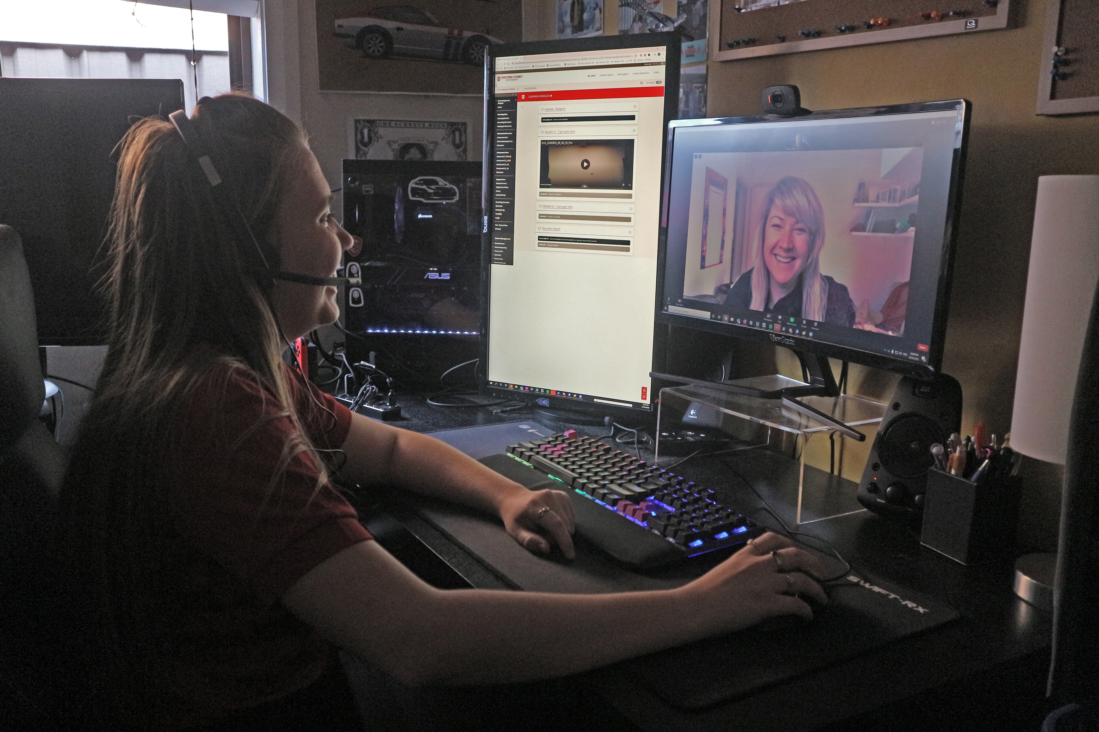
eLearning Support One to One (101)
Would you like to learn more about vUWS Blackboard tools and functionalities to enhance teaching and learning experience?
Learning Futures team is now able to offer personalised one-on-one eLearning support session via a zoom appointment. If you have any vUWS related queries, a member of our eLearning support team will support you through a tailored session specific to your needs.
Book a session today using our online form https://forms.gle/23UoDvsvSoybqHgZ6
If you have any additional queries, our contact email is elearning@westernsydney.edu.au
Notes:
Would you like to learn more about vUWS Blackboard tools and functionalities to enhance teaching and learning experience?
Learning Futures team is now able to offer personalised one-on-one eLearning support session via a zoom appointment. If you have any vUWS related queries, a member of our eLearning support team will support you through a tailored session specific to your needs.
Links for Chat:
One on one Consultation link:
https://forms.gle/23UoDvsvSoybqHgZ6

Slide 9
Additional Resources
Training
Upcoming Sessions
Recorded Sessions
eLearnathon page – Where you will find the PowerPoint slides
Support
Contact eLearning@westernsydney.edu.au
Notes:
Links for Chat:
Upcoming Sessions : https://www.westernsydney.edu.au/digital_futures/dft/services_and_resources/Learning_Futures_Online_Workshops/LF_Workshop_Schedule
Recorded Sessions: https://www.westernsydney.edu.au/digital_futures/dft/services_and_resources/Learning_Futures_Online_Workshops/recorded_sessions
eLearnathon page: https://www.westernsydney.edu.au/digital_futures/dft/services_and_resources/Learning_Futures_Online_Workshops/elearnathon

Slide 10
Feedback

Slide 11
Tell us what you think!
Quick feedback form :
The URL in the chat. It should only take 2-3min (we promise!)
We actually use your feedback to fine-tune, create and schedule future workshops
Notes:
URL: https://forms.gle/JrUyGf3szvuLTJZc8

Slide 12
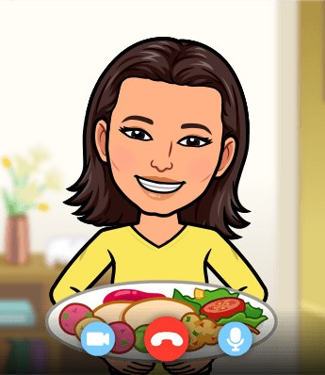
Thank you for attending

Slide 13
Notes:
Thank you for your time

