Slide 1
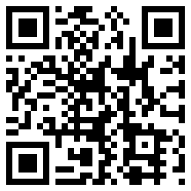
EXTRA DAY ADDED!
Want to learn about 3D printing and
become a digital blacksmith?
Then attend the workshop on Friday 17th April 2015
More info @ http://www.scem.uws.edu.au/DBWorkshop

